Slide 1
Associating OpenStreetMap tags to CORINE land-cover classes using text and semantic similarity measures
- VGI-ALIVE Workshop -
Tessio Novack, Janek Voss, Michael Schultz and Alexander Zipf
novack@uni-heidelberg.de
Heidelberg University – GIScience Group

Slide 2
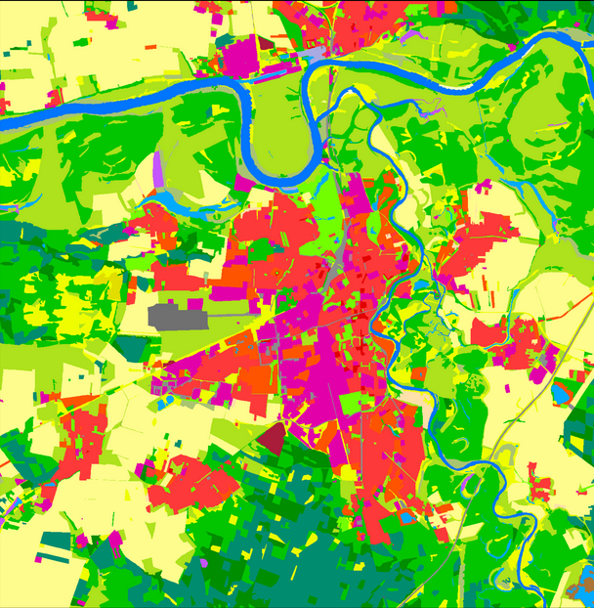
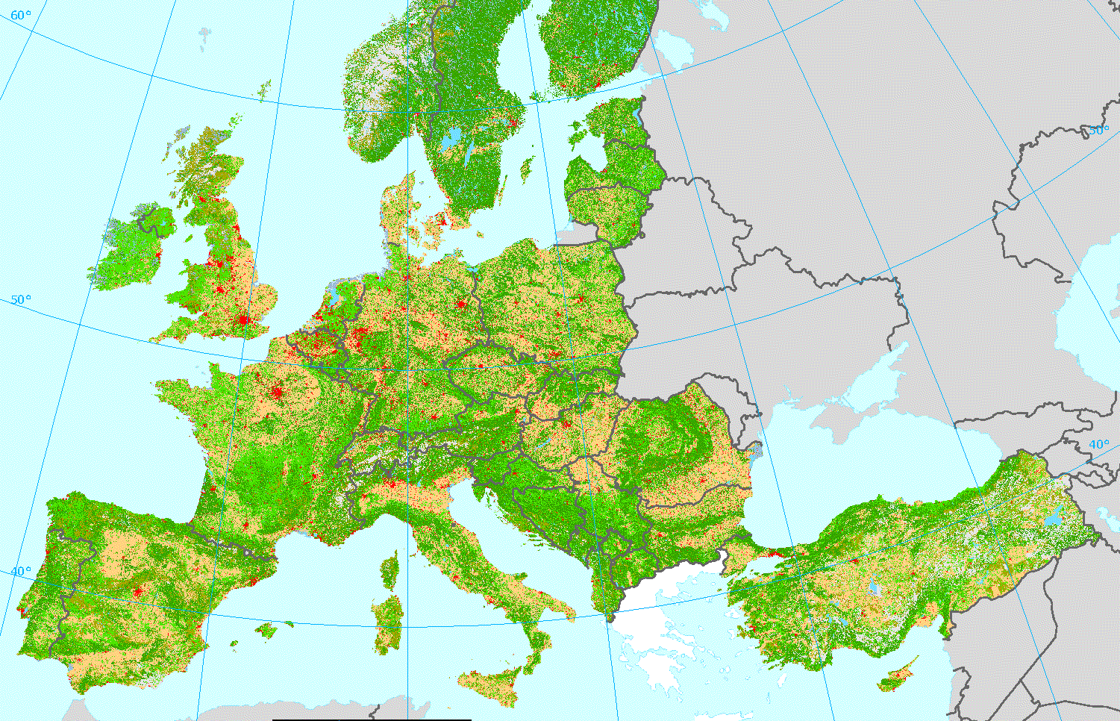
Introduction – CORINE Land Cover
Main cartographic product of land-cover for the whole Europe
Main characteristics:
44 classes, 3 hierarchical levels
Production years: 1990, 2000, 2006, 2012
How it is produced:
Country-specific
HR RS, GIS and national in-situ data
Visual interpretation and semi-automatic
approaches
Applications:
Environment
Agriculture
Transport
Spatial Planning

Slide 3
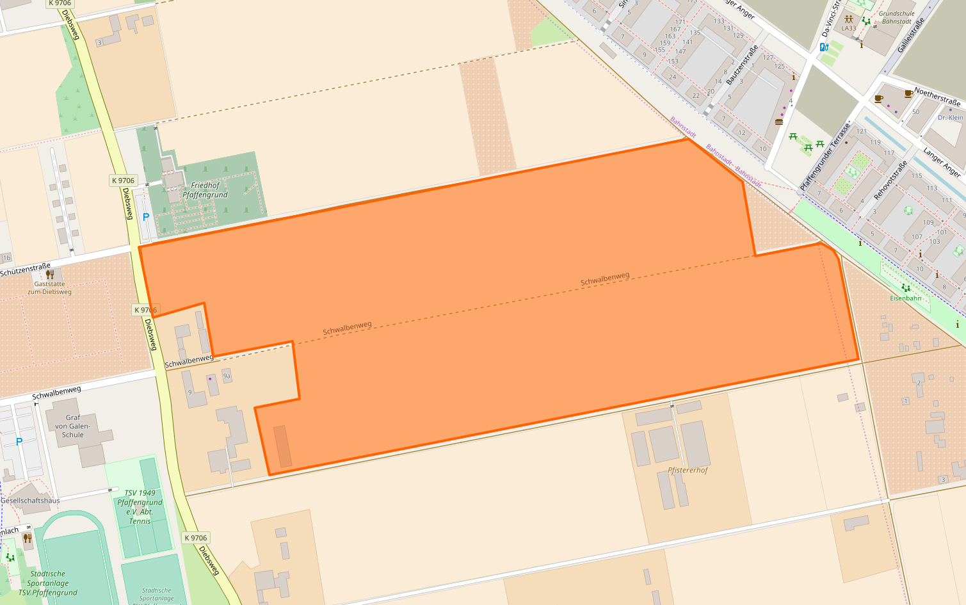
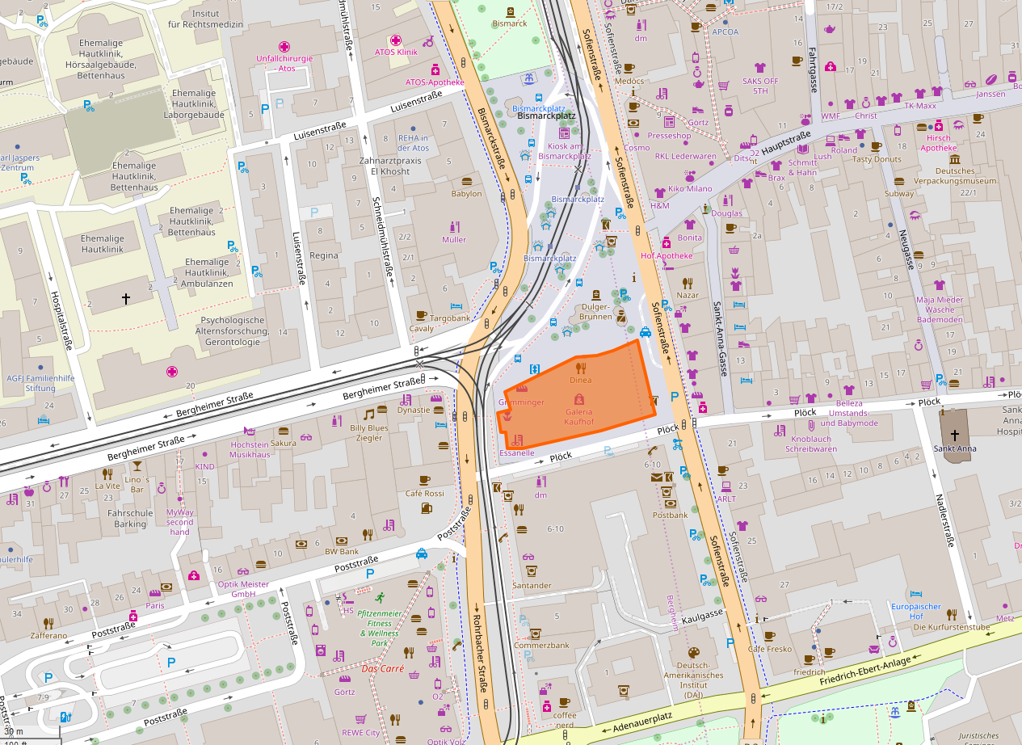
Introduction – OpenStreetMap (OSM)
Community of mappers is growing!
Community of users is growing!
It is becoming more accurate geometrically and more complete semantically.
“OpenStreetMap is a map of the world, created by people like you and free to use under an open licence.”
Real-word entities are mapped as
Nodes (points),
Ways (lines and polygons) and
Relations (group of polygons).
Semantic information is attached as so-called tags, i.e. key=value pairs.

Slide 4
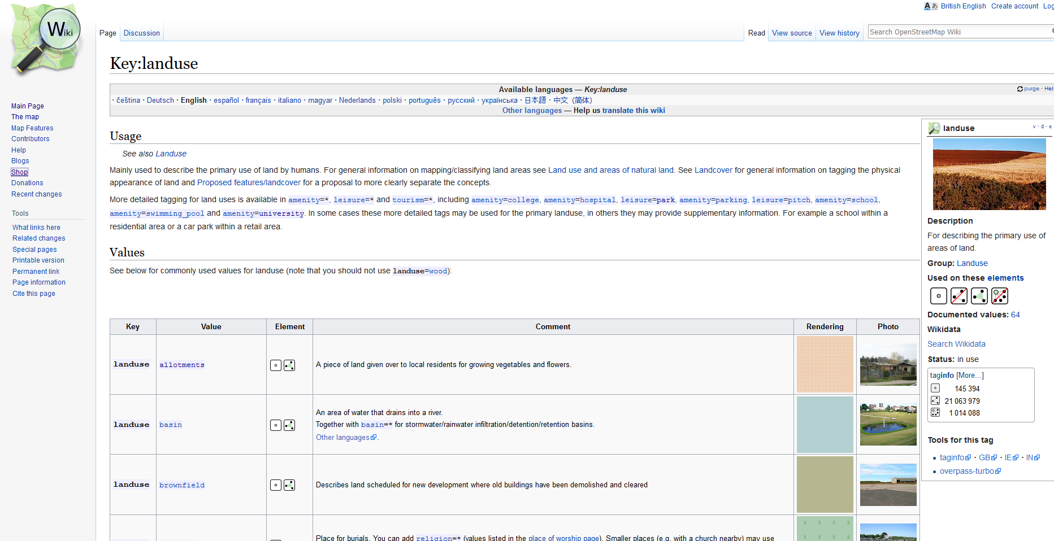
Introduction – Land-Use/Cover in OSM
Notes:
The OSM Community provides general instructions on how to identify, map and tag LULC classes.
Thinking on the process of how tags are created, widely adopted and finally crystalized in OSM wiki, one could say this is bottom-up LULC mapping.

Slide 5
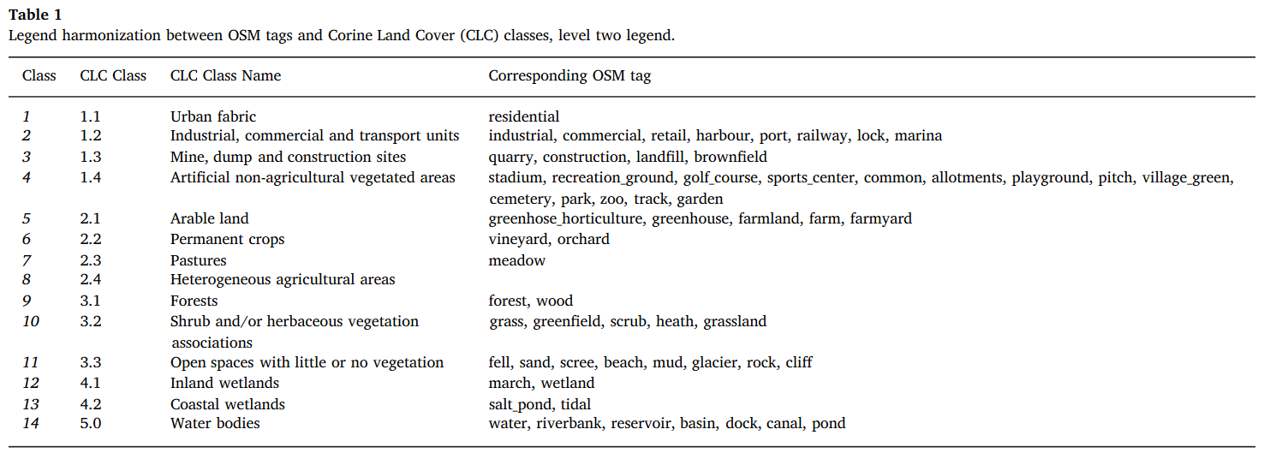
Related Work – OSM to Land Use/Land Cover Maps
Source: [Schultz et al., 2017]
Schultz, M., Voss, J., Auer, M., Carter, S., and Zipf, A. (2017): Open land cover from OpenStreetMap and remote sensing. International Journal of Applied Earth Observation and Geoinformation, 63, pp. 206-213.
Notes:
Some researchers have attempted to translate this BU and organic OSM LULC mapping/tagging into LULC maps of official and authoritative nomenclatures.
This translation is done however via a manual, costly and somewhat subjective association of tags to the classes.

Slide 6
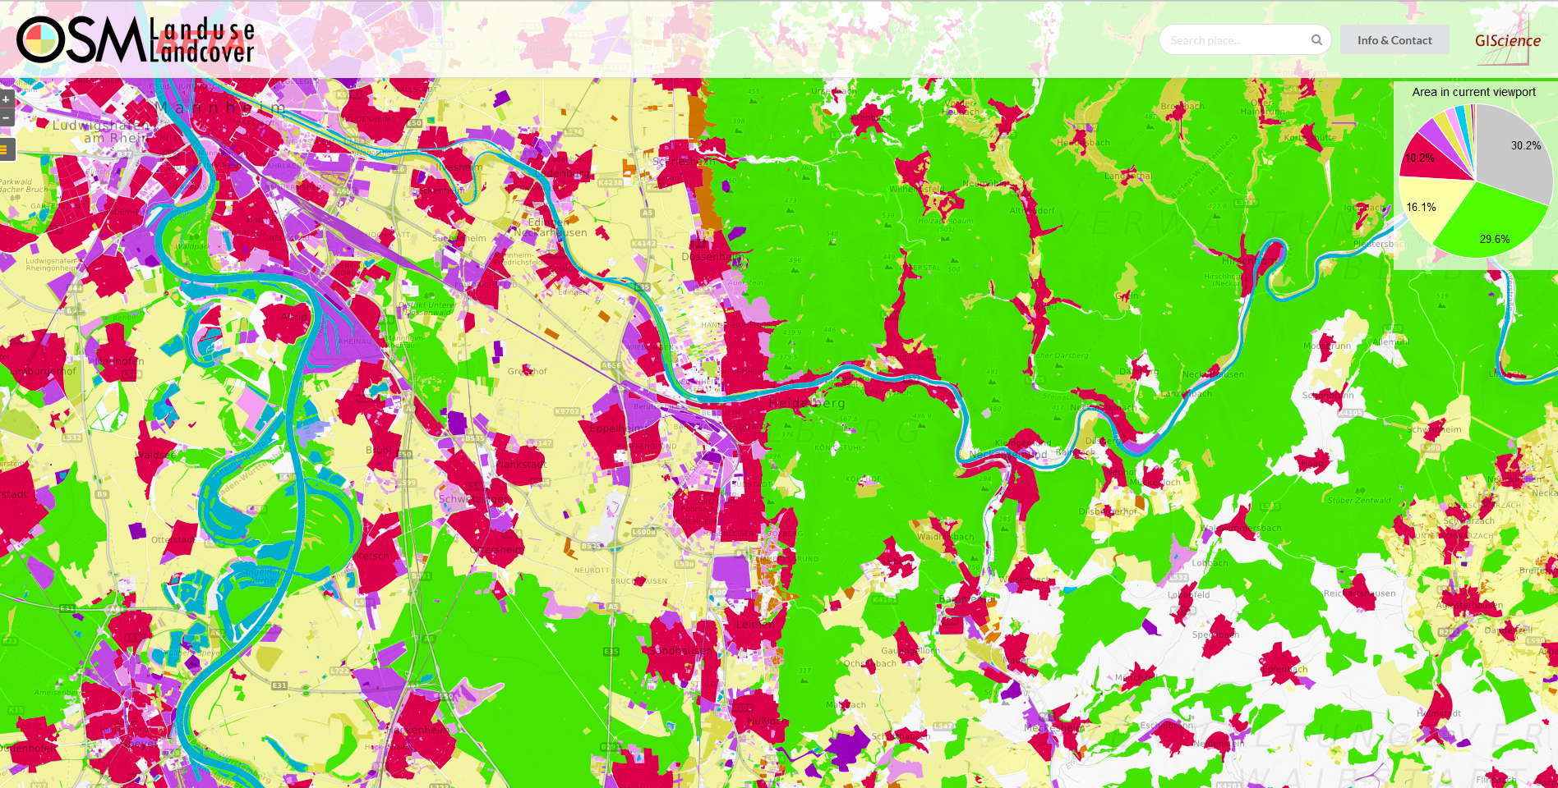
Related Work – OSMLandUse (http://osmlanduse.geog.uni-heidelberg.de)

Slide 7
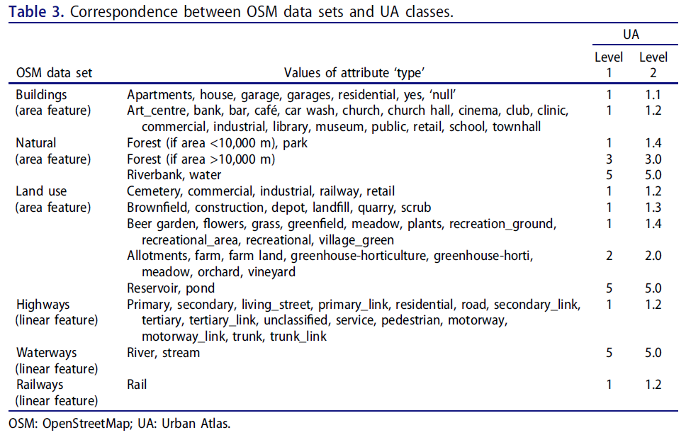
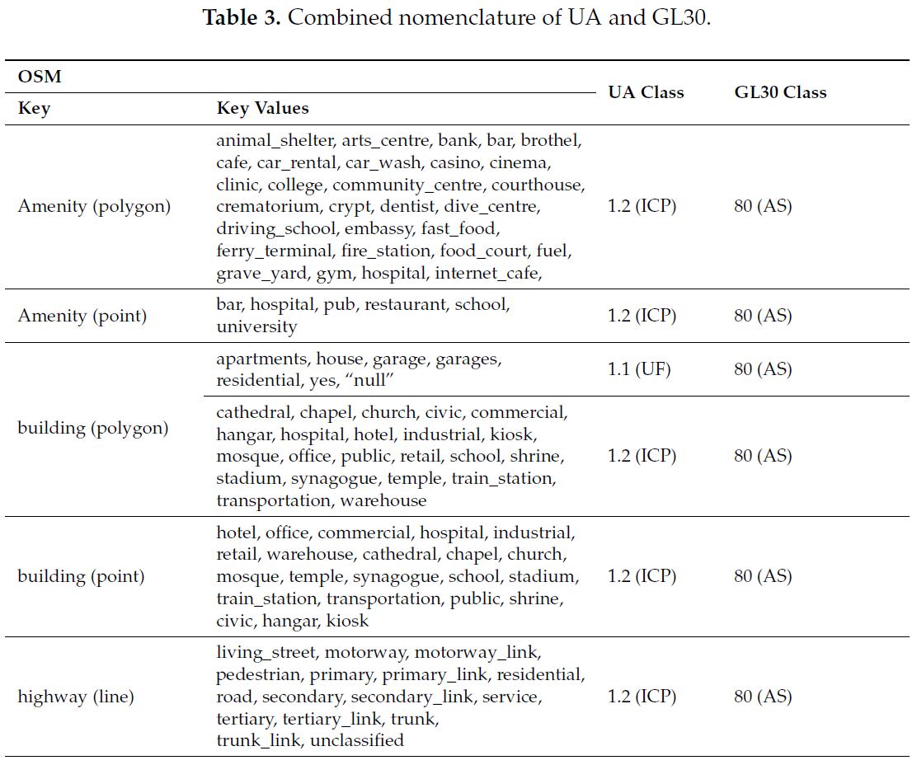
Related Work – OSM to Land Use/Land Cover Maps
Source: [Fonte and Martinho, 2017]
Source: [Fonte et al., 2017]
Fonte, CC, Minghini, M., Patriarca, J., Antoniou, V., See, L. and Skopeliti, A. (2017a) Generating Up-to-Date and Detailed Land Use and Land Cover Maps Using OpenStreetMapand GlobeLand30. ISPRS International Journal of Geo-Information, 6, 125.
Fonte, CC and Martinho N. (2017) Assessing the applicability of OpenStreetMap data to assist the validation of land use/land cover maps, International Journal of Geographical Information Science, 31:12, 2382-2400.

Slide 8
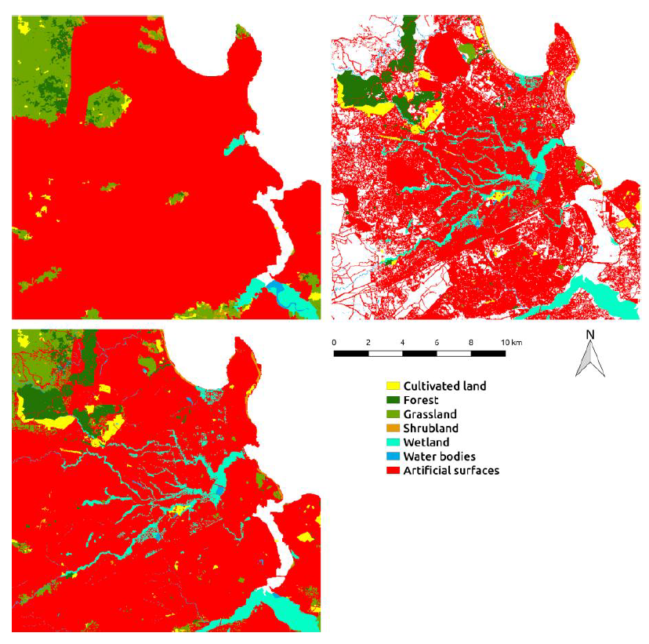
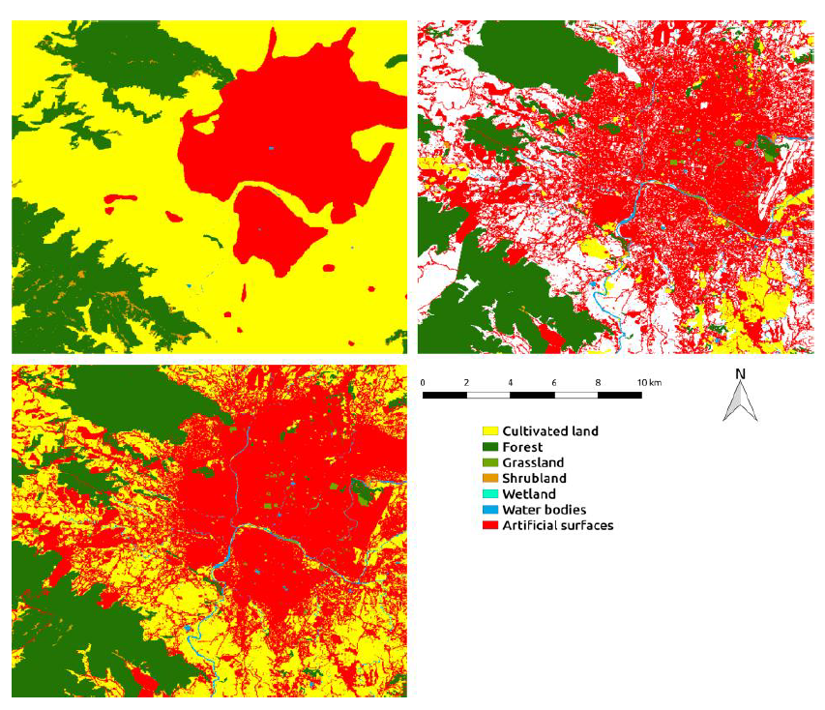
Related Work – OSM to Global Land 30
Global Land 30
OSM-derived LULC
Global Land 30
OSM-derived LULC
Enhanced Map
Enhanced Map
Source: [Fonte et al., 2017]
Source: [Fonte et al., 2017]
Fonte, CC and Martinho N. (2017) Assessing the applicability of OpenStreetMap data to assist the validation of land use/land cover maps, International Journal of Geographical Information Science, 31:12, 2382-2400.

Slide 9
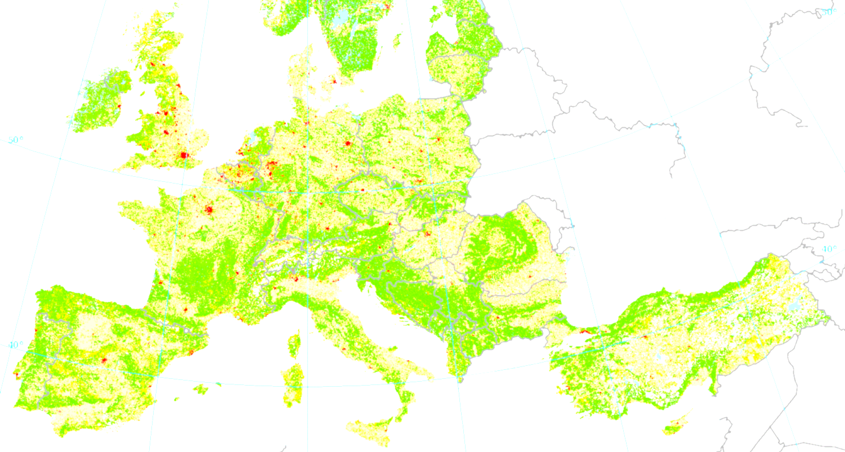
Goal, Contribution and Approach
GOAL:
To estimate the updated state and enhance official land-use and land-cover (LULC) maps at the frequency with which the OSM dataset is edited and extended.
CONTRIBUTION:
To conceive an effective approach for automatically associating OSM tags to LULC classes of widely adopted nomenclatures.
APPROACH:
Based on the textual and semantic similarities between OSM tags and the LULC classes of a given nomenclature.
Notes:
New tags appear,
Tags change theirs usage/meaning
Tags become deprecated
Tag meaning is culture-dependent

Slide 10
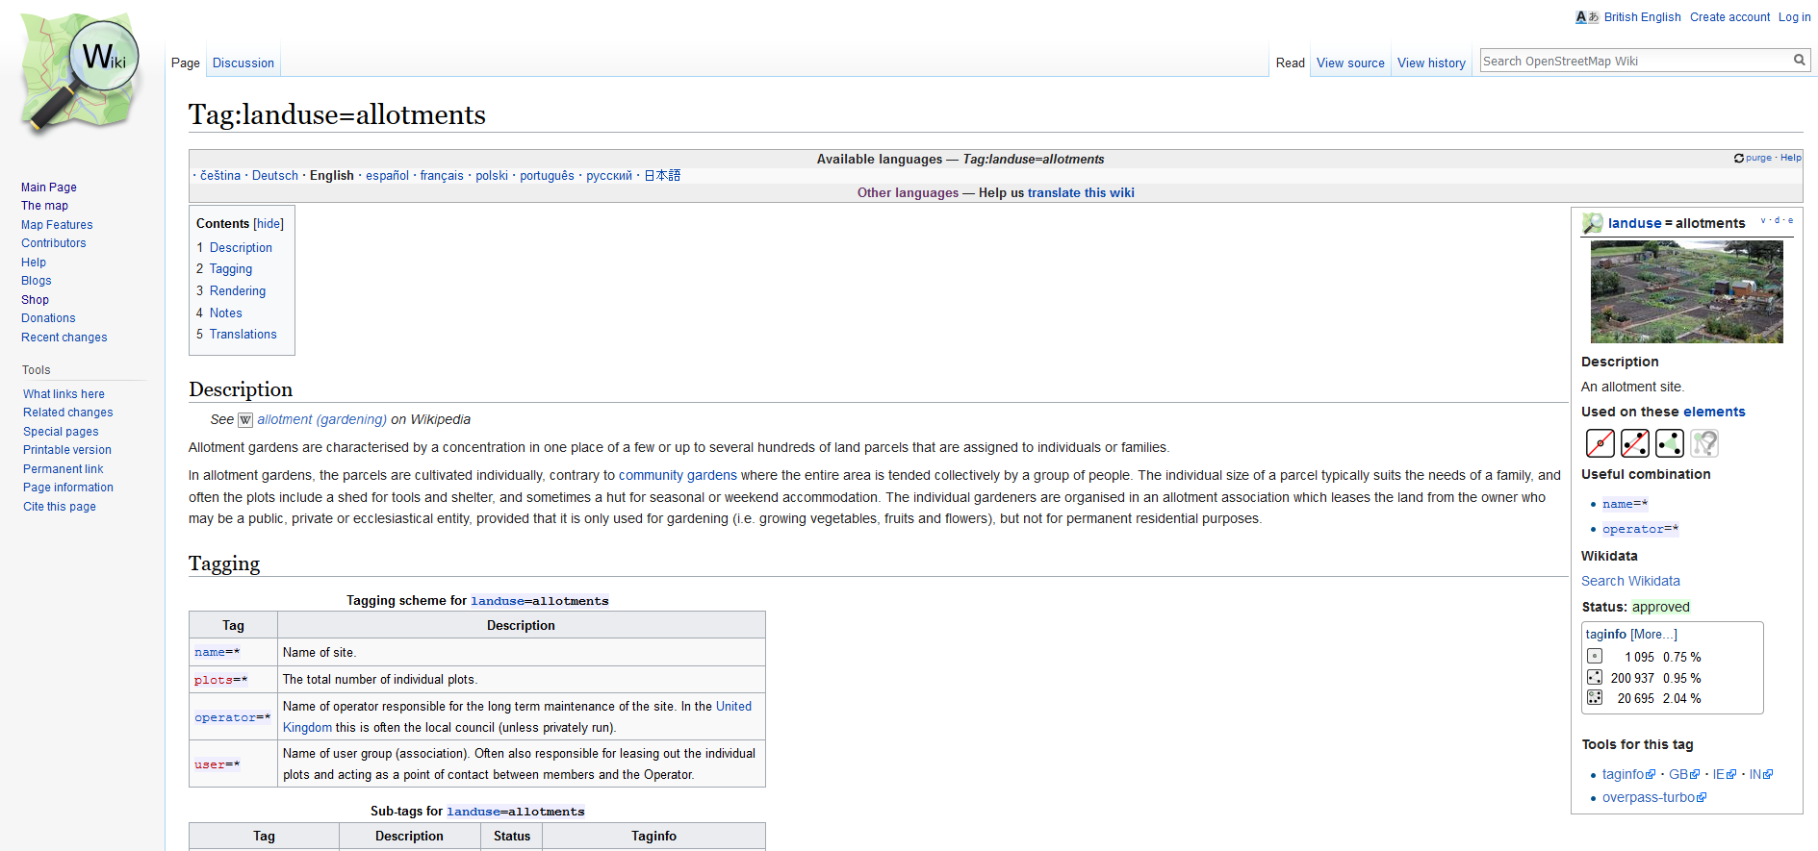
Data – OSM Tag Descriptions

Slide 11
Data – CORINE Land Cover Class Descriptions
Taken from the CORINE Nomenclature Ilustrated Guide document.

Slide 12
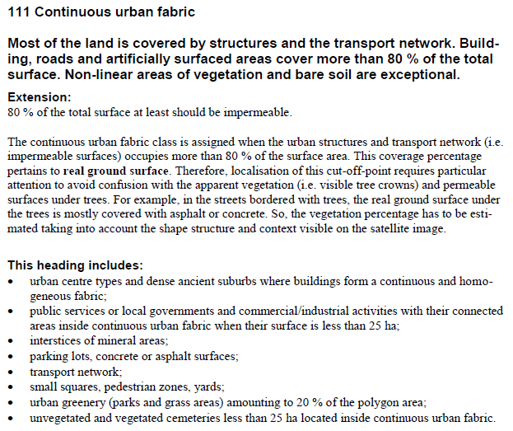
Data – CORINE Land Cover Class Descriptions
Taken from the CORINE Nomenclature Ilustrated Guide document.

Slide 13
Methods
Pre-processing:
Part-of-speech tagging
Performed for each tag and class separetely
Only nouns and adjectives were kept
Lemmatization was performed to reduce nouns to their singular form
Textual similarity between the tags and the classes descriptions:
Steps:
TF-IDF text similarity metric
Multinomial Naive Classifier
Probabilities P(class|tag) were computed.
where
and
------------------
a term
a document
the set of documents
number of times t occurs in f
num. of docs. that contain t

Slide 14
Methods
Semantic similarity between the tags and the classes descriptions:
Word-to-word similarity computation
Methods applied and compared:
Based on a knowledge-model (WordNet):
Shortest path (Spath)
Wup
Based on a corpus (Brown, SemCor and WordNet):
Resnik
Based on a knowledge-model and a corpus:
Lin
Jcn
Metrics extracted from the matrix:
Max. value, mean, 50th, 75th and 90th percentiles
for each synset of word i :
for each synset of word j :
compute semantic similarity
get highest semantic similarity value
assign value to ij-cell
i-th word in the tag description
j-th word in the class description

Slide 15
Experiment Design
One-hundred OSM tags were considered in the experiment
The most area-covering tags in Heidelberg, Vienna and Toulouse with keys ‘landuse’, ‘leisure’, ‘tourism’ and ‘amenity’.
Validation made from five experienced LULC researchers
Specialists were asked to associate each tag to a CORINE Level 2 LULC class and give it a certainty label, i.e., ‘High’, ‘Medium’, ’Low’
OSM tags | Expert 1 | Expert 2 | Expert 3 | Expert 4 | Expert 5
allotments | 1.4 | 1.4 | 1.4 | 1.2 | 1.4
basin | 5.1 | 5.0 | 4.1 | 1.3 | 4.1
beach | 3.3 | 3.3 | 3.3 | 3.3 | 3.3
brownfield | 1.3 | 1.3 | 1.3 | 1.3 | 1.3
camp_site | 1.4 | 1.4 | 1.4 | 3.2 | --
cemetery | 1.4 | 1.4 | 1.4 | 1.2 | 1.1
cliff | 3.3 | -- | 3.3 | 3.3 | 3.3
club | 1.2 | -- | 1.1 | 1.2 | 1.1
commercial | 1.2 | 1.2 | 1.2 | 1.2 | 1.2
key | value | Area Percentage
landuse | residential | 47,75%
landuse | farmland | 9,24024%
landuse | industrial | 8,98507%
leisure | aerodrome | 3,94755%
amenity | park | 3,65981%
landuse | commercial | 3,00400%
landuse | forest | 2,96482%
amenity | grassland | 2,54019%
landuse | retail | 2,19148%
landuse | riverbank | 2,01785%
amenity | parking | 1,01970%

Slide 16
Experiment Design
One-hundred OSM tags were considered in the experiment
The most area-covering tags in Heidelberg, Vienna and Toulouse with keys ‘landuse’, ‘leisure’, ‘tourism’ and ‘amenity’.
Validation made from five experienced LULC researchers
Specialists were asked to associate each tag to a CORINE Level 2 LULC class and give it a certainty label, i.e., ‘High’, ‘Medium’, ’Low’

Slide 17
Experiment Design – Accuracy Evaluation
Accuracy analysis of the tag to class associations:
Tag-class association methods were evaluated in terms of their “strict” and “soft” accuracies.
Strict acc.: the highest P(class|tag) agrees with the opinion of at least one expert.
Soft acc.: one the 3 highest P(class|tag) agrees with the opinion of at least one expert.
OSM tags | Expert 1 | Expert 2 | Expert 3 | Expert 4 | Expert 5 | 1st Class | 2nd Class | 3rd Class
allotments | 1.4 | 1.4 | 1.4 | 1.2 | 1.4 | 1.2
club | 1.2 | 1.1 | 1.2 | -- | 1.1 | 1.3
P(class|tag)
 |  | CORINE Level 2 LULC Classes
 |  | 1.1 | 1.2 | 1.3 | 1.4 | 2.1 | 2.2 | 2.3 | 2.4 | 3.1 | 3.2 | 3.3 | 4.1 | 4.2 | 5.1 | 5.2
OSM tags | allotments | 0.0681 | 0.0732 | 0.0659 | 0.0661 | 0.0666 | 0.0675 | 0.0659 | 0.0662 | 0.0659 | 0.0652 | 0.0654 | 0.0658 | 0.0655 | 0.0660 | 0.0658
 | club | 0.0655 | 0.0696 | 0.0766 | 0.0658 | 0.0652 | 0.0655 | 0.0655 | 0.0658 | 0.0654 | 0.0644 | 0.0689 | 0.0652 | 0.0649 | 0.0656 | 0.0652

Slide 18
Experiment Design – Accuracy Evaluation
Accuracy analysis of the tag to class associations:
Tag-class association methods were evaluated in terms of their “strict” and “soft” accuracies.
Strict acc.: the highest P(class|tag) agrees with the opinion of at least one expert.
Soft acc.: one the 3 highest P(class|tag) agrees with the opinion of at least one expert.
OSM tags | Expert 1 | Expert 2 | Expert 3 | Expert 4 | Expert 5 | 1st Class | 2nd Class | 3rd Class
allotments | 1.4 | 1.4 | 1.4 | 1.2 | 1.4 | 1.2 | 2.2 | 1.4
club | 1.2 | 1.1 | 1.2 | -- | 1.1 | 1.3 | 1.2 | 3.3
P(class|tag)
 |  | CORINE Level 2 LULC Classes
 |  | 1.1 | 1.2 | 1.3 | 1.4 | 2.1 | 2.2 | 2.3 | 2.4 | 3.1 | 3.2 | 3.3 | 4.1 | 4.2 | 5.1 | 5.2
OSM tags | allotments | 0.0681 | 0.0732 | 0.0659 | 0.0661 | 0.0666 | 0.0675 | 0.0659 | 0.0662 | 0.0659 | 0.0652 | 0.0654 | 0.0658 | 0.0655 | 0.0660 | 0.0658
 | club | 0.0655 | 0.0696 | 0.0766 | 0.0658 | 0.0652 | 0.0655 | 0.0675 | 0.0658 | 0.0654 | 0.0644 | 0.0689 | 0.0652 | 0.0649 | 0.0656 | 0.0652

Slide 19
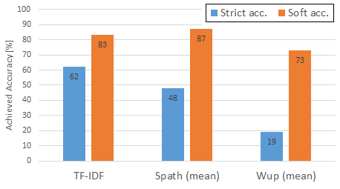
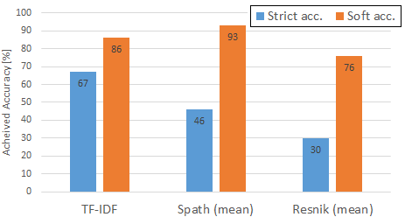
Main Results – Level 2
15 classes
All the 100 tags considered
Main comments:
All soft accuracies are above 70%.
TF-IDF achieved the highest strict accuracy (62%), followed by Spath (48%)
15 classes
Only the 49 tags of 100% agreem. among experts
Main comments:
Soft accuracy of Spath is above 90%.
TF-IDF achieved the highest strict acc. (67%)
Text and semantic similarities with TF-IDF and knowledge model-based methods
Text and semantic similarities with TF-IDF, knowledge model-based (Spath) and corpus-based (Resnik) methods.

Slide 20
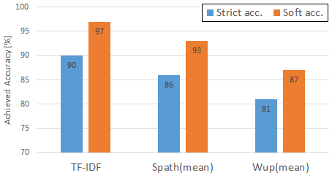
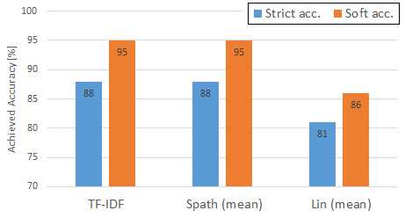
Main Results – Level 1
Level 1 (5 classes)
All the 100 tags
Main comments:
Soft accuracy of Spath is above 85%.
TF-IDF achieved the highest strict acc. (90%)
Level 1 (5 classes)
Only the 49 tags of 100% agreem. among experts
Main comments:
Strict accuracies are above 80%
Soft accuracies of up to 95 %.
Text and semantic similarities with TF-IDF and knowledge model-based methods
Text and semantic similarities with TF-IDF, knowledge model-based (Spath) and corpus-based (Lin) methods.

Slide 21
Future Work (Follow-up Idea)
i
j
 |  | CORINE Level 2 LULC Classes
 |  | 1.1 | 1.2 | 1.3 | 1.4 | 2.1 | 2.2 | …
OSM tags | allotments | 0.0681 | 0.0732 | 0.0659 | 0.0661 | 0.0666 | 0.0675 | …
 | club | 0.0655 | 0.0658 | 0.0696 | 0.0766 | 0.0652 | 0.0655 | …
amenity=club
landuse=allotments

Slide 22
Future Work (Follow-up Idea)
i
j
 |  | CORINE Level 2 LULC Classes
 |  | 1.1 | 1.2 | 1.3 | 1.4 | 2.1 | 2.2 | …
OSM tags | allotments | 0.0681 | 0.0732 | 0.0659 | 0.0661 | 0.0666 | 0.0675 | …
 | club | 0.0655 | 0.0658 | 0.0696 | 0.0766 | 0.0652 | 0.0655 | …
amenity=club
landuse=allotments
where
and

Slide 23
Last Remarks
The work presented a simple approach for automatically associating OSM tags to LULC classes based on the text and semantic similarities of their descriptions.
The results showed that it has some potential. It performed bad for Level 2, but very good for Level 1 classes.
We propose the methods can be improved by considering the context of each OSM feature.
Besides contextual influences, semantic rules could also be applied in the future.

Slide 24
Associating OpenStreetMap tags to CORINE land-cover classes using text and semantic similarity measures
- VGI-ALIVE Workshop -
Tessio Novack, Janek Voss, Michael Schultz and Alexander Zipf
novack@uni-heidelberg.de
Heidelberg University – GIScience Group

Slide 25
Main Results
Level 2 (15 classes)
Only the 49 tags of 100% agreem. among experts
Main comments:
Soft accuracy of Spath is above 90%.
TF-IDF achieved the highest strict acc. (67%)
Level 1 (5 classes)
All the 100 tags
Main comments:
Soft accuracy of Spath is above 85%.
TF-IDF achieved the highest strict acc. (90%)
Text and semantic similarities with TF-IDF, knowledge model-based (Spath) and corpus-based (Resnik) methods.
Text and semantic similarities with TF-IDF and knowledge model-based methods

Slide 26
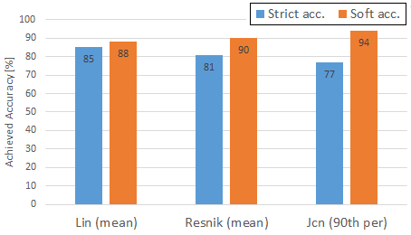
Main Results
Level 1 (5 classes)
All the 100 tags considered
Main comments:
Best strict acc. from Lin (85%).
Soft acc. of about 90%.
Level 1 (5 classes)
Only the 49 tags of 100% agreem. among experts
Main comments:
Strict accuracies are above 80%
Soft accuracies of up to 95 %.
Semantic similarities with corpus-based and hybrid methods
Text and semantic similarities with TF-IDF, knowledge model-based (Spath) and corpus-based (Lin) methods.

Slide 27
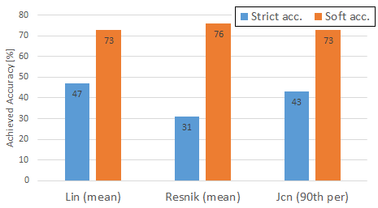
Main Results
Level 2 (15 classes)
All the 100 tags
Main comments:
All soft accuracies are above 70%.
TF-IDF achieved the highest strict accuracy (62%), followed by Spath (48%) and Lin (47%).
Text and semantic similarities with TF-IDF and knowledge model-based methods
Semantic similarities with corpus-based and hybrid methods

