Slide 1
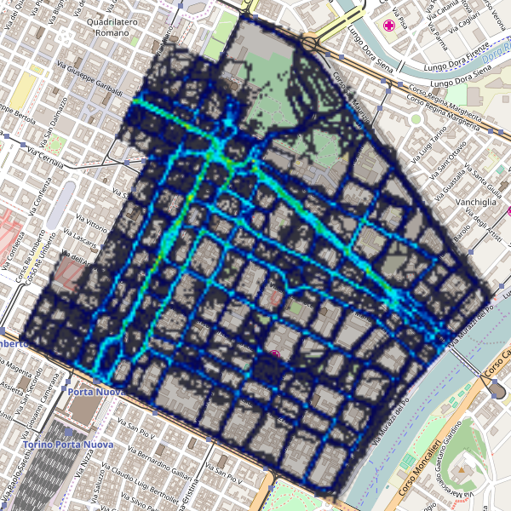
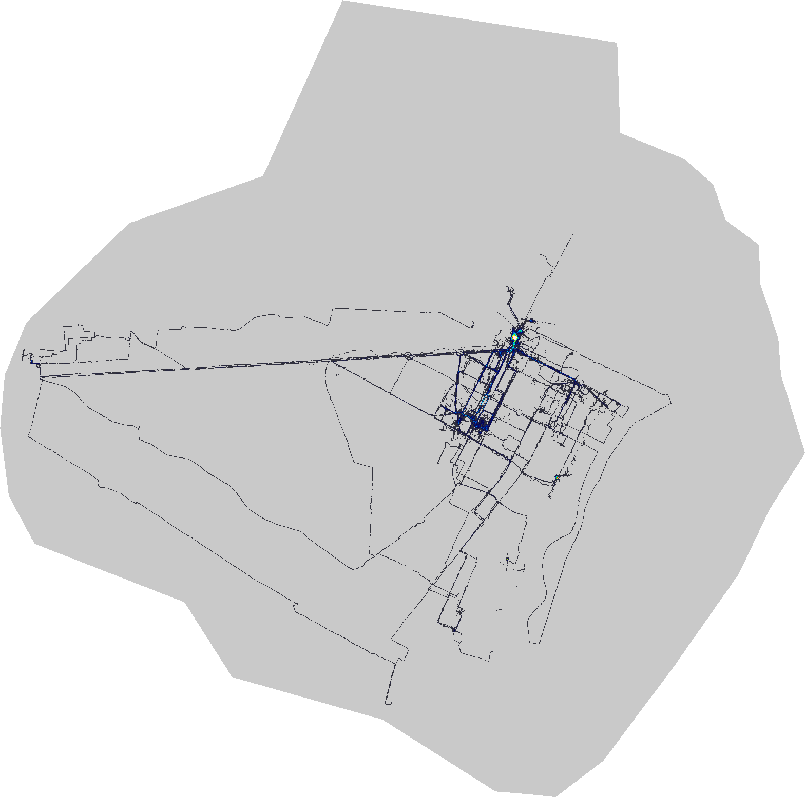
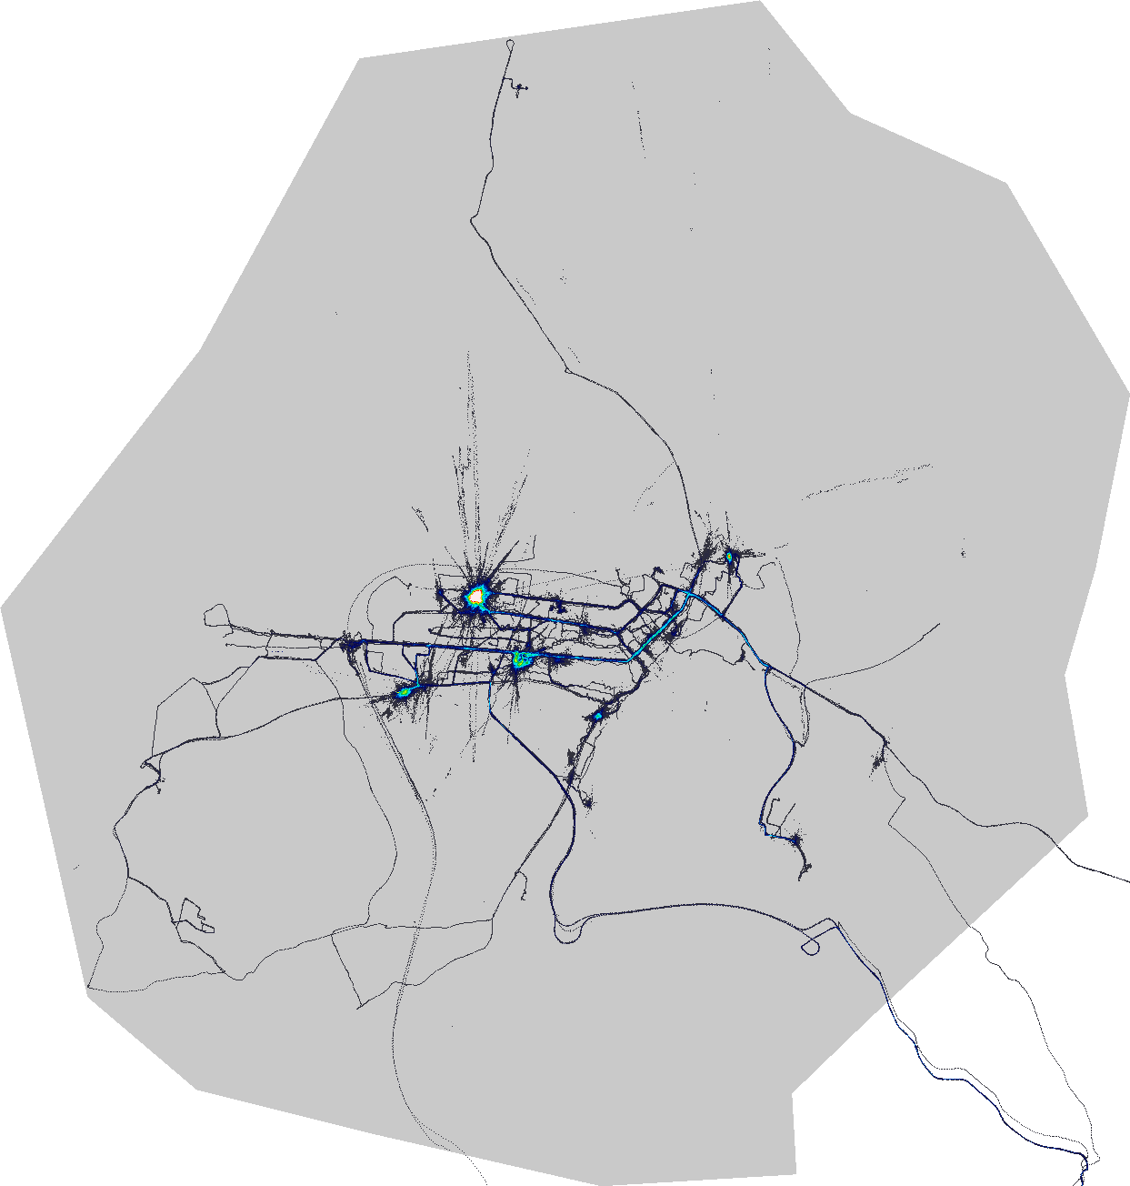
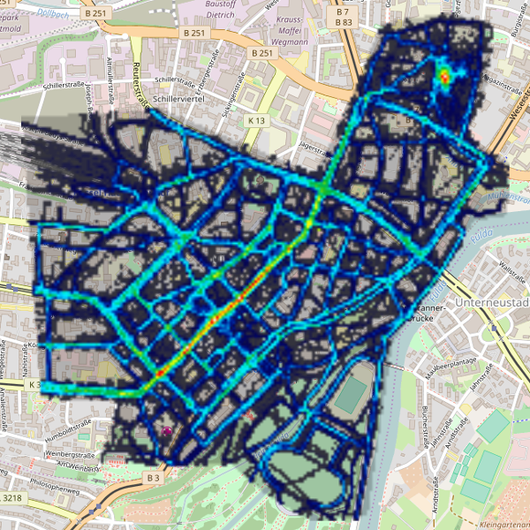
AirTrails
Urban Air Quality Campaign Exploration Patterns
Martin Becker, Florian Lautenschlager, Andreas Hotho

Slide 2
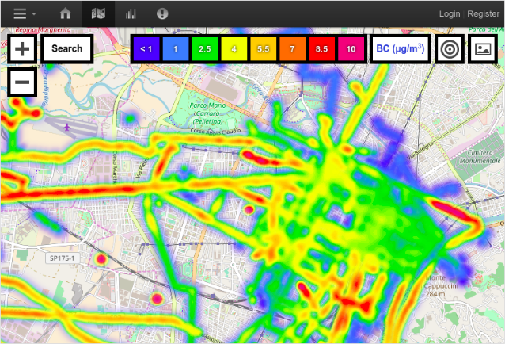
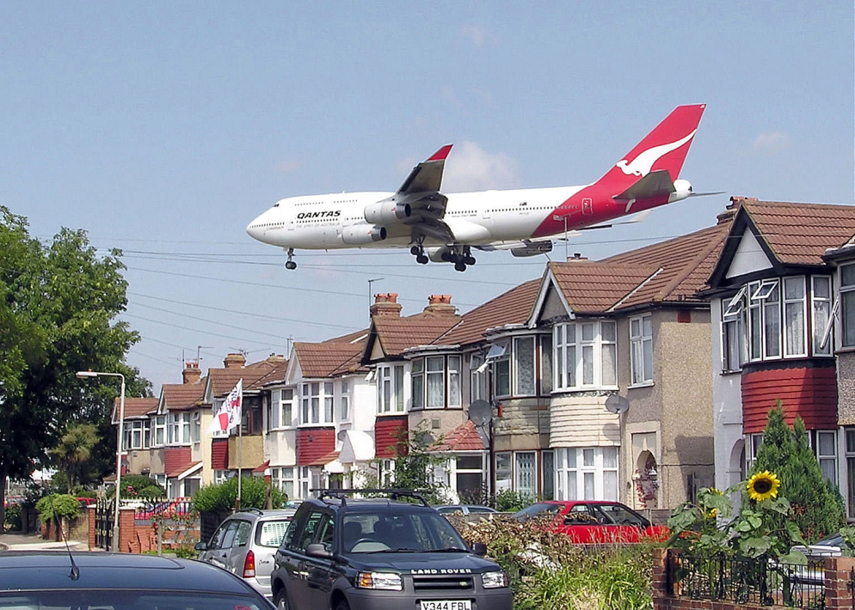
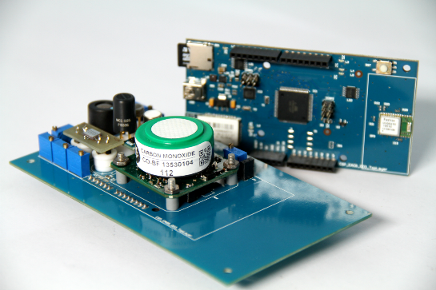
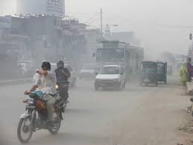
Participatory sensing

Slide 3
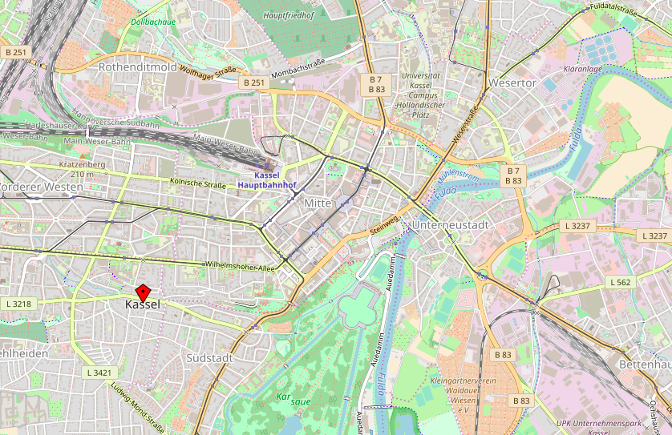
From GPS tracks …

Slide 4
... to complex patterns
Understanding complex
navigation processes
Notes:
Wir haben Photopfade… ja ne ;)s

Slide 5
... random?
Notes:
Random: good for a representative map of the complete city.

Slide 6
... towards bad air?
Notes:
Towards bad air:
people actiually seem interested in what they are measuring
However, may introduce bias for aggregate statistics

Slide 7
... follow roads?
Notes:
Follow roads:
Should be a pretty good explanation otherwise something is wrong
Focus on roads; maybe add incentive to move more randomly?

Slide 8
A hypothesis driven approach
People move
Randomly
Towards bad air
By roads
By road type (footway, residential, etc.)
Towards city center
Towards points of interest
From
domain experts (e.g., social scientists)
theory
intuition
experience
previous experiments

Slide 9
Agenda
HypTrails
Adopting HypTrails and formulating hypotheses
Data
Results
Discussion

Slide 10
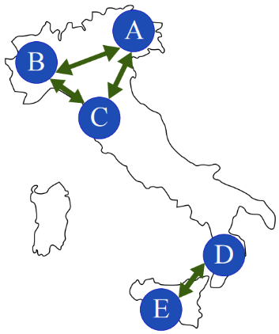
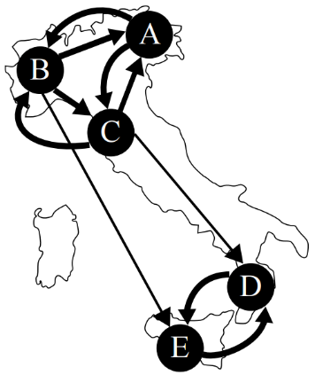
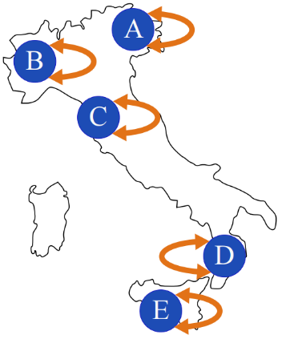
HypTrails (1):
A Bayesian approach for comparing hypotheses about sequential data on the web
$$H_{1}$$
First order
Markov chain
Hypotheses
Data
evidence
$$H_{2}$$
Transition probabilities ${ p}_{ij}$
T$ransitions n_{ij}$
0.5
0.2
$$\left(\begin{matrix}0.5 & 0.2 & 0.3 \\ ⋮ & ⋱ & ⋮ \\ p_{n,1} & ⋯ & p_{n,n}\end{matrix}\right)$$
$$\left(\begin{matrix}2 & 1 & 3 \\ ⋮ & ⋱ & ⋮ \\ n_{n,1} & ⋯ & n_{n,n}\end{matrix}\right)$$
0.5
increasing “believe” (K)
0.8
Marginal likelihood of observations $D$
given as
transition counts $n_{ij}$
Encoded as
Dirichlet Prior
conditioned on a hypothesis $H$
given as parameters of a Dirichlet prior $α_{ij}$
or „pseudo counts“${ α}_{ij}$
Marginal likelihood
Bayes factor
$$\underset{\begin{aligned}marginal \\ likelihood \\ of H\end{aligned}}{\underbrace{\operatorname{Pr}\left(D | H_{i}\right)}}=\int{\underset{likelihood of θ}{\underbrace{\operatorname{Pr}\left(D | θ\right)}}⋅ \underset{prior of θ }{\underbrace{\operatorname{Pr}{(θ|H_{i})}}}{ dθ}}$$
$$B_{1,2}=\frac{\operatorname{Pr}\left(D | H_{1}\right)}{\operatorname{Pr}\left(D | H_{2}\right)}$$
>
$$\left(\begin{matrix}0.2 & 0.4 & 0.4 \\ ⋮ & ⋱ & ⋮ \\ p_{n,1} & ⋯ & p_{n,n}\end{matrix}\right)$$
Philipp Singer, Denis Helic, Andreas Hotho and Markus Strohmaier, HypTrails: A Bayesian Approach for Comparing Hypotheses About Human Trails on the Web
Bayes Formula
$$\overset{evidence}{\overbrace{P\left(D | H\right)}}=\frac{\overset{likelihood}{\overbrace{P\left(D | θ,H\right)⋅}}\overset{prior}{\overbrace{P(θ|H)}}}{\underset{posterior}{\underbrace{P\left(θ | D,H\right)}}}$$
Bayes factor
$$B_{1,2}=\frac{P\left(D | H_{1}\right)}{P\left(D | H_{2}\right)}$$
Notes:
HypTrails ist für Navigation im Web entwicklet worden und basiert auf
diskretem Zustandsraum (wichtig)
mit Übergangswahrscheinlichkeiten
Hypothesen werden als Übergangswahrscheinlichkeiten formalisiert
Beobachtet Daten müssen als Anzahl von Übergangen zwischen Zuständen repräsentiert werden
Dann rechnet man die Marginal Likelihood aus, die der Wahrschienlichkeit der Daten entspricht gegeben eine bestimmte Hypothese
Wobei die Hypothese als im Prior der Übergangswahrscheinlichkeiten als Parameter einer Dirichlet-Verteilung kodiert wird
Diese ML verwendet man dann, um den Bayes Faktor auszurechnen,
der dann eine Aussage darüber liefert, welche Hypothese plausibler ist
Technisch gehen wir später noch einmal genauer auf HypTrails ein,
Da wir dann eine methodische Erweiterung von HypTrails vorstellen.
Dazu aber später mehr.
Das tolle an HypTrails ist jetzt….

Slide 11
HypTrails: Comparing Hypotheses
$$H_{random}$$
0.33 | 0.33 | 0.33
0.33 | 0.33 | 0.33
0.33 | 0.33 | 0.33
$$H_{semantic}$$
Marginal likelihood / evidence
$$H_{random}$$
$$H_{semantic}$$
0.0 | 0.9 | 0.1
0.9 | 0.0 | 0.1
0.4 | 0.6 | 0.0
increasing “believe” (K)

Slide 12
Agenda
HypTrails
Adopting HypTrails and formulating hypotheses
Data
Results
Discussion

Slide 13
Adopting HypTrails: State Space
HypTrails
0.5
0.2
0.8
0.5
First order Markov chain
n vertical cells
200x200m
m horizontal cells
Notes:
Meaning, we can now define a large transition probability matrix, defining transition probabilities between all cells.

Slide 14
Adopting HypTrails: Hypothesis
$$H_{semantic}$$
Transition
probabilities
between all cells
$$\left(\begin{matrix}p_{1,1} & ⋯ & p_{1,nm} \\ ⋮ & ⋱ & ⋮ \\ p_{nm,1} & ⋯ & p_{nm,nm}\end{matrix}\right)$$
0.0 | 0.9 | 0.1
0.9 | 0.0 | 0.1
0.4 | 0.6 | 0.0
n vertical cells
m horizontal cells
Notes:
Meaning, we can now define a large transition probability matrix, defining transition probabilities between all cells.

Slide 15
Adopting HypTrails: Adjacency
GPS Tracks
are often
„temporally
dense „
200x200m
Notes:
Konkretes Beispiel … Traffic or infrastructure optimization
Wenn poi dann busse zu pois

Slide 16
Adopting HypTrails: Adjacency
GPS Tracks
are often
„temporally
dense „
200x200m
Notes:
Konkretes Beispiel … Traffic or infrastructure optimization
Wenn poi dann busse zu pois

Slide 17
Adopting HypTrails: Adjacency
GPS Tracks
We only
need transition
probabilities to
adjacent cells.
We set the
probability for
long distance
transitions to 0!
200x200m
Notes:
Konkretes Beispiel … Traffic or infrastructure optimization
Wenn poi dann busse zu pois

Slide 18
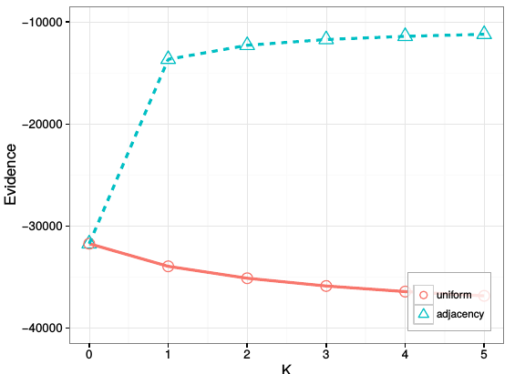
Adopting HypTrails: Adjacency
Random (including long distance transitions)
VS adjacency
200x200m
Notes:
Konkretes Beispiel … Traffic or infrastructure optimization
Wenn poi dann busse zu pois

Slide 19
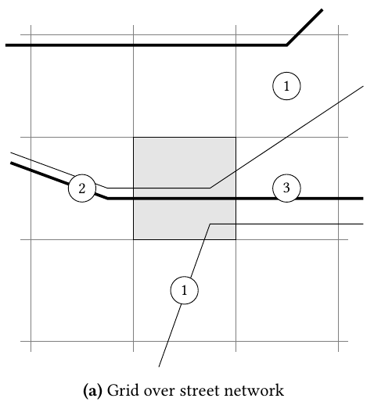
Hypotheses
$$r_{i,j}=\sum_{x∈R_{i} ∩R_{j} }{1}$$
Roads
$${\bar{P}}_{roads}(s_{j}|s_{i} ) = r_{i,j}·adj_{i}(j)$$
Road types (weighting 2/1)
$${\bar{P}}_{footway} \left(s_{j} | s_{i} \right) = w_{i ,j}^{footway}· adj_{i} (j)$$
$${\bar{P}}_{residential} (s_{j}|s_{i} ) = w_{i ,j}^{residential}·adj_{i} (j)$$
Notes:
Basic idea is, that people stick to roads when moving betweens cells. Thus the more roads in a target cell also appear in our current cell, the more likeliy is a transition from the current to that target cell.
When we consider road types we are not only counting but we are also using a weight. That is, for the footway hypothesis we double the weight for footways and for the residential hypothesis we double the weight for residential roads.

Slide 20
Agenda
HypTrails
Adopting HypTrails and formulating hypotheses
Data
Results
Discussion

Slide 21
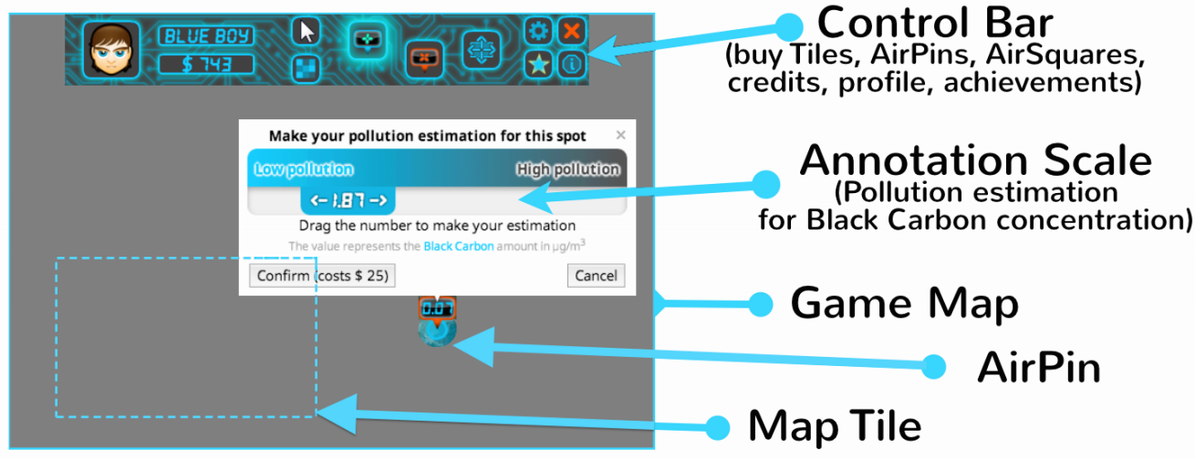
APIC – AirProbe International Challenge
Phase 1
Phase 2
Phase 3
restricted measurement area
unrestricted
Web Game
Web Game +
Mobile sensing
Web Game +
Mobile sensing

Slide 22
Agenda
HypTrails
Adopting HypTrails and formulating hypotheses
Data
Results
Discussion

Slide 23
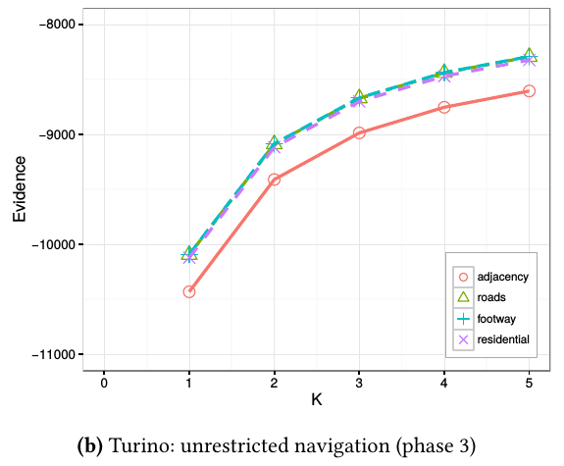
Results: Turino
Preference for following roads is very strong
Phase 2: Residential roads are the most important factor to explain navigation
Phase 3: Footways and roads in general are a better explanation for navigation

Slide 24
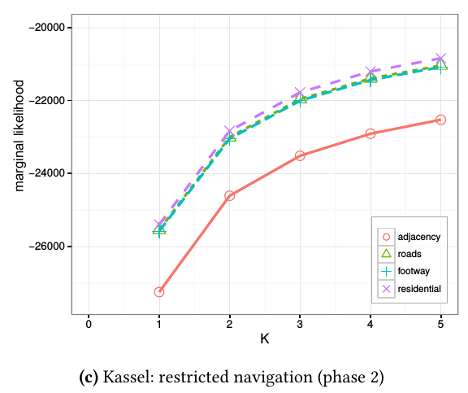
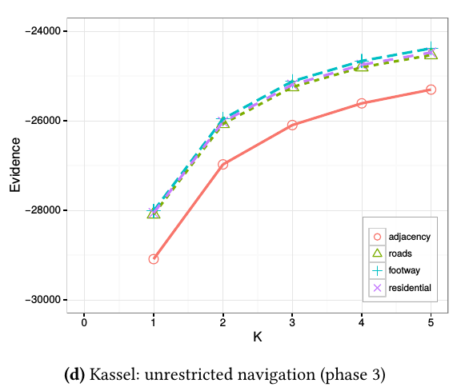
Results: Kassel
Similar results
with a stronger preference for footways

Slide 25
Results: Discussion (1)
Two trends are apparent
Types of roads are important to explain navigation behavior
Context dependency
Phase 2: residential roads
Phase 3: footways and normal roads
In line with the findings of previous work [10] where differing user behavior was observed in phase 2 and 3.
Notes:
Similarity to [10] in difference between phases but with regard to different aspects:
Navigation
Rather than: coverage and black carbin averages

Slide 26
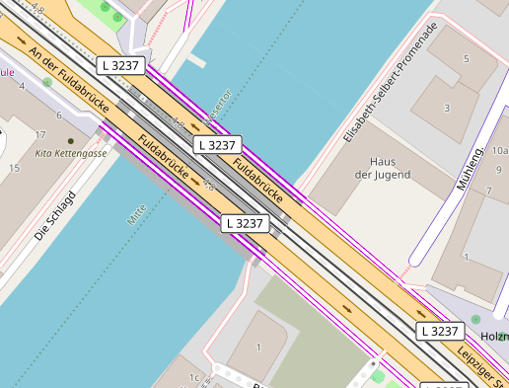
Results: Discussion (2)
Context dependent behavior:
Phase 2: focus on city centers where most common streets are residential roads.
Phase 3: no restrictions results in a less focused usage of road types; good performance of footways in Kassel may be due to large roads often having attached footways

Slide 27
Agenda
HypTrails
Adopting HypTrails and formulating hypotheses
Data
Results
Discussion

Slide 28
General Discussion
Flexible and easy to use framework to formulate and compare hypotheses
Powerful extensions available (MixedTrails, SubTrails)
Only relative judgements (solution: goodness of fit tests possible)
Limited to hypotheses about aggregated data (solution: MixedTrails, SubTrails)
Formulating hypotheses sometimes challenging
Modeling history information computationally challenging

Slide 29
The End
Presented HypTrails [Singer et al. 2015], a Bayesian approach for comparing hypotheses about navigation on the web
Adopted HypTrails to study behavioral patterns in mobile participatory sensing campaigns
Initial results on applying our approach to data from the large scale air quality measuring campaign APIC
Many possible extension!
Questions?
Notes:
In this work, we introduced a method to apply HypTrails for study-
ing the underlying processes of exploration patterns in the context
of mobile participatory sensing campaigns. In particular, we adapted
HypTrails to temporally dense navigation paths in a continuous
geo-spatial setting as is characteristic for GPS tracks. To illustrate
our approach, we applied this novel method to data from the APIC
challenge. The corresponding experiments yield promising results:
We show that roads and road types play an important role explain-
ing the observed paths. In addition, the results confirm a difference
in navigational characteristics depending on the geo-spatial con-
straints defined by the APIC challenge as also found in [10].
Overall, this study provides a novel method for understanding
behavioral processes in the context of geo-spatial navigation paths.
In particular, our approach can be used to build user models, to bet-
ter interpret data in the context of participatory sensing campaigns,
and to develop and compare new theories about the motivational
processes of volunteers.
For future work, it may be interesting to extend the transition
models as applied in this work, for example, by further investigat-
ing the influence of the road network in the context of the data
provided by OpenStreetMap, or by formulating heterogeneous hy-
potheses to explain the overall behavior of users during the APIC
campaign [2]. Finally, by employing data from other participatory
sensing campaigns as well as subjective information from users
may provide the necessary background information to formulate
and compare hypotheses that enable further insights into human
navigation behavior as well as their incentives and goals in the
context of environmental studies.

Slide 30
How can we explain participatory (movement) behavior?
Useful for
Understanding behavioral processes in participatory campaigns
Understanding movtivation
Interpreting measured data
Optimizing campaigns

Slide 31
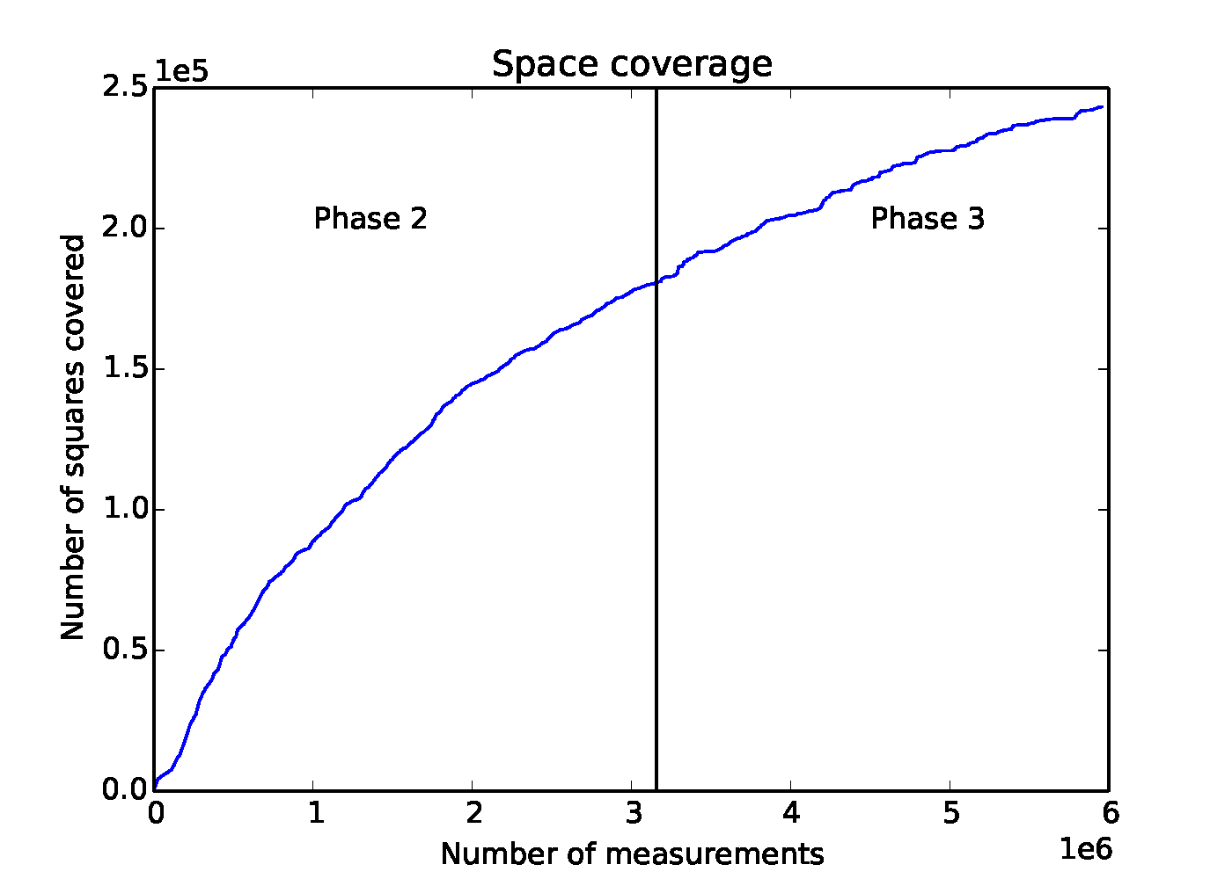
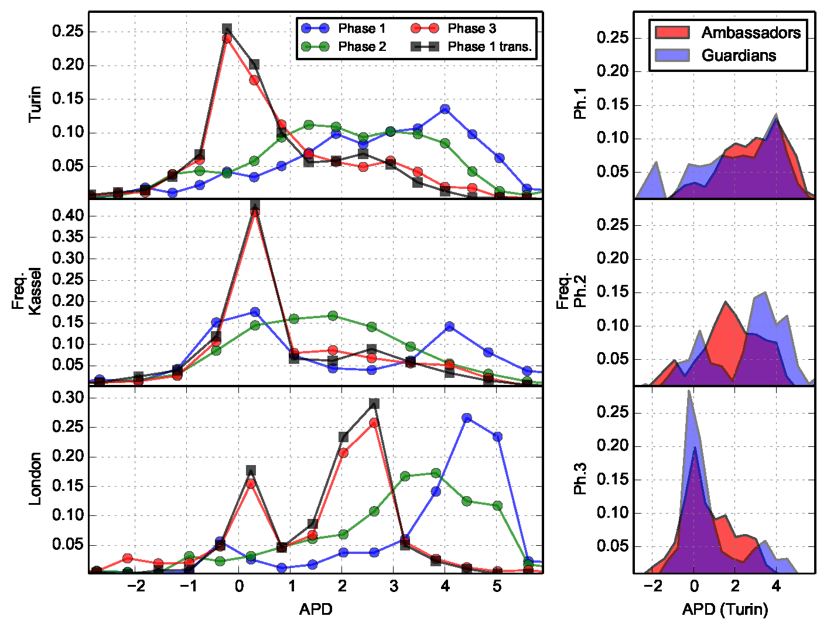
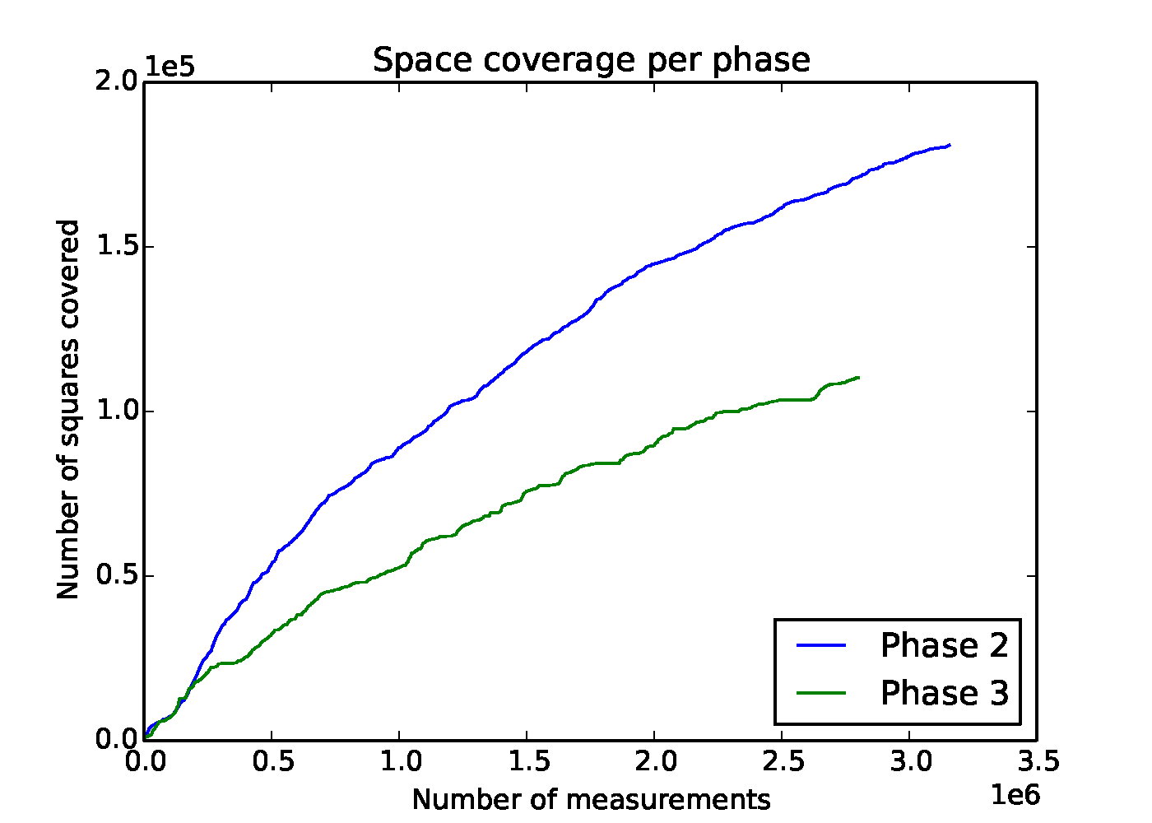
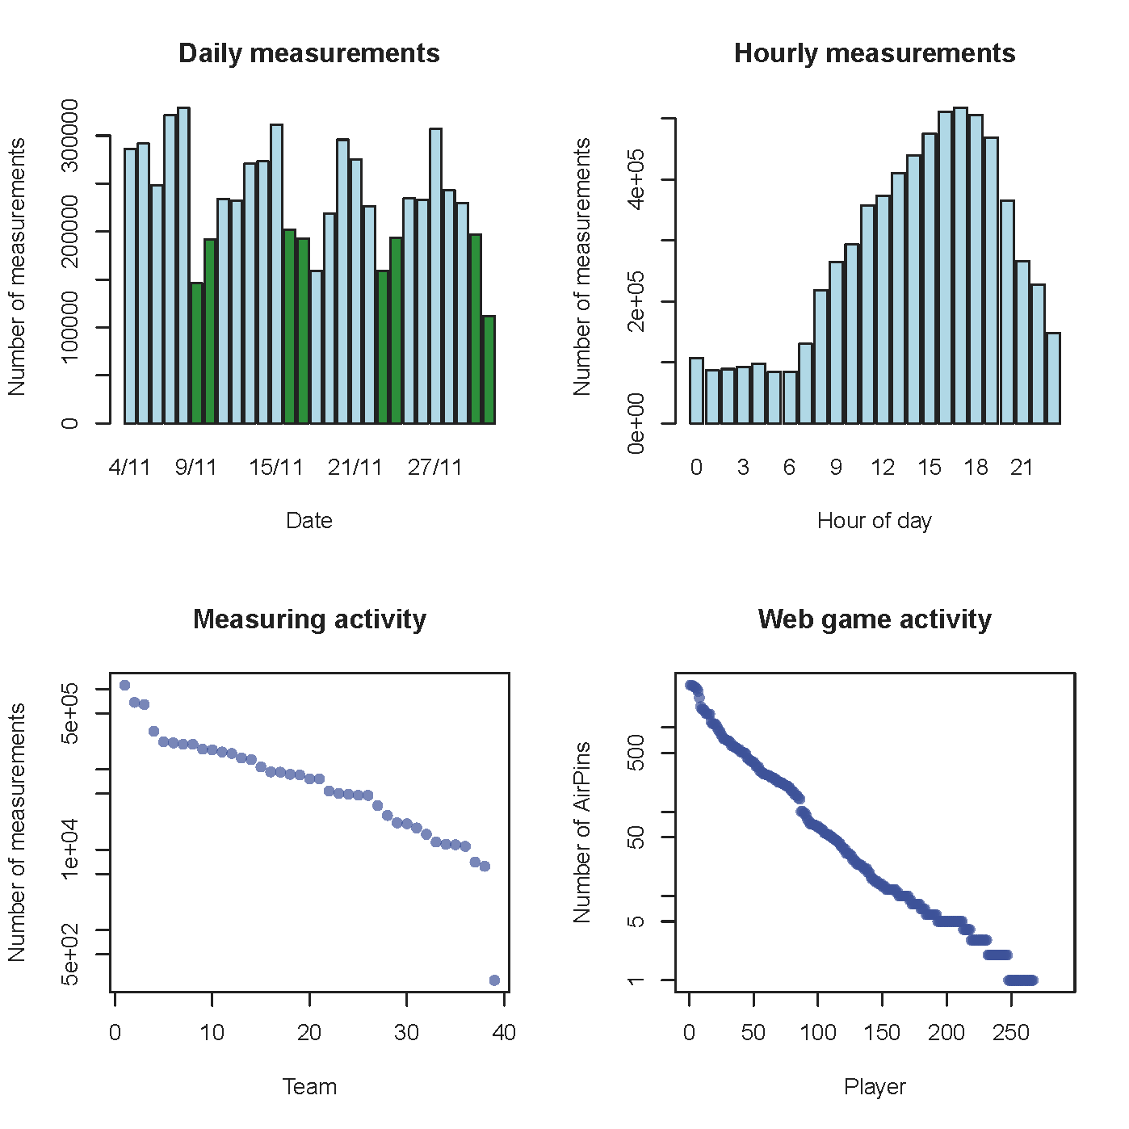
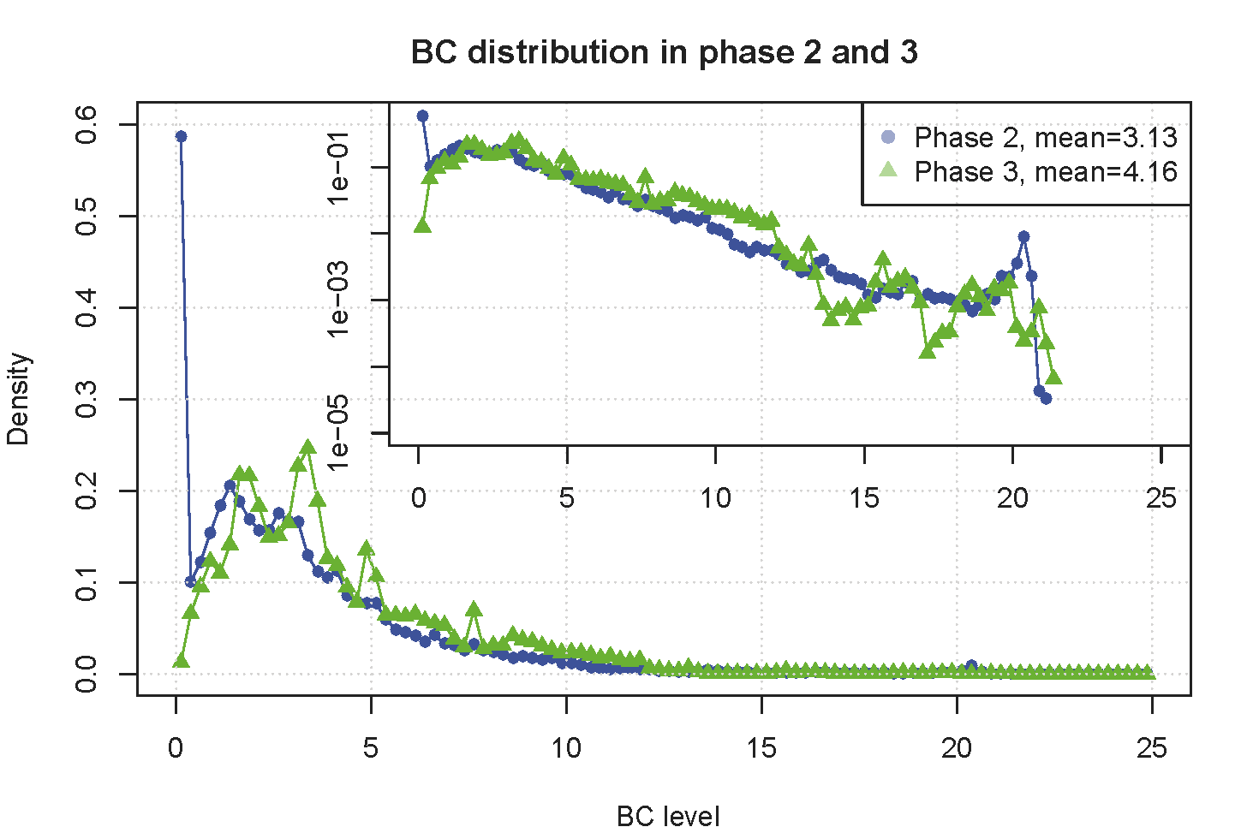
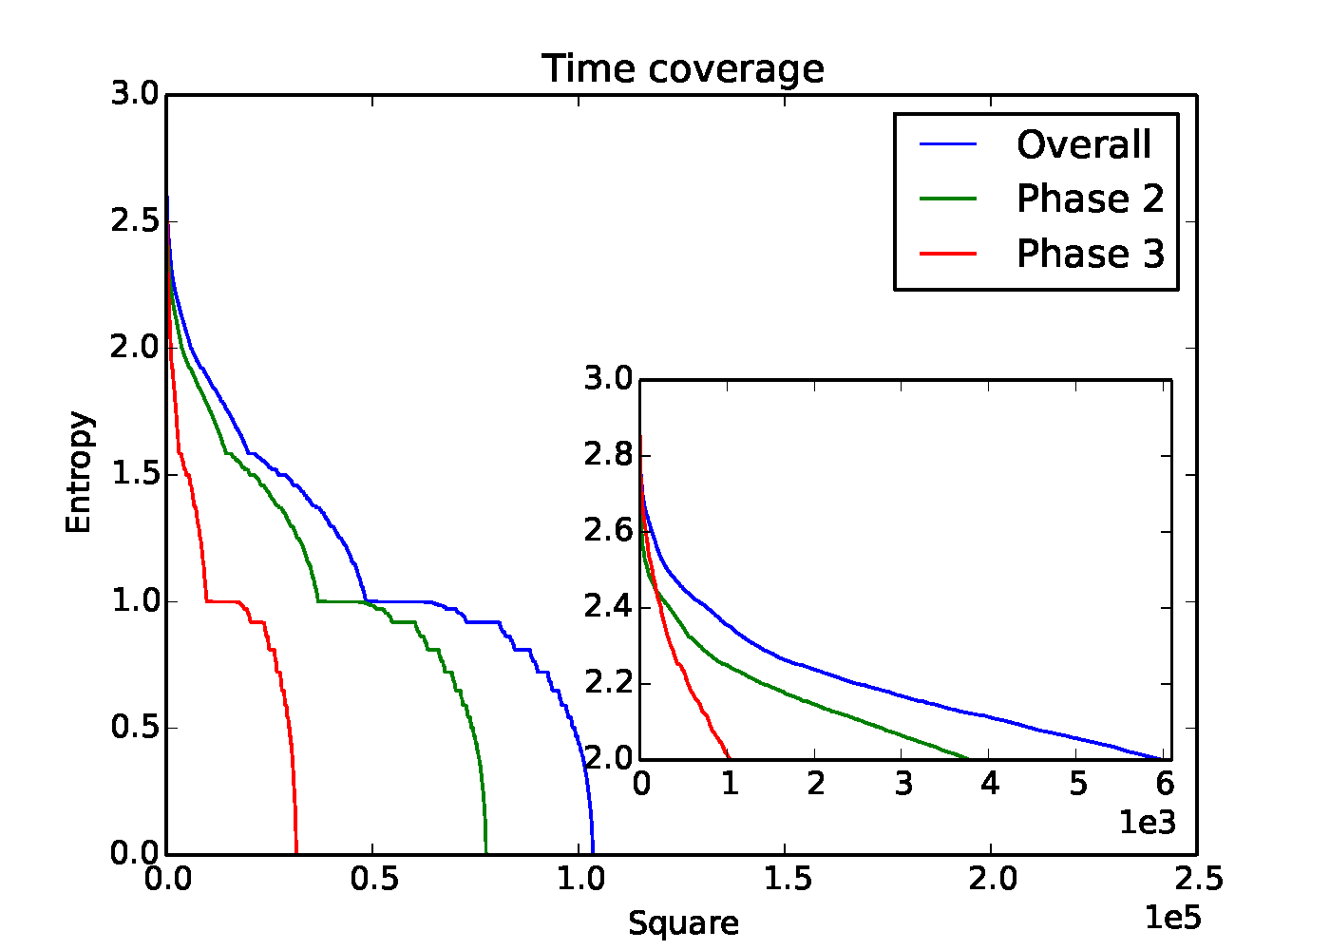
AirProbe Paper

Slide 32
HypTrails (2): Interpretation
Pseudo Counts?
(Dirchlet Prior)
$${log⁡(B}_{1,2})=log⁡(P\left(D | H_{1})\right) −log⁡(P\left(D | H_{2})\right)$$
$$H_{1}$$
Hypothesis $H_{1}$ is better than hypothesis $H_{2}$
marginal
likelihood
$$H_{2}$$
Hypothesis $H_{3}$ covers a prominent factor of the data but is not as good a fit as $H_{1}$ and $H_{2}$
Konzentrationsfaktor (K)
Hypothesis PDF for
a single state:
Brandenburg Gate
$$H_{1}$$
$$H_{2}$$
$$D$$
Notes:
Die ML gibt an ob eine Hypothese besser auf die Daten passt als eine andere.
Der Konzentrationsfaktor gibt an wie stark man an eine Hypothese „glaubt“.
Wenn man stark an seine Hypothese glaub, …

Slide 33
Participatory Sensing

Slide 34
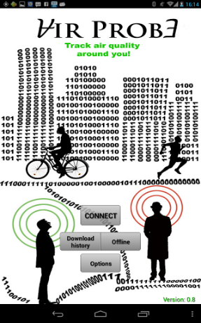
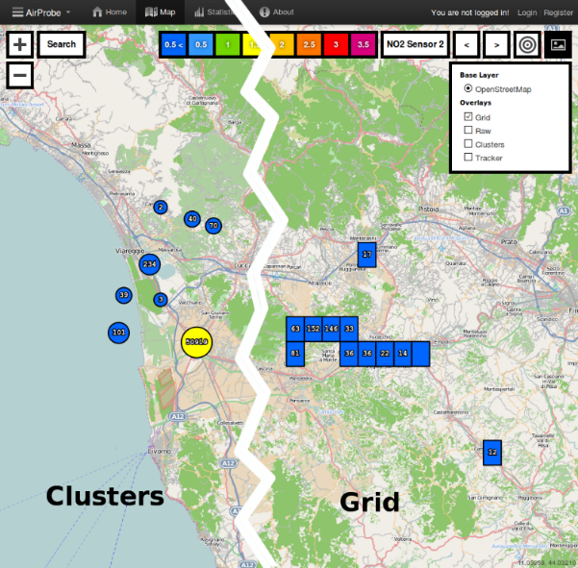
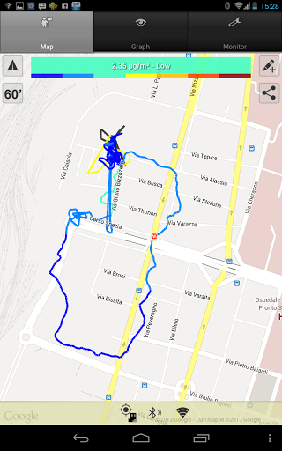
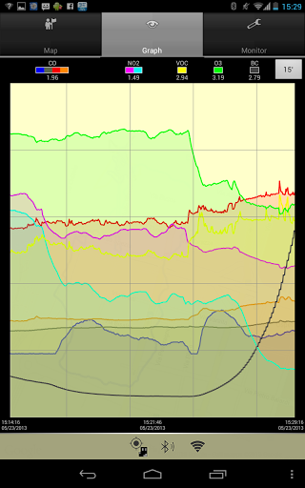
AirProbe collective air quality monitoring http://airprobe.eu
my way to work,
hectic
Notes:
continuous

Slide 35
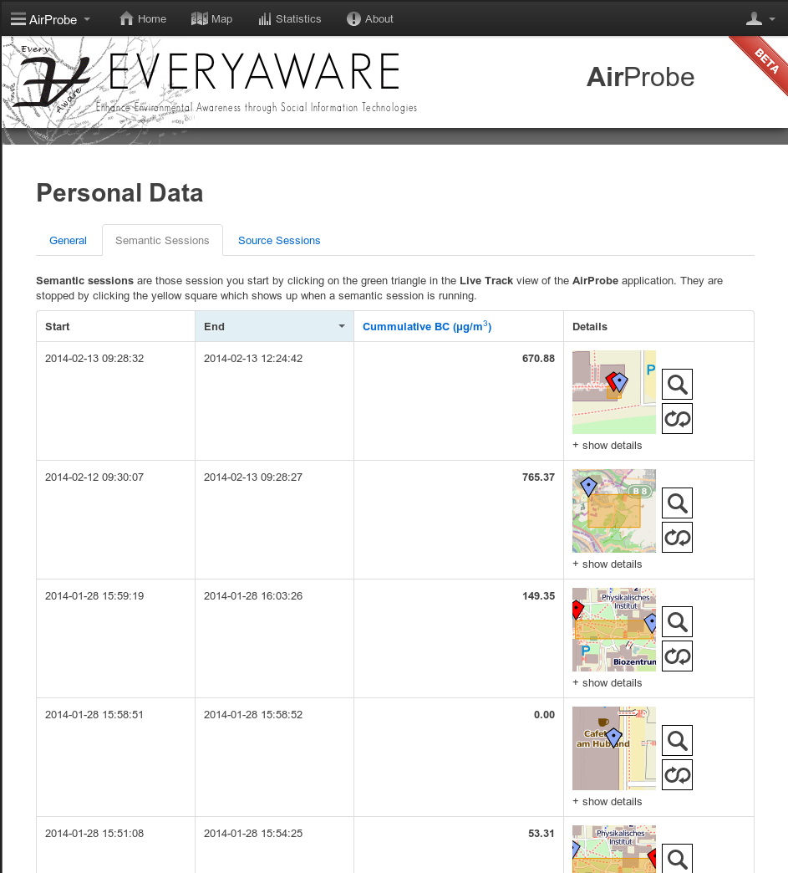
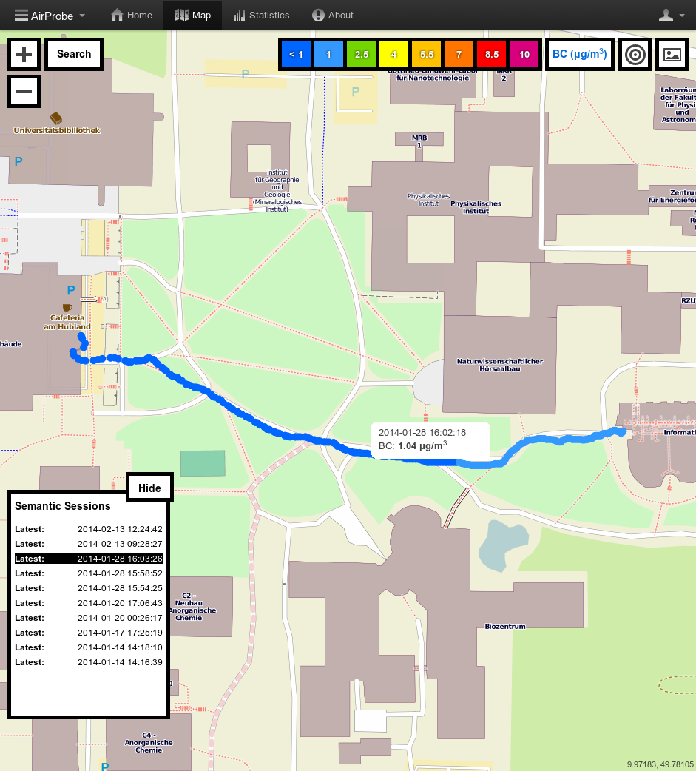
Web Interface: Sessions
+ Google Earth
Notes:
Now, what you see on the screen is a way of looking at personal sessions.
What sessions are about … ?
Start and stop button for personal tracks with different meanings by adding tags.
Allows to record and revisit personal data / tracks.
We provide several statistics for those personal sessions, like average, min, max and cumulative BC.
And these personal statistics make the AirProbe application a useful tool in comparison with static sensors, since those will only return average values for a whole area, while AirProbe measures your PERSONAL exposure.

Slide 36
Collected Data Overall Statistics
Week of APIC | Measurements
3rd | 1,409,770
4th | 1,548,607
5th | 1,364,537
6th | 1,990,658
Sum | 6,313,572
AirProbe
17,360,763 measurements
51 sensor boxes
59 users
30 teams
98 devices
209 tagged measurements
WideNoise Plus
50,373 measurements
15,447 devices
9,009 tagged measurements
+ 3,326,956 additional points
Web Game
325 players
70,758 pins
Snapshot: 2014-05-26, 15:40
Notes:
WideNoise many tags, because it is integrated into the measurement process.

Slide 37
APIC - participation
6 weeks
39 teams
4 locations
6,615,409 valid points
3,326,956 additional
325 players
70,758 pins

Slide 38
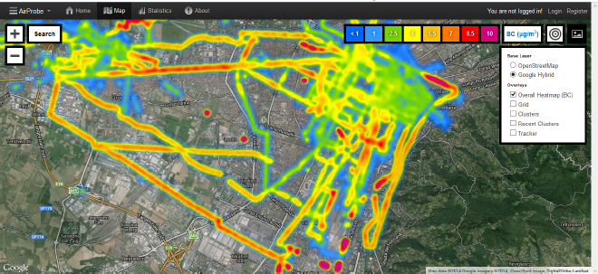
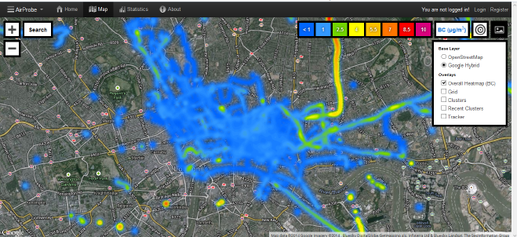
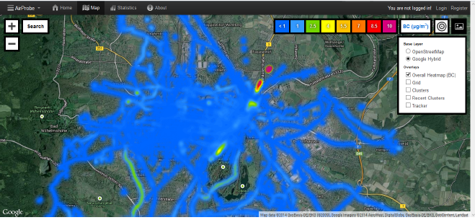
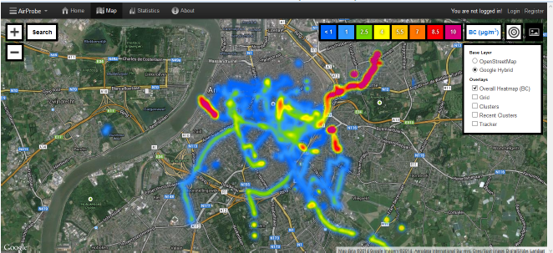
Map Outcomes
Turino
London
Kassel
Antwerp
Notes:
A total of 23835095 air quality data points were captured through the EveryAware project, with XXX of these captured during the APIC challenge. The London teams captured XXX points, the Kassel teams XXX, the Turin teams xXX and the Antwerp teams XXX data points.

Slide 39
Coverage for phase II and III

Slide 40
Exploration behavior over time
Notes:
Fig 2 indicates that space coverage grows steadily with the number of measurements, meaning that users continue to explore new areas over the course of the challenge. However, while at the beginning of the challenge the growth is fast, this decreases in time. This indicates less exploration as the challenge evolves, due to the fact that volunteers measure at the same location multiple times. When looking at individual phases, it appears that during phase 2 space coverage was much better than in phase 3. This does indeed mean that volunteers displayed a better exploratory behavior at the beginning and when asked to cover a specific area of the city, compared to when they were asked to map any place they wished. In the latter case, they went for their daily routes that were not so extensive, and did not explore further. For both phases the growth of the space coverage follows a power-law, with exponent 0.73 in phase 2 and 0.79 in phase 3. This suggests that, although on the short term, space coverage in phase two is larger, in the long run the strategy of phase 3 might actually produce better coverage. However, the restricted time frame of our challenge can not provide further proof for this hypothesis.

Slide 41
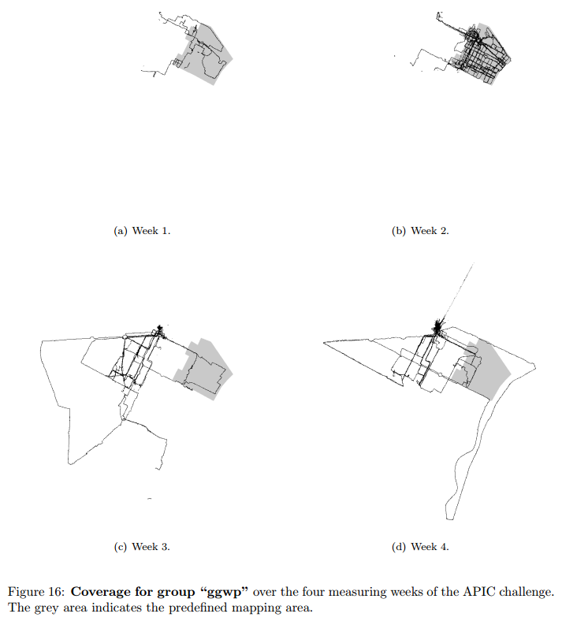
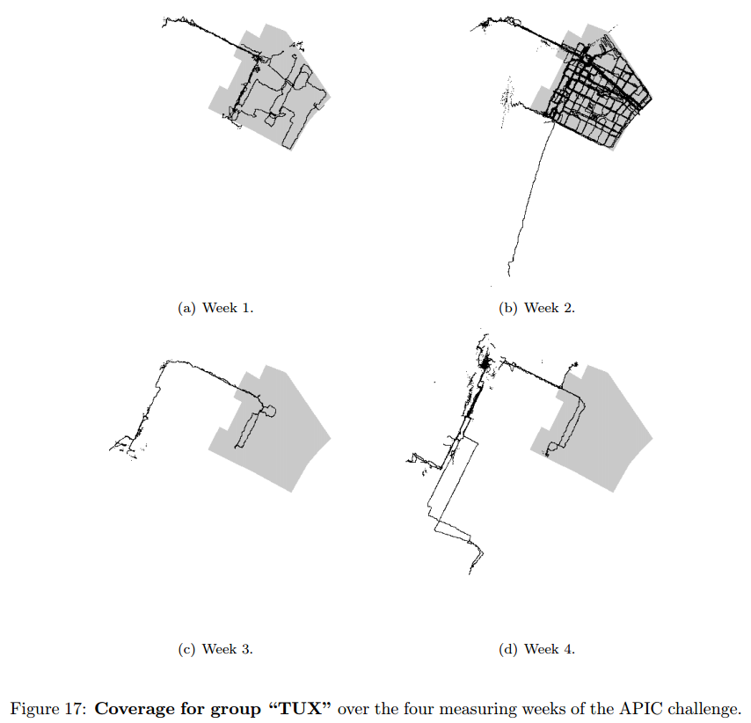
Exploration behavior of individual groups

Slide 42
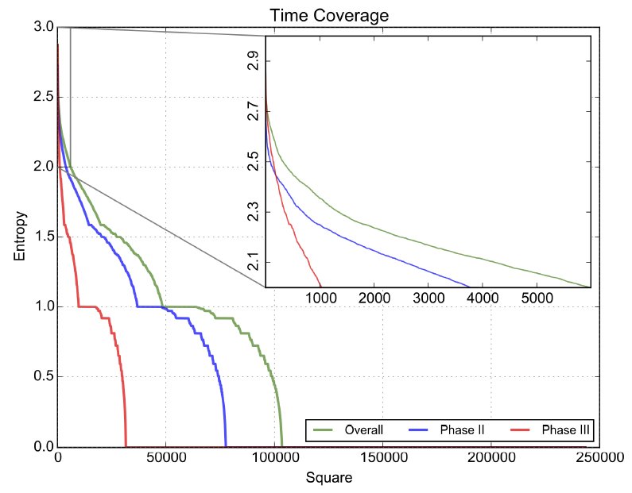
Coverage in Time
Notes:
So, for each tile, we also look at how measurements are spread in time, i.e., time coverage.
measurements into 8 categories based on the time of measurement.
working days (Monday to Friday) from the
Weekends (Saturday and Sunday).
Each of the two groups were divided into 4 further categories, by setting time thresholds at hours 08:00, 14:00, 18:00 and 23:00.
The entropy of the resulting sets was computed. For each square, we obtained the fraction fi of measurements in each category i
as the ratio between measurements falling into that category and the overall number of measurements in that square. Then the entropy for that square is
E= sum fi log2 fi.
A higher entropy indicates a better spread of measurements in time.
Fig 3 shows the distribution of the entropy for all squares covered, in a rank-entropy plot (squares are sorted descending by
entropy and the entropy values plotted for each square). A few squares had a very good time coverage. These correspond to hubs in the four cities such as popular leisure locations
(e.g. Königsstrasse in Kassel), main squares (e.g. Piazza Castello in Turin) and transportation hubs
(e.g. the Barbican and Bank subway exits in London).
At the other extreme there are many
squares (more than half) that have been covered only in one time slot (entropy is 0). Between
the two extremes, time coverage is dropping fast when moving through the ranked squares.
The curves display jumps and it appears that squares can be divided into sets based on time
coverage. One first set (rightmost) includes those squares that have measurements only at one
time of the day (entropy 0), which is followed by those covered in 2 time slots, ending with
those that are covered at all times of the day (leftmost). Within each set, coverage decays differently.
While for the highly covered squares decay appears to be exponential (as plotted in the
inset), this becomes slower as the coverage decreases, with curves resembling polynomial
decay.
When comparing the two phases, time coverage in phase 2 is much better overall than in
phase 3. This indicates that volunteers not only explored more in space, but also in time, during
phase 2, while in phase 3 they followed their daily schedule which allowed for poor time coverage
as well. This underlines again the importance of giving volunteers a specific mapping area
in order to obtain better measurement spread.
The overall coverage results are also displayed as spatial heat maps in Fig 4 (phase 2) and
Fig 5 (phase 3). These show the areas of the 4 cities (mapping area for phase 2 and the entire
city for phase 3) with the covered tiles. Bright colours correspond to higher time coverage, with
bright red indicating the locations with most measurements. It is clear that the mapping area
(phase 2) is much better covered than others (phase 3), with a few clear locations containing
many measurements. These do correspond to landmarks and main roads in the 4 cities, as discussed
earlier.

