Slide 1

Ethics of data governance
Simone van der Burg

Slide 2
Agenda
Introduction
Workshop: step 1, 2, 3
Wrap up

Slide 3
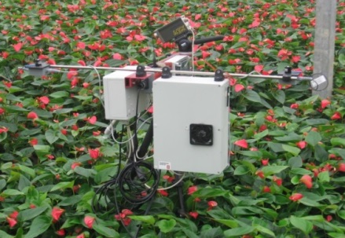
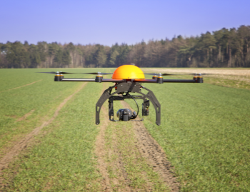
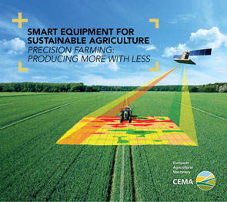

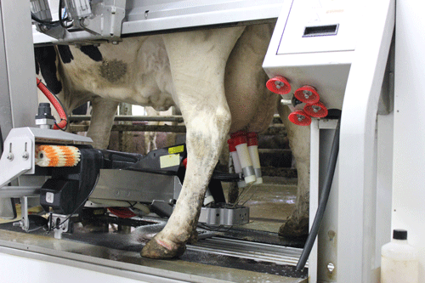


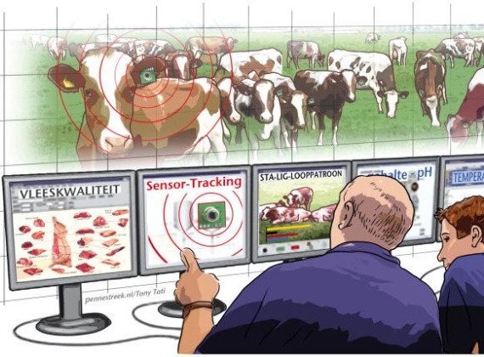
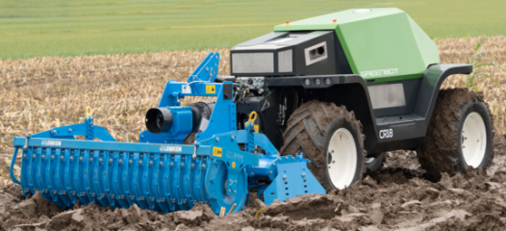


Smart farming technologies
SMART
SENSING
& MONITORING
BIG DATA
SMART
ANALYSIS
& PLANNING
SMART
CONTROL

Slide 4
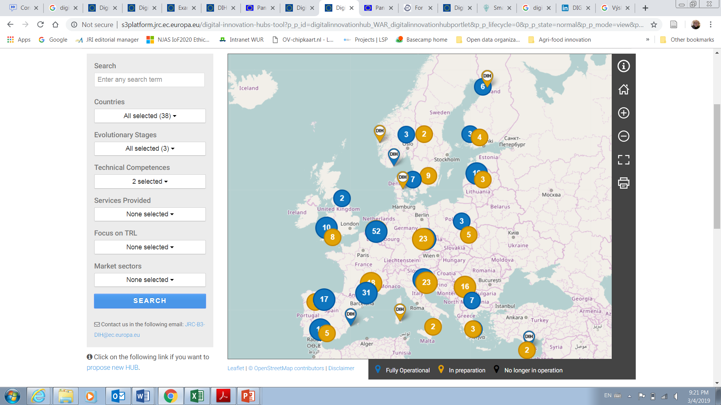
Digital innovation hubs
What happens to the ‘big data’?
Europe is investing in DIH’s. Who governs data in DIH’s? Who decides about who can collect them, analyse them, interpret them, re-use and –reinterpret them over time?

Slide 5
Questions about data
Who is the data owner?
Who has the right to benefit from data?
Should data be protected?
What do we mean when we say farmers ‘have a right to’ data?
What is the role of privacy in agriculture?
What should be done to give farmers a role in decisions to collect, evaluate, transfer or use data?

Slide 6
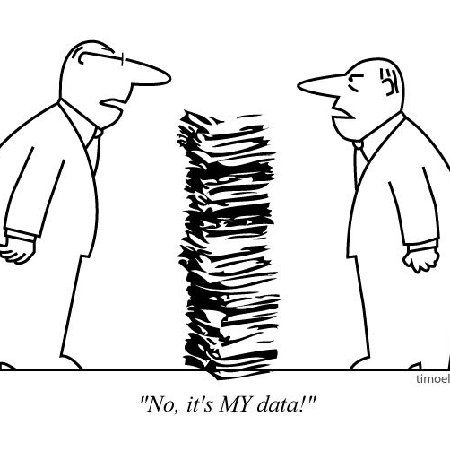
reflections about data governance
We did interviews and distinguished four lines of thinking about the future (which you are allowed to combine/alter)
1. The ‘I choose’ model
2. Data as public library
3. Data governance is settled by the market
4. Data allow to re-organize
collaboration in the value chain

Slide 7
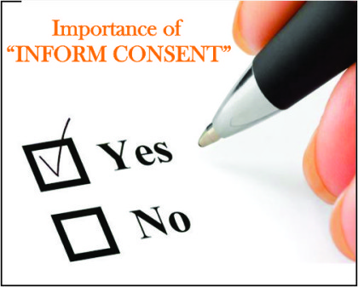

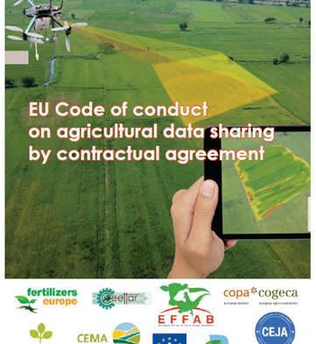
The ‘I choose’ model
Farmer should get to choose whether and with whom he or she shares data
  Copa Cogeca: shape good contracts
  Practical. But: feasible in the long run? And does it really enhance autonomy?

Slide 8
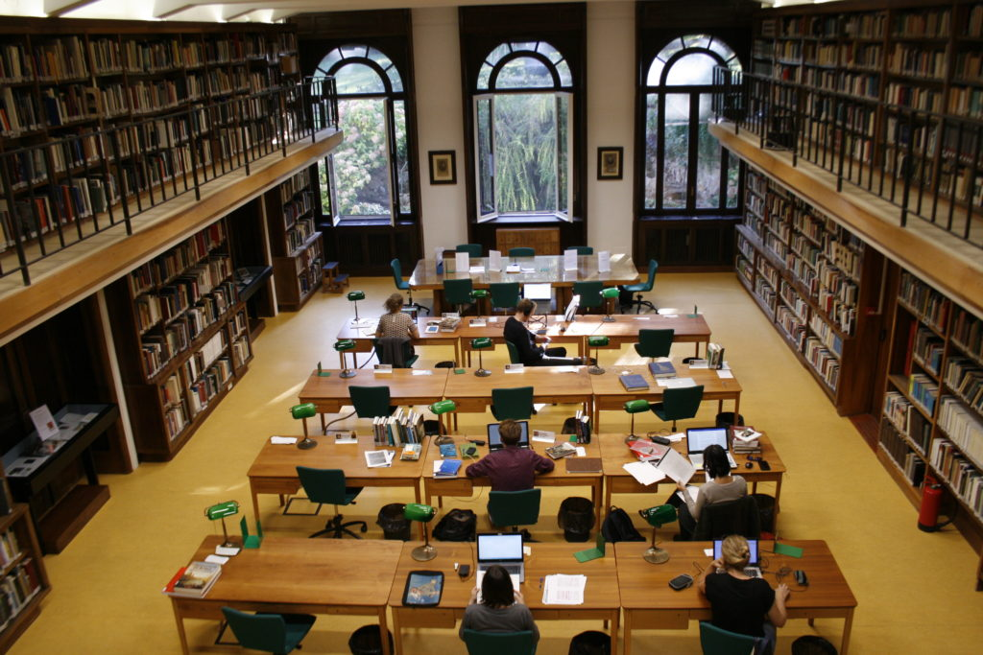
Data as a digital library (hub?)
Management of the ‘library’ develops sharing policy
But: who pays? If it is the government, can it decide?

Slide 9
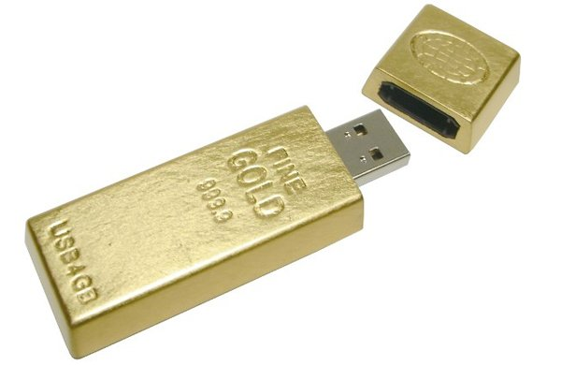
Data governance should be settled by the market
Farmers and other businesses will share data when it brings them benefits
But: Competition, inequality of knowledge/expertise, digital divide, big data divide

Slide 10
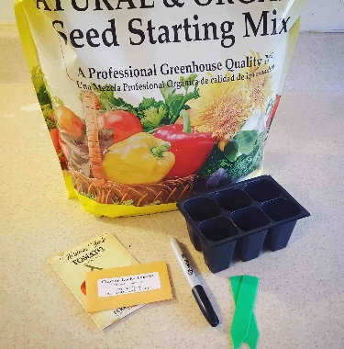
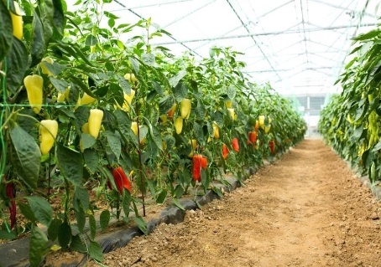
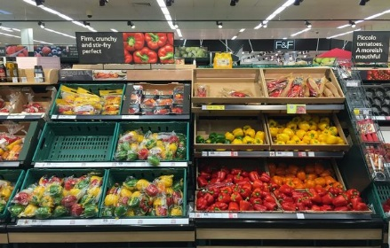
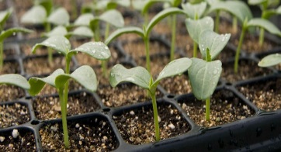

Data should be shared in the value chain
Farmers shape collaborative with supply-chain and supermarket
But: unequal competition?

Slide 11
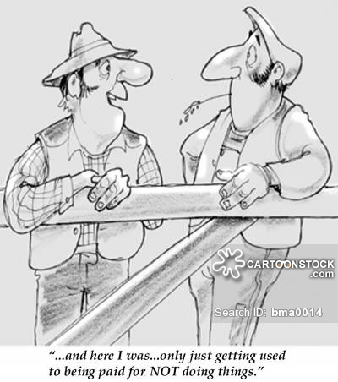
1. Is there a model that you prefer?
1. The ‘I choose’ model
2. Data as public library
3. Data governance is settled by the market
4. Data allow to re-organize
collaboration in the value chain

Slide 12
2. Pick your preferred cards
Choose a neighbour and take a set of cards
  What (2 or 3) values do you think are most important when you think of farm data? (or what values do you want to add on the empty cards?)
  How would you serve these values in your preferred model (or combination of models)?
Share your conclusions with the group

Slide 13
Societal issues
Smart farming is thought to tackle 21st century challenges
The population grows; more mouths to feed
Climate change; diminish the environmental impact of farming
Foster safety and social acceptance of food products
(How) will your scenario help to realize these goals? Is it sufficiently able to do that? What do you think are barriers/facilitators?

Slide 14
3. Societal questions
What should be the primary goals served with farm data? Are these business goals/societal goals (or both?)? What does this imply for who is to have access to data?
Banks, insurance companies, make attractive offers to farmers who protect the environment, in exchange for their data. What do you think of this idea? Is/should it be the role of banks and insurance companies to foster environmental sustainability on farms? (Whose role is it to do that?)
According to some, the big data divide challenges social equality and just distribution. Is this a reason to diminish the big data divide? What could be done to diminish the big data divide in your data governance scenario? Who should take action?
The EU fosters the development of DIH’s. Who should be in charge of regional DIH’s? (regional governments, companies, farmers cooperatives or...?)
What should the role of farmers/tech service providers/governments/ NGO’s/researchers be in DIH’s?

Slide 15
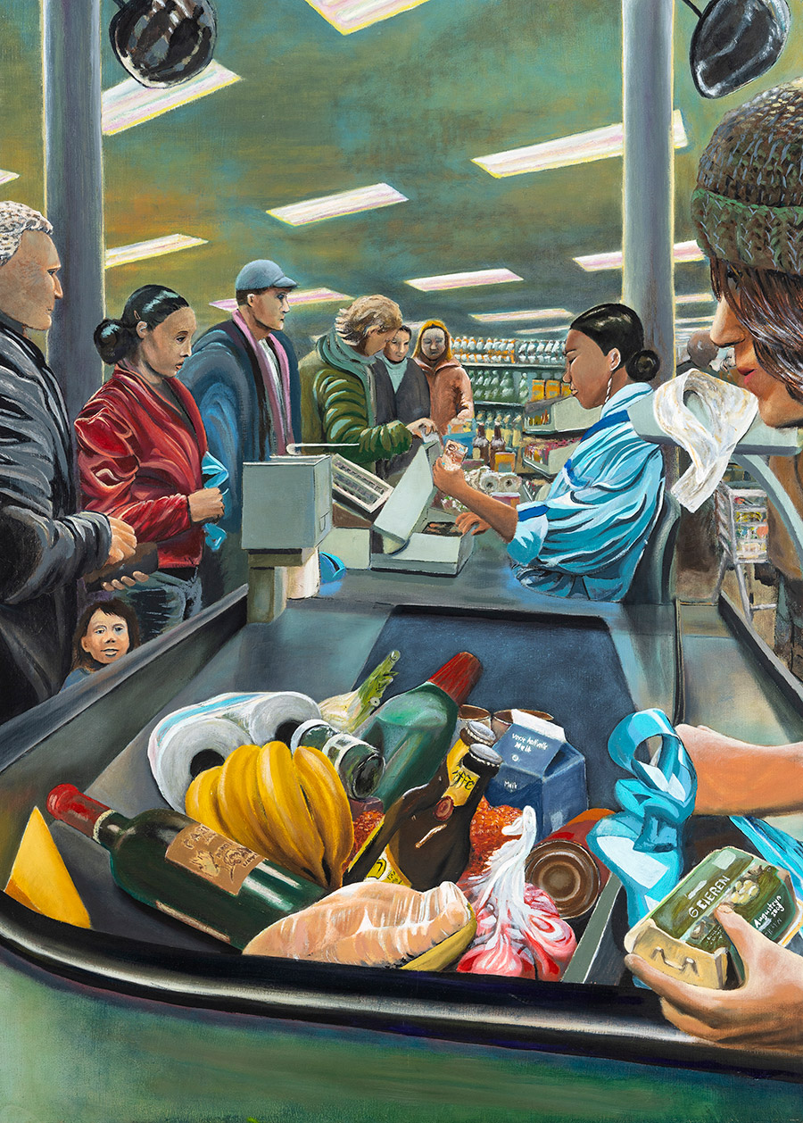
Plenary
Results?
Magda Augusteijn, Surviving in the supermarket

