Slide 1
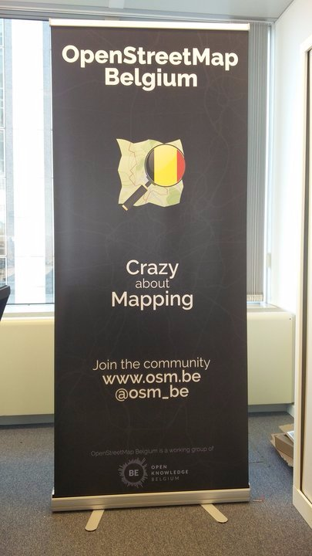
OpenStreetMap and National Mapping
A Flemish/Belgian Experience
Notes:
Crazy? See the Mapper of the Month series
https://wiki.openstreetmap.org/wiki/WikiProject_Belgium/Belgian_Mapper_of_the_Month

Slide 2
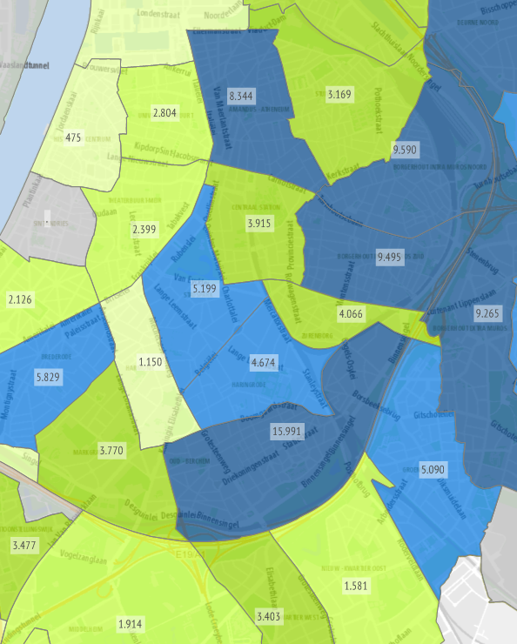
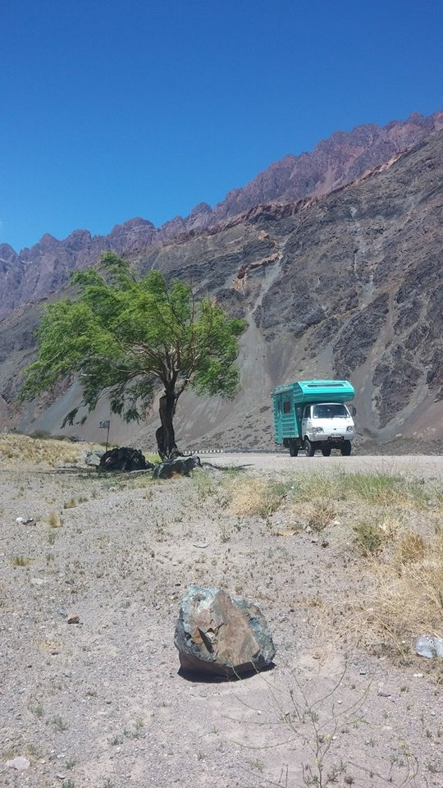
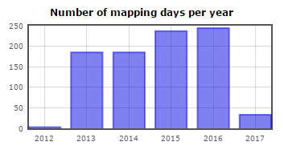
Intro
Hi!
Notes:
OSM afficionado: editing almost every day; organizer in OSMbe community. Crazy about mapping.
Government: statistics, geostatistics, GIS – in Antwerp, “largest city” in Belgium
Travel, hike, dog
https://www.linkedin.com/in/joost-schouppe-60393948
https://stadincijfers.antwerpen.be/dashboard/
http://www.openstreetmap.org/user/joost%20schouppe/
https://twitter.com/joostjakob

Slide 3
Explaining OpenStreetMap by comparing to Govenment managed mapping
Notes:
If we're going to talk about what OSM and government mapping can mean to each other, let's first clarify what OSM is and how our approach differs from government.

Slide 4
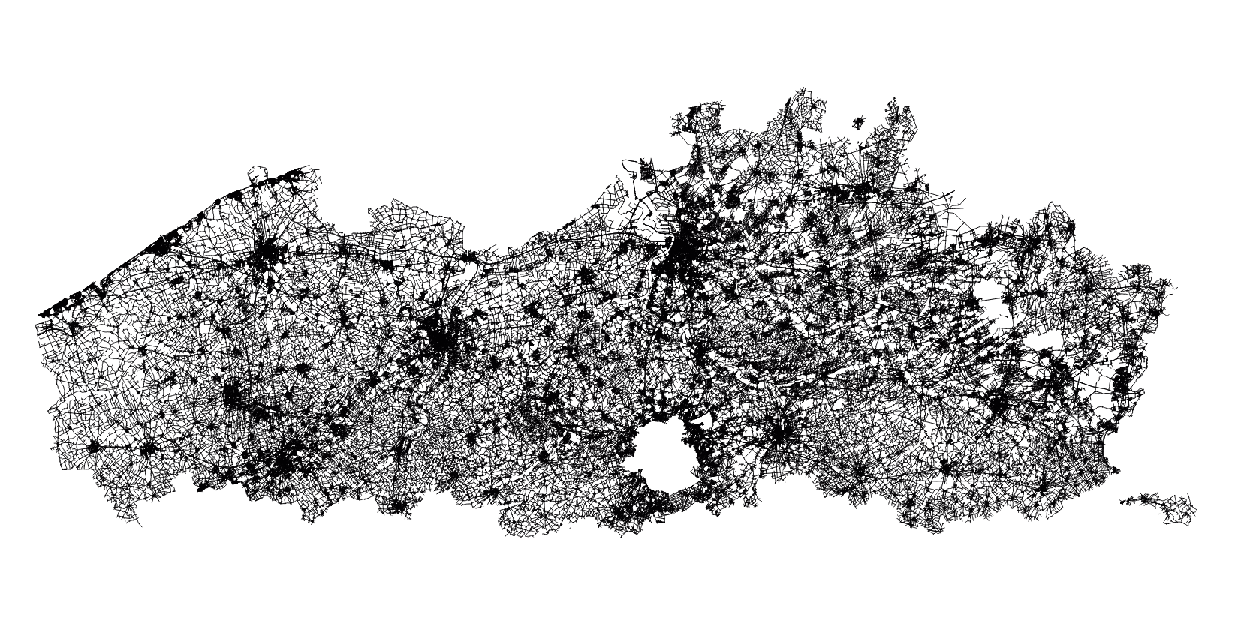
GRB
Notes:
Governments start with a problem. "We want to know where our roads are". So they start defining what a road is. "Well, a road is a government-managed thing that cars drive on." Then they start building a system that fits this definition. After a while, the goal is reached, and a beautiful dataset is created. If the government is smart, it will keep the dataset up to date. Maybe it will even have a nice history.

Slide 5
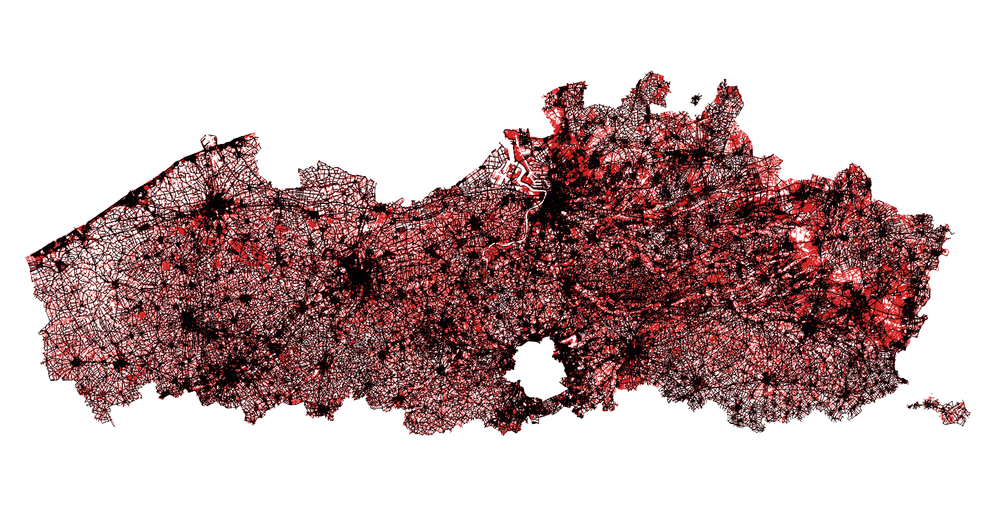
Wegenregister
Notes:
Then, the government discovers that it wants to do more things. In the case of roads, it discovers that there are also other types of roads, suchs as paths and tracks. They were forgotten because another level of government or a different branch needs to manage those.
So they add the data.

Slide 6
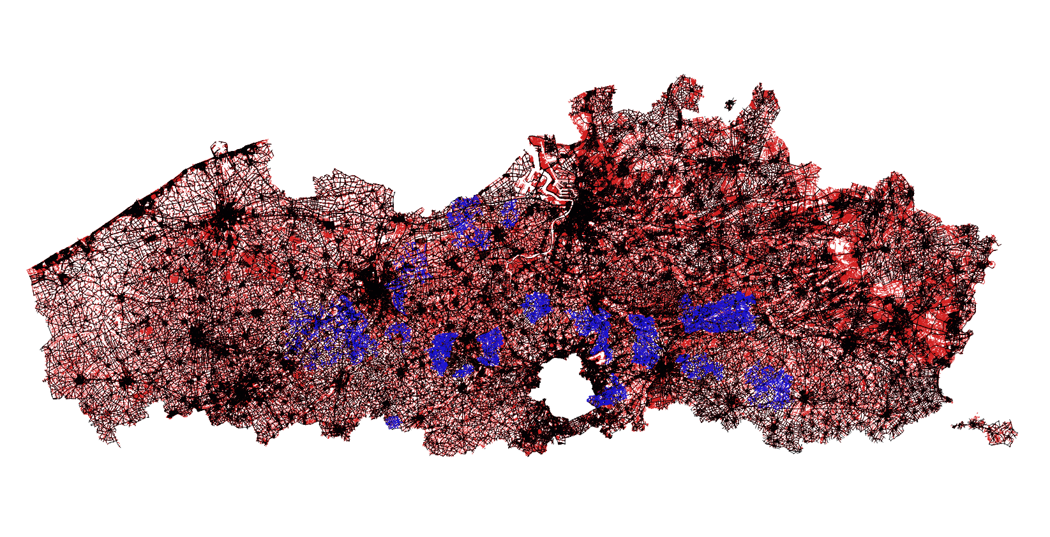
Trage Wegen
Notes:
But then you need to keep that data up to date. So we start collaborating with a specialist in slow roads, and you get a patchwork of updates.
Now that we have this beautiful road network, shouldn't we allow for mapping cycleways, turn restrictions, max speeds, access restriction?

Slide 7

Notes:
OSM works quite differently. Our first problem was "we need some data we can use".
What exactly you want to use it for, and how exactly you want to do it, depends on the mapper and the data user.
We don't start with road type A, then move on to road type B, and so on. We do everything at once.
As we're working on one thing, so suddenly the map becomes usable for something else.
Those users in turn become new mappers, who bring their own interests to the community.

Slide 8
Notes:
So it is not that when we approach our goal, the interest in the subject goes down. This might be true at the individual level, for some. But as the map gets "completed", there are always more things to do. While some people were hard at work adding all the main roads, other people started fine tuning the data model for cycleways.

Slide 9
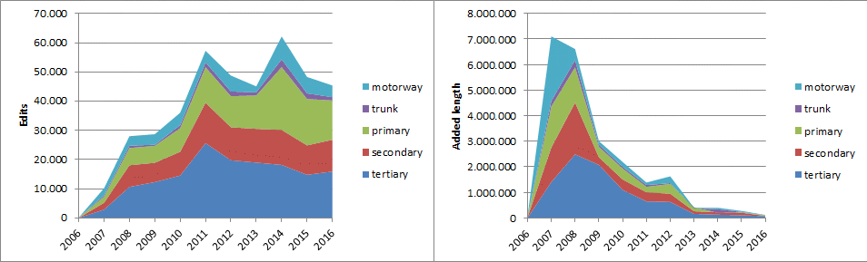
Interest doesn’t fade, it expands
Notes:
There is no problem with integrating these new models. Everything is integrated by default. This is sometimes hard for data consumers. You need to study our messy documentation to realize you need to query nodes, ways and relations, in two ways, just to get all the ATMs.
But we don’t have separate projects. While people are adding new roads, others are already adding cycleways and maxspeeds.

Slide 10
Belgian basics
Over 12.000 contributors
About 75 cummulative labour years
6.5 million edits per year
17.000 “userdays” per year
Notes:
http://www.openstreetmap.org/user/joost%20schouppe/diary
https://wiki.openstreetmap.org/wiki/Stats

Slide 14
Government VS OpenStreetMap
Fixed geography | Unlimited geography
Made for a purpose | Grows to fill the needs of those willing to invest in solutions
Fixed data model | Darwinistic data models
Authentic, authoritative | Verified in the field
Notes:
Quality assurance, not by processes but by “many eyes”, like in Wikipedia. And also by crazy mappers.
Don’t ask what OSM can do for you. Ask what OSM -could- do for you, with a little investment.

Slide 15
What OSM wants from Government
Top quality basic data, …
… that is open
  in a level playing field
  with an easy license
  with UI and machine readable interface
  with metadata!
Which we can co-create
Notes:
Privileged partnerships with Google, Waze? What?
We want you to love your data as much as we do
On metadata: describe processes, varying level of quality, common errors, …

Slide 16
What’s in it for GOV?
Quality assurance
Staying relevant
Notes:
We are a quality conscious bunch, our community is a passionate one. If you’re data needs cleaning, look no further. As we integrate, we will fix huge amounts of data.

Slide 17
On Relevancy
Music > Spotify
TV > Netflix
Tour operators > Booking
Mapping > Google Maps
Notes:
Why is Google the “common enemy”? Because of power: they own the data, control what is in it, control what you see. OSM is the last chance for government to not become Encyclopedia Brittanica
All these “cool new things” turn out to be the exploiters of the future, working below or against government
We are absurdly cost-effective

Slide 18
Relevancy in mapping
“If government mapping is supposed to be serving the public, the main goal should be how do we get our data onto those mobile devices, and into the pockets of our millions of citizens”
Notes:
Taken from http://j.mp/ccog2015

Slide 19
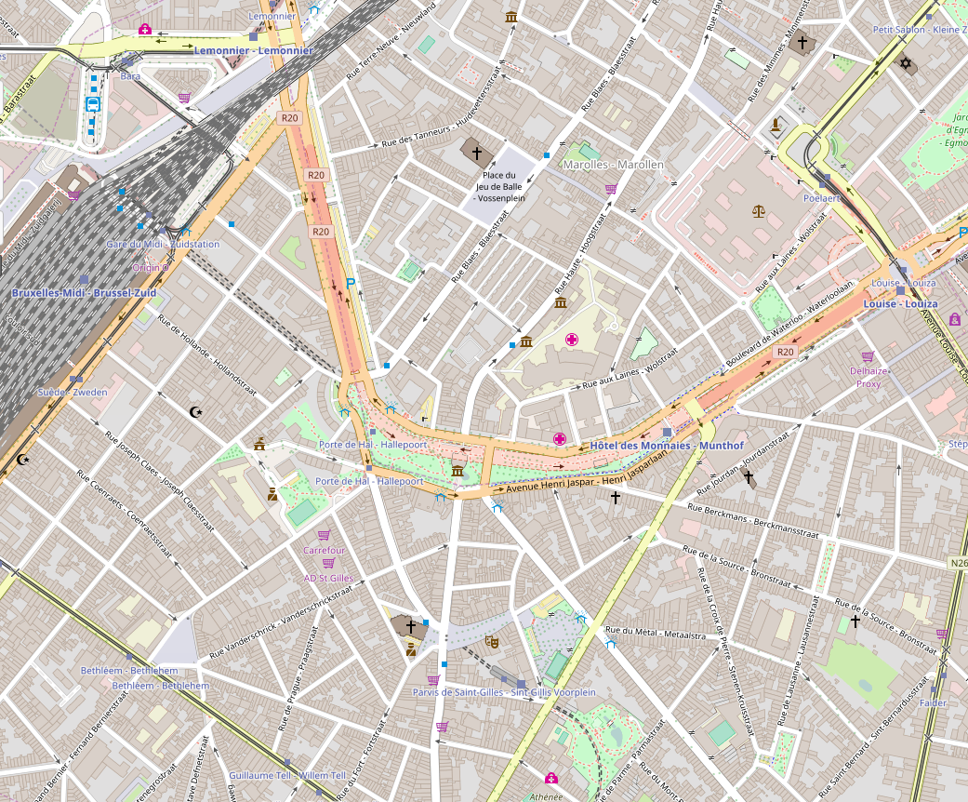
Notes:
An easy way to achieve this is, is by migrating data to OSM.
Urbis buildings were imported quite soon into OSM
They are now available in our standard map, enriched with POI info

Slide 20
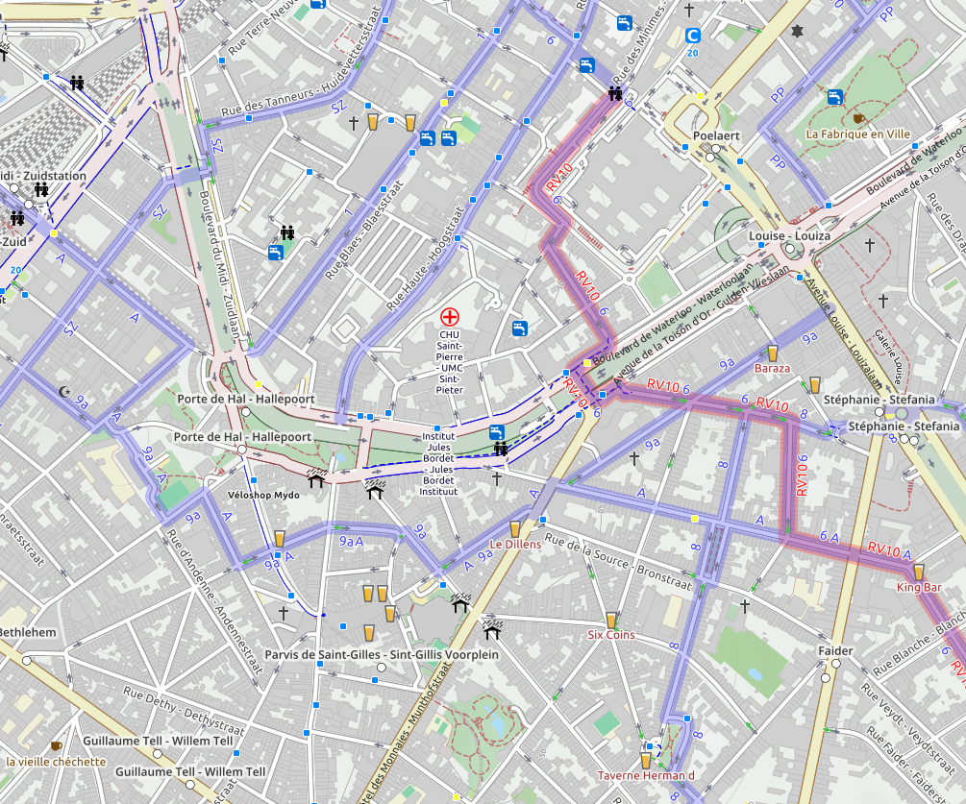
Notes:
But also in thematic maps like this cycle map
A little note on data model: OSM has no thematic layers. Everything is integrated with everything. While that sometimes means things break, more often it means that when you zoom to fix an error, you fix errors in “all thematic layers”
This “haphazard fixing”, powered by love for the data, is maybe our stronges point. Data use = data fixing. NOT a consumer product, but a product that is the most effective in turning users into producers

Slide 21
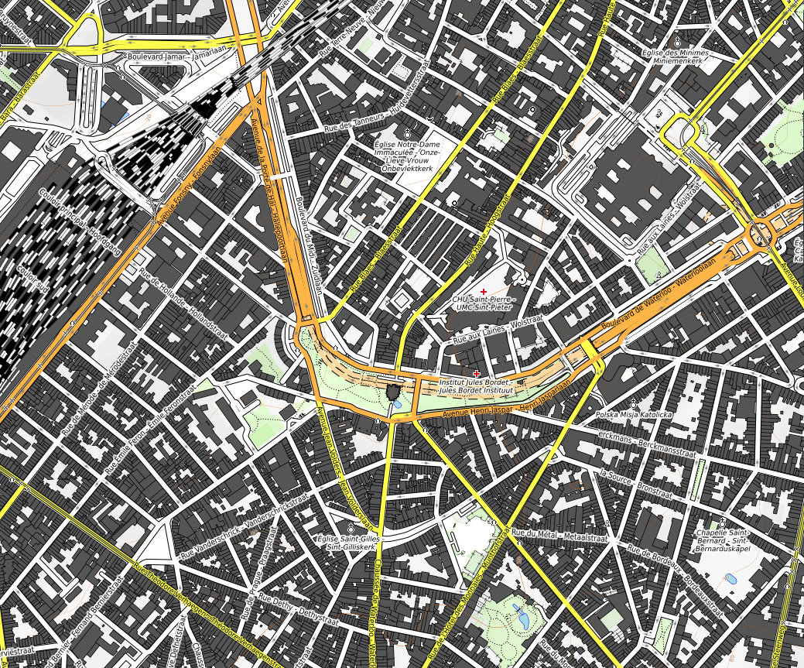
Notes:
And of course in the hundreds to thousands other maps, like topo maps with hill shades, or the basemaps provided by Mapbox to huge clients around the world

Slide 22
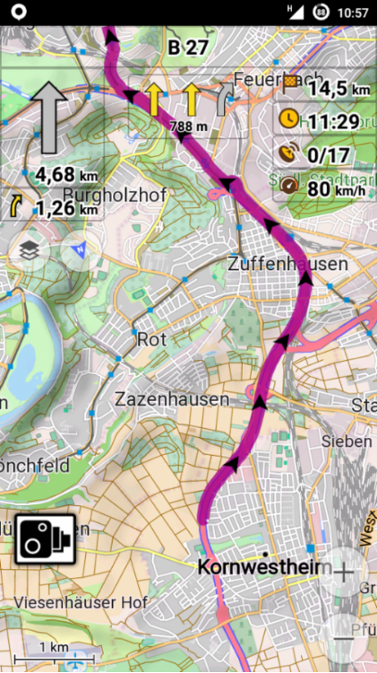
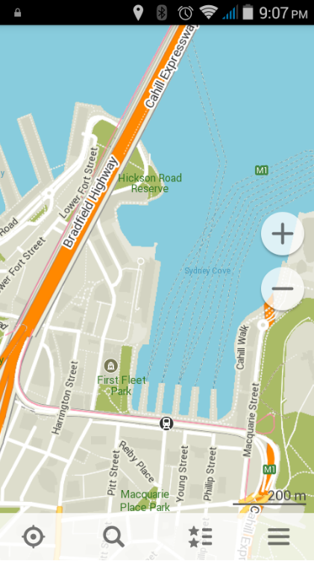
Osmand
Maps.me
Notes:
And of course to several apps for offline navigation, with literally millions of users
Go ride, go hike, tweak your maps, make your own version of the app
Oh, and contribute POIs, gps tracks, error reports

Slide 23
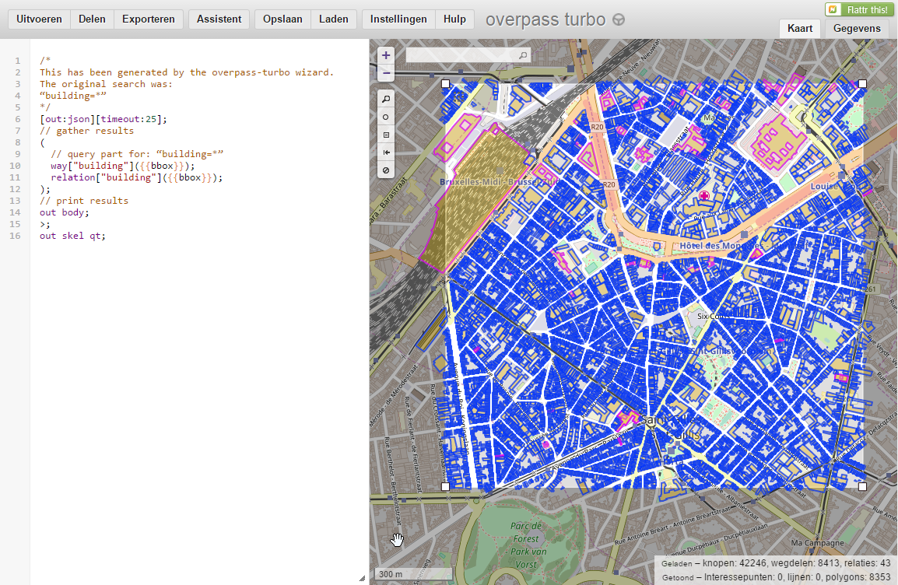
Notes:
The –enriched- data itself is readily available, within global tools with a globally usable data model
This is “linked open data”, not as a “project”, just as a thing that is there

Slide 24
Staying relevant
Offer usable services
Encourage integration into OSM
Manage your data in OSM: trade control for influence
  > join the community!

Slide 25
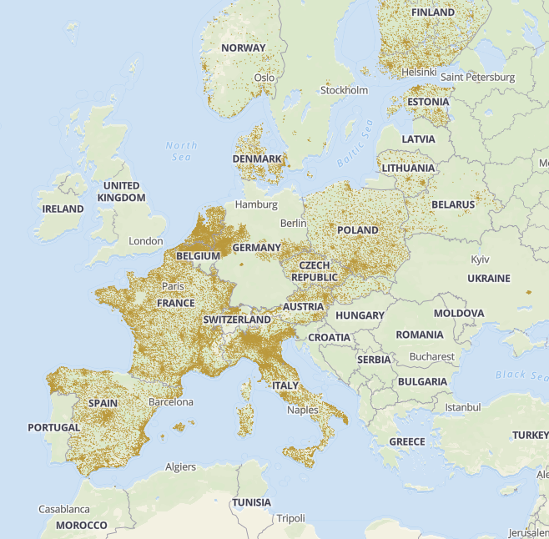
OpenAdresses.io
Notes:
OpenAdresses
The only alternative model: “linked open data”, or merged authorative datasets
Two clicks to download all the open adress data in the world (only 8 gig)
Why is this an open source community initiative?

Slide 26
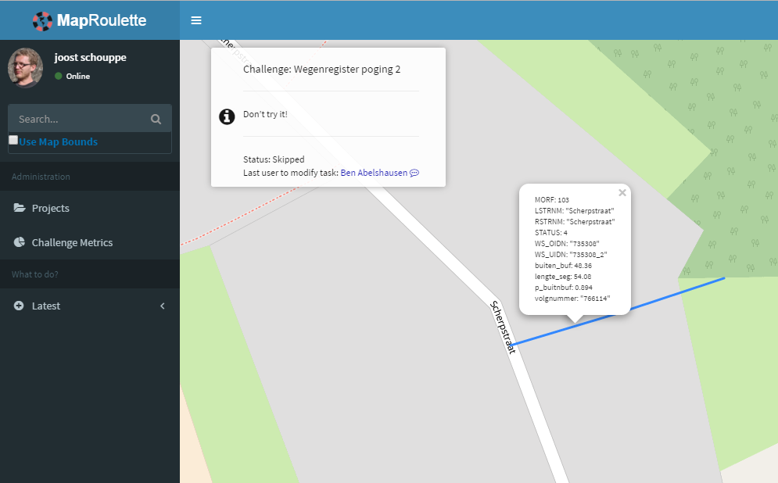
Incorporating open data into OSM
Notes:
Just an example, other workflows possible. Harder, or even easier (mapcontrib!)
Frequent geometrical comparison of open and OSM roads
Creating microtasks for easy fixes
Creating lists of segments: “validated by OSM mappers”, “invalidated by mappers”, “needs terrain visit”, “false positive”
Feedback to government + improved map > we don’t care as much about this, so this tool doesn’t really do it. But you could change that.
Most of what we do is digitized fresh
But we use open data when that makes sense
We use artificial intelligence when that makes sense

Slide 27
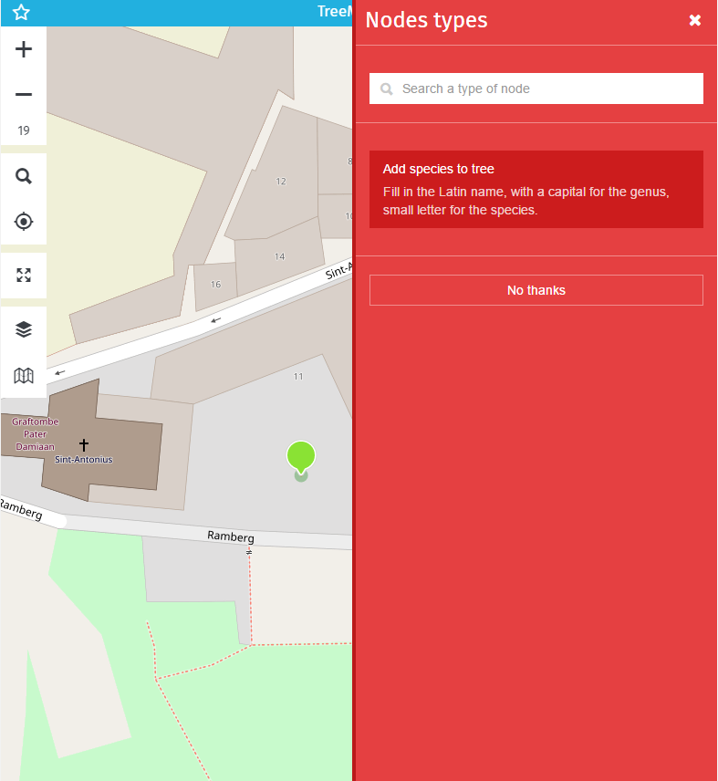
Integrating & enriching
https://www.mapcontrib.xyz/t/224865-TreeMapper
Notes:
Example made in five minutes

Slide 28
Encouraging integration?
Build personal contacts with your local community
Don’t just dump or take data:
  Organize or support mapping party/mapathon
  Support tool development
Notes:
We’re talking about minimal investments here. It is easy to focus attention to a subject. A little harder to maintain focus ☺
Tools are made from a mapper’s perspective, not a gov perspective

Slide 29
Do you really need private data?
Essential tasks
Control is paramount
Tools available
Money is available
Privacy issues

Slide 30
Or could you manage it within OSM?
Non-essential tasks
Use cases and scope unknowable or unaffordable
Take advantage of open source ecosystem
Disfunctional processes
Notes:
Do you really need to know where your cycle lanes are, if you already know where the traffic signs are?
Example of taking advantage of OS: current and future routing
When evaluating OSM: consider time dimension!

Slide 31
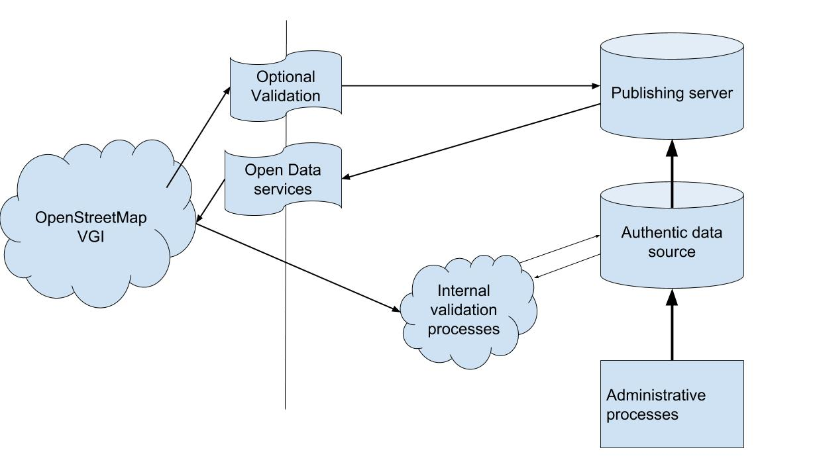
Incorporating VGI into gov processes,
the Antwerp model
Notes:
Already, at certain government levels, OSM is becoming a standard data source. This schema is a generalization of what is already happening in the City of Antwerp.
Note on quality:
network completeness check for “real roads”: similar amount of errors on both sides of the devide

Slide 32
Stepping it up
Only control what you need to control > migrate to OSM
Harness crowdsourcing for data quality >
become OSM
Validate OSM and call the copy authoritative

Slide 33
How to start
Read some use cases, understand legal stuff: OpenStreetMap_for_Government
Use the map! Improve the map!
Contact talk mailing list
Find your local community
Notes:
Open methods: do we need Flemish Google Streetview? And if we do, why not make it Open Flemish Streetview?

Slide 34
In the age of big data?
We still need human eyes
An algorithm-empowered human is more powerfull than an algorithm

Slide 35
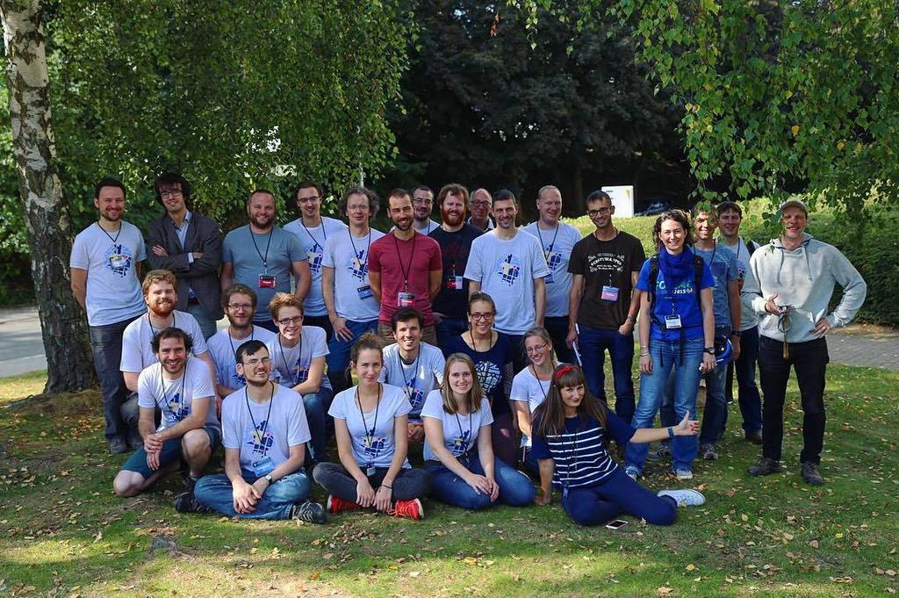
Belgian community
@osm_be
www.osm.be
maptime.io/belgium/
community@osm.be

