Slide 1
Crowdsourcing in National Mapping
Academic Research Viewpoint
Vyron Antoniou
Hellenic Military Geographical Service, Greece

Slide 2
Overview
Volunteers
Uses
Participation
Gamification
Quality Measures
Quality Indicators
Protocols
Specifications
Tools
Introduction
VGI
+
Future of VGI

Slide 3
Introduction: Research
Understand
Future
Explore
Impact
Benefits
Caveats

Slide 4
Introduction: Points to Consider
Volunteered Geographic Information. Fundamentally different production mechanisms
Sources. Online gazetteers, GPS tracks, geo-tagged photos, synchronous micro-blogging, social networking sites, blogs, gaming spaces, sensor measurements, complete topographic maps….
Characteristics: No/Low Cost, timely data, local knowledge, extended field of scope….
Academia: Few VGI sources as proxies for the entire phenomenon (e.g. OSM, Flickr)
Volunteered Geographic Information. Disruptive innovation?

Slide 5
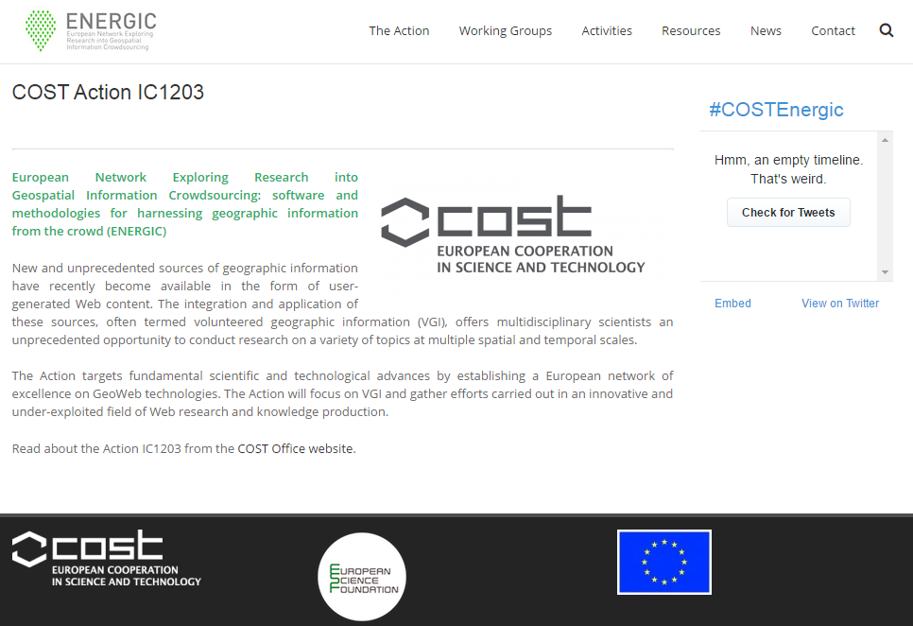
Introduction: EU Support
Part I: Theoretical and social aspects
Part II: Quality: Criteria and methodologies
Part III: Data analytics
Part IV: VGI and crowdsourcing in environmental monitoring
Part V: VGI in mobility
Part VI: VGI in spatial planning

Slide 6
VGI and Volunteers
Who are the volunteers?
What is their background?
What can they offer?
What motivates them?
Which mode of engagement?
What drives them away?
How can they become more active?
Typology of participation?

Slide 7
VGI and its Uses
VGI in Land Use / Land Cover mapping

Slide 8
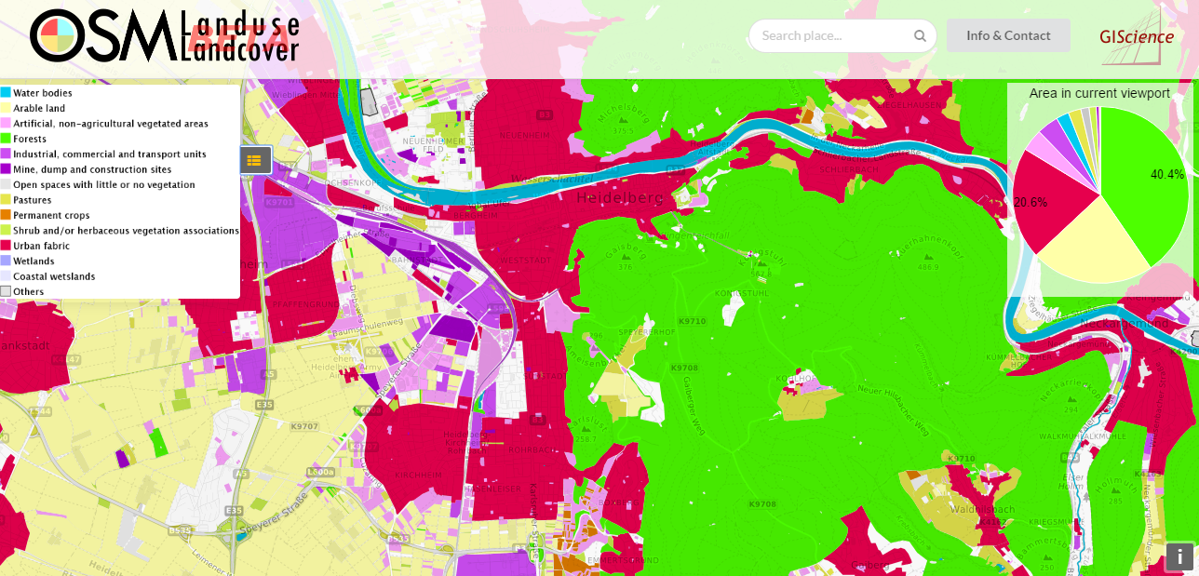
VGI and its Uses
VGI in Land Use / Land Cover mapping

Slide 9
VGI and its Uses
VGI in Cadastre

Slide 10
VGI and its Uses
VGI in Government
Source: Haklay et al. 2014

Slide 11
VGI and Participation
Coordination: The need for high volumes of data in large temporal and spatial scales makes co-ordination and supervision a challenging task.
Engagement: Devise a strategy on how to effectively engage volunteers.
Spatial Biases: Spatial biases are common since high populated and touristic areas is expected to attract participants while more obscure and hard to reach areas will be under-represented in the data collection phase
Temporal Biases: Working hours and days is less likely to attract participation compared to after-work hours, weekends and holidays, especially when the project needs in-situ data gathering.
Social Biases: A project needs lasting public engagement which will not be prone to biases (for example due to race, gender, socioeconomic status or other factors).
Economic Biases: Educational and technical skills needed, the access to resources and the free time correlate with individuals that live in advanced economies.

Slide 12
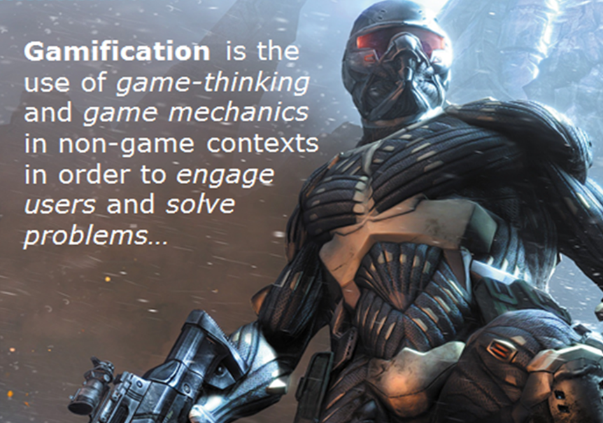
VGI and Gamification
Source: https://allthingslearning.wordpress.com

Slide 13
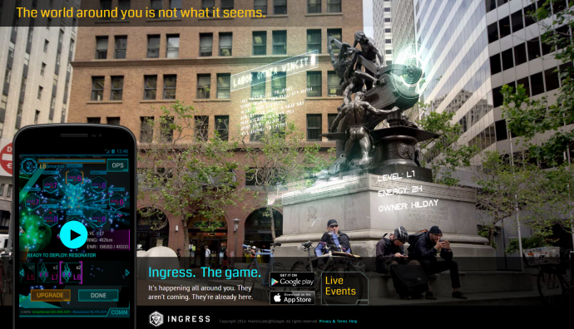
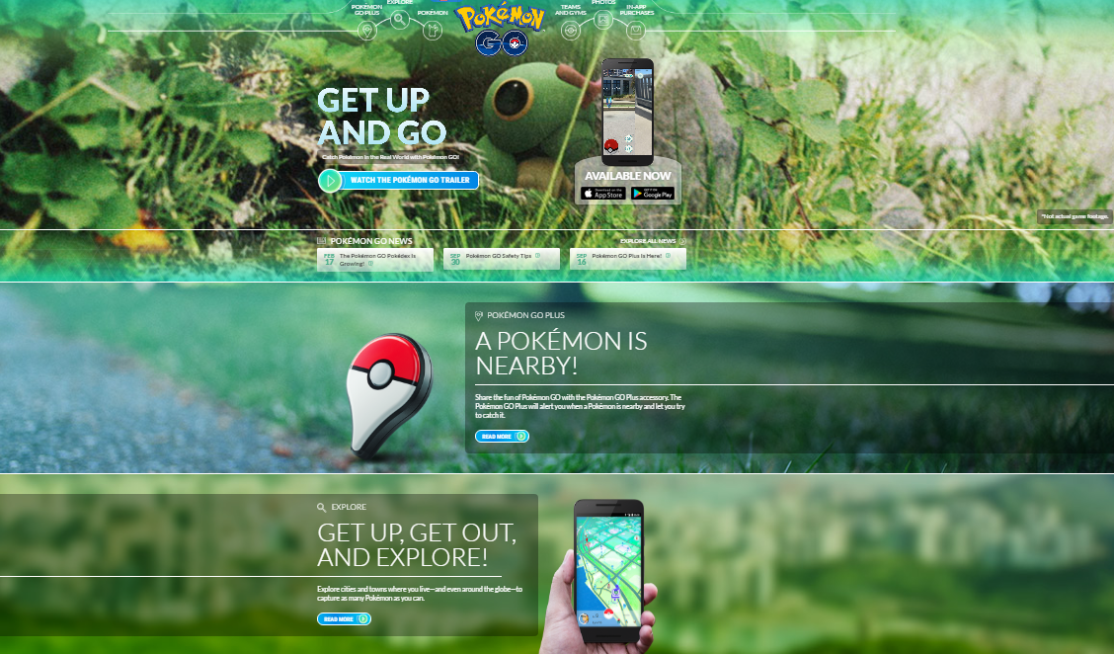
VGI and Gamification
Source: Google.com

Slide 14
VGI and Gamification
Places in the geographic environment act as resources that the mechanics of the geogame allocates to the players according to a variety of rule sets.
What kind of game? ….. Search games, Capture-the-flag games, Spatial allocation games
What kind of geography? ….. Bounded game field, Without spatial restrictions
What about time? ….. Last for a limited playing time, Go on without end (pervasive play)
Allocation Mechanisms? ….. Exclusive, Inclusive, Multiple
De-allocation Mechanisms? ….. Never, When-reclaimed, Decay time
Place-to-player ratio?
Place Allocation and Game flow?
The problem of accumulated advantage?

Slide 15
VGI and Quality Measures
ISO: Principles and Guidelines. Reference Datasets.
Fundamental Assumption: Authoritative data are of higher quality than VGI
ISO Quality Elements:
Completeness
Logical Consistency
Thematic Accuracy
Positional Accuracy
Temporal Accuracy
Usability

Slide 16
VGI and Quality Measures
Completeness
Grid-based length
Number of features
Total length
Total area covered
Completeness Index
Logical Consistency
Intra-theme consistency
Inter-theme consistency
Hierarchical ordering
Outliers spotting
Topological consistency
Semantic similarity
Inappropriate Classification
Thematic Accuracy
% of correct classification
% of the existence of specific values
Levenstein Distance
Number of features with specific attributes
Hierarchical ordering
Confusion Matrix
Kappa Index Analysis
Refers to the presence of data that fall out of the scope of the universe of discourse and thus there are errors of commission and to the absence of data that fall within the scope of the universe of discourse and thus there are errors of omission.
Refers to the accuracy of the attributes recorded for each captured feature with the exception of the positional and temporal attributes.
Refers to the degree of the dataset’s adherence to the logical rules (conceptual, domain, format and topological consistency) provided by the product’s specification.

Slide 17
VGI and Quality Measures
Positional Accuracy
Buffer-Zone Analysis
Distance between corresponding intersections
Euclidean distance
Hausdorff distance
Surface distance, granularity and compactness
Shape similarity
Grid-based minimum Bbox
Number of vertices
Distance between polygons centroids
Temporal Accuracy
Feature evolution in time
Time between creation and upload (geo-tagged images)
Refers to the accuracy of the temporal attributes and temporal relationships of the captured features.
Refers to the geometric accuracy (absolute, relative or gridded accuracy) of the position of the captured features.

Slide 18
VGI and Quality Indicators
Authoritative data: Limited data availability, licensing restrictions, high procurement costs.
Purpose: VGI is considered either as a replacement of authoritative data or as a way to enrich them, the use of authoritative data for the evaluation process does not make much sense other than research purposes.
Fundamental Assumption: Authoritative data are of higher quality than VGI
Is it???

Slide 19
VGI and Quality Indicators
Data
Feature-level geometry (length, point density)
Feature-level attributes (num. of versions, stability against changes, corrections and rollbacks)
Feature provenance
Frameworks (e.g iOSM Analyzer).
Demographics
As VGI is user generated content, many researchers have supported that a correlation between data quality and demographic data might exist. Correlation between demographics of an area and:
Completeness
Positional Accuracy
Number of contributors

Slide 20
VGI and Quality Indicators
Socio-Economics
The grassroots engineering and the bottom-up conceptualization of VGI turned the focus of the research in socio-economic factors as it has been presumed that they might influence the overall quality.
Correlation between:
Social Deprivation - Completeness
Social Deprivation - Positional accuracy.
High Income - Higher number of contributions
Contributors
The understanding of the motivation drivers can give a better insight into user generated data.
History and Profiling of contributors
Experience, recognition and local knowledge
Number of “collaborating” contributors
Contributors’ evaluation model

Slide 21
VGI and Protocols

Slide 22
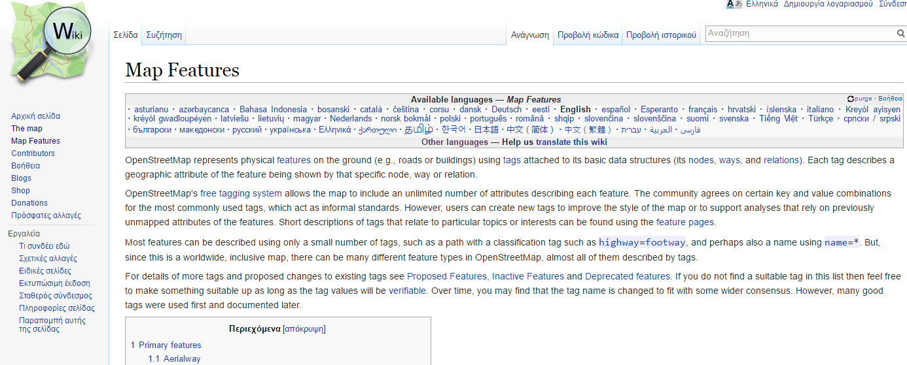
VGI and Specifications
Source: Openstreetmap.org

Slide 23
VGI and Specifications
Changes in the “Vertical” Dimension for OSM
Source: Antoniou, V., & Skopeliti, V., 2017 (in print). The impact of the contribution micro-environment on data quality: the case of OSM

Slide 24
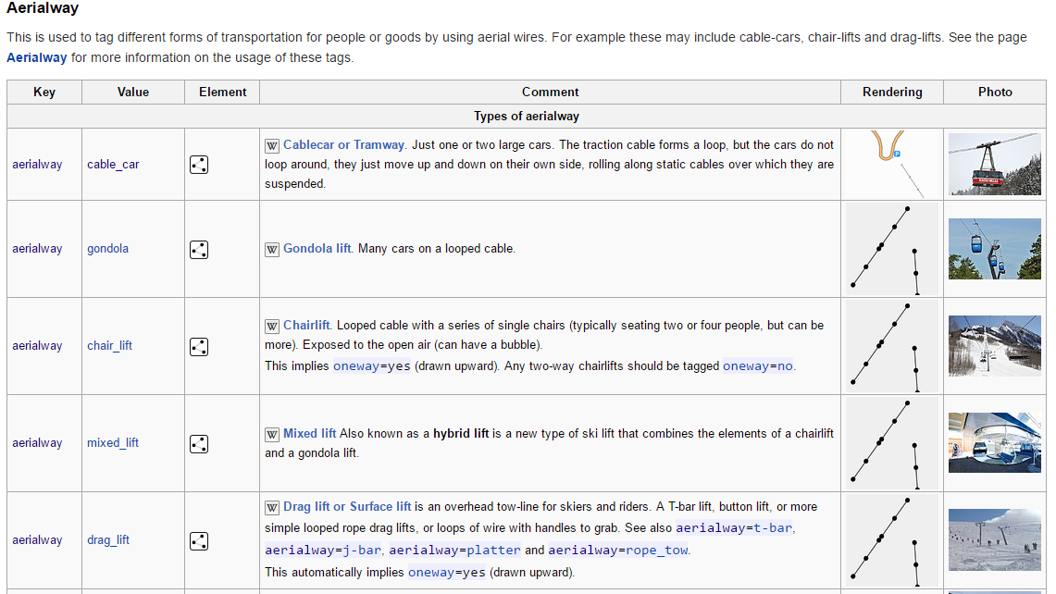
VGI and Specifications
Changes in the “Horizontal” Dimension for OSM
End of 2006
End of 2015
Source: Openstreetmap.org

Slide 25
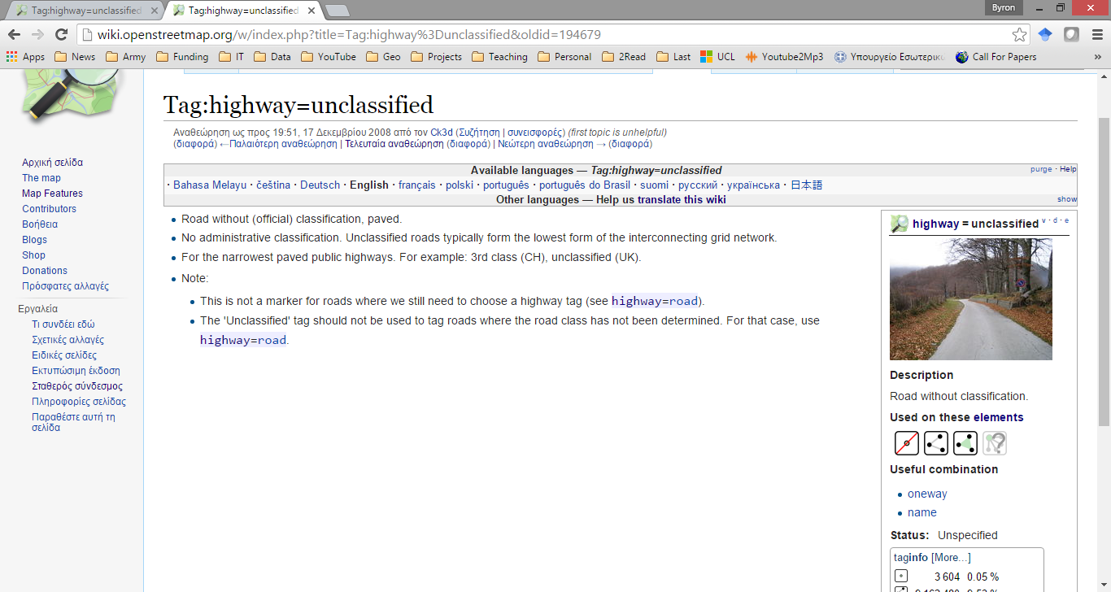
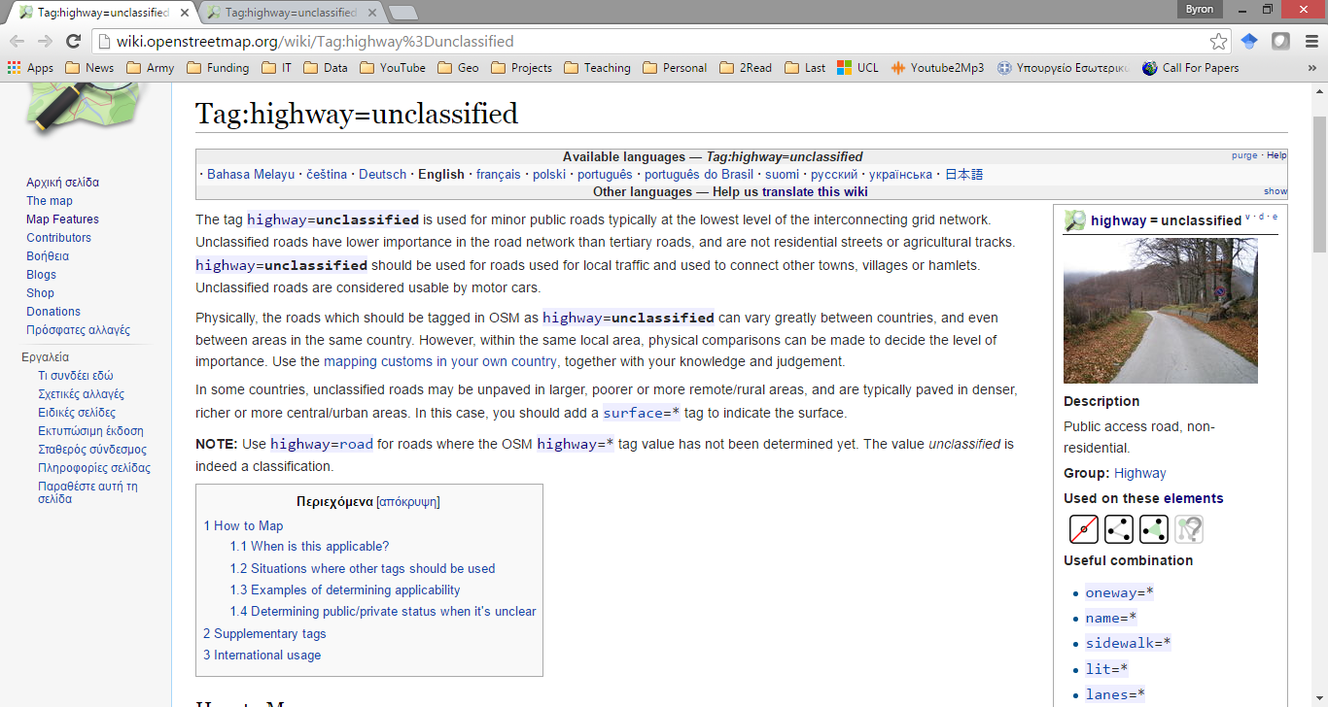
VGI and Specifications
Changes in the “in-depth” Dimension for OSM
End of 2008
End of 2015
Source: Openstreetmap.org

Slide 26
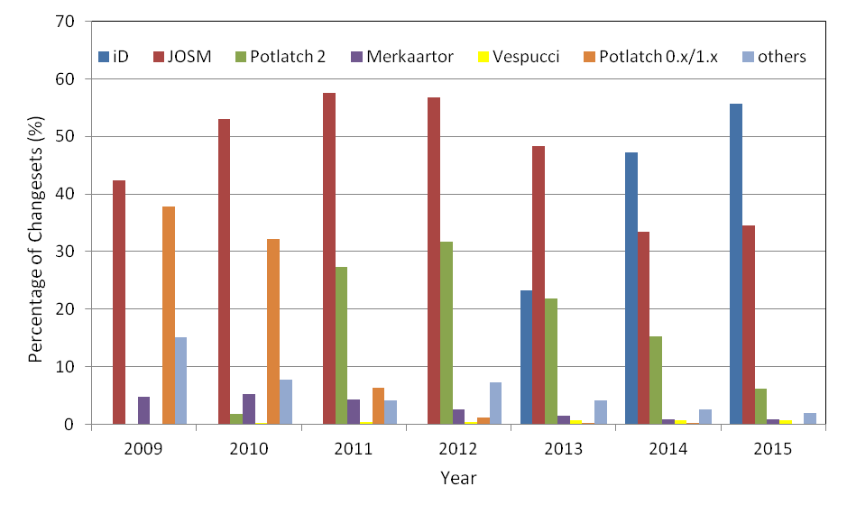
VGI and Tools
Source: Antoniou, V., & Skopeliti, V., 2017 (in print). The impact of the contribution micro-environment on data quality: the case of OSM

Slide 27
Future of VGI
Source: microsoft.com
Source: opendronemap.org

Slide 28
Future of VGI
What if:
“… consider location and spatial information as common goods…”
(Roche et al., 2014)

Slide 29
Crowdsourcing in National Mapping
Academic Research Viewpoint
Vyron Antoniou
Hellenic Military Geographical Service, Greece

