Slide 1
Bringing the local knowledge to the maps
Collecting VGI for national topographic database
Mari Laakso
Finnish Geospatial Research Institute, National Land Survey of Finland
3.4.2017 EuroSDR workshop, Crowdsourcing in National Mapping 2017

Slide 2
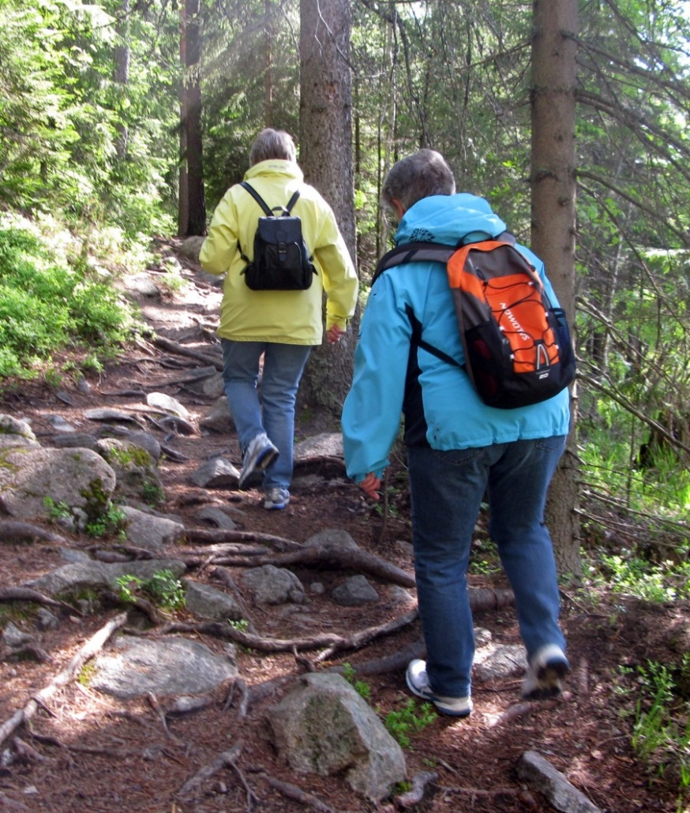
Identified pros of VGI
People who
have the need for reliable topographic maps and
are willing to collect and share data
are able to participate.
For certain features only possible way of mapping (paths and trails).
Enable up-to-date information
Contributions visible without delays.
Communication of changing conditions.
Notes:
Geographic information collected voluntarily by citizens
The aim is to get more than a traditional feedback system.
Traditional feedback system with position in map and free text to describe the issue. Several hundreds per year.
Most reports from feedback system are useful and produce changes to the data.
Other users don’t see feedbacks.

Slide 3
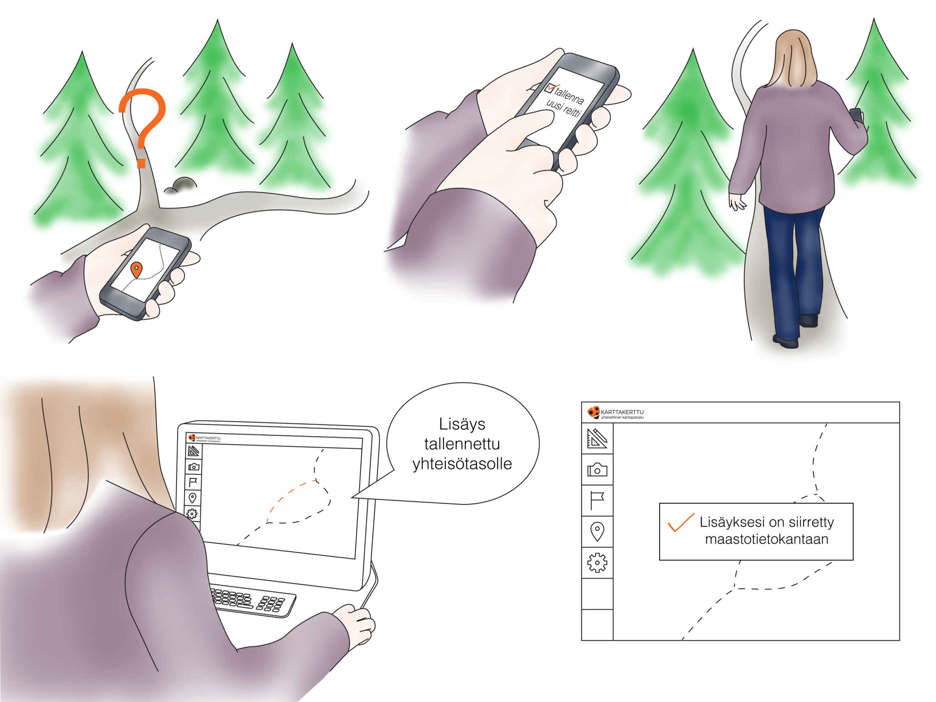

Slide 4
A VGI map service to pilot crowdsourcing for national topographic database
Focus on outdoor features ( paths, trails, crossing points etc.)
New features enabled.
Also possible to report errors.

Slide 5
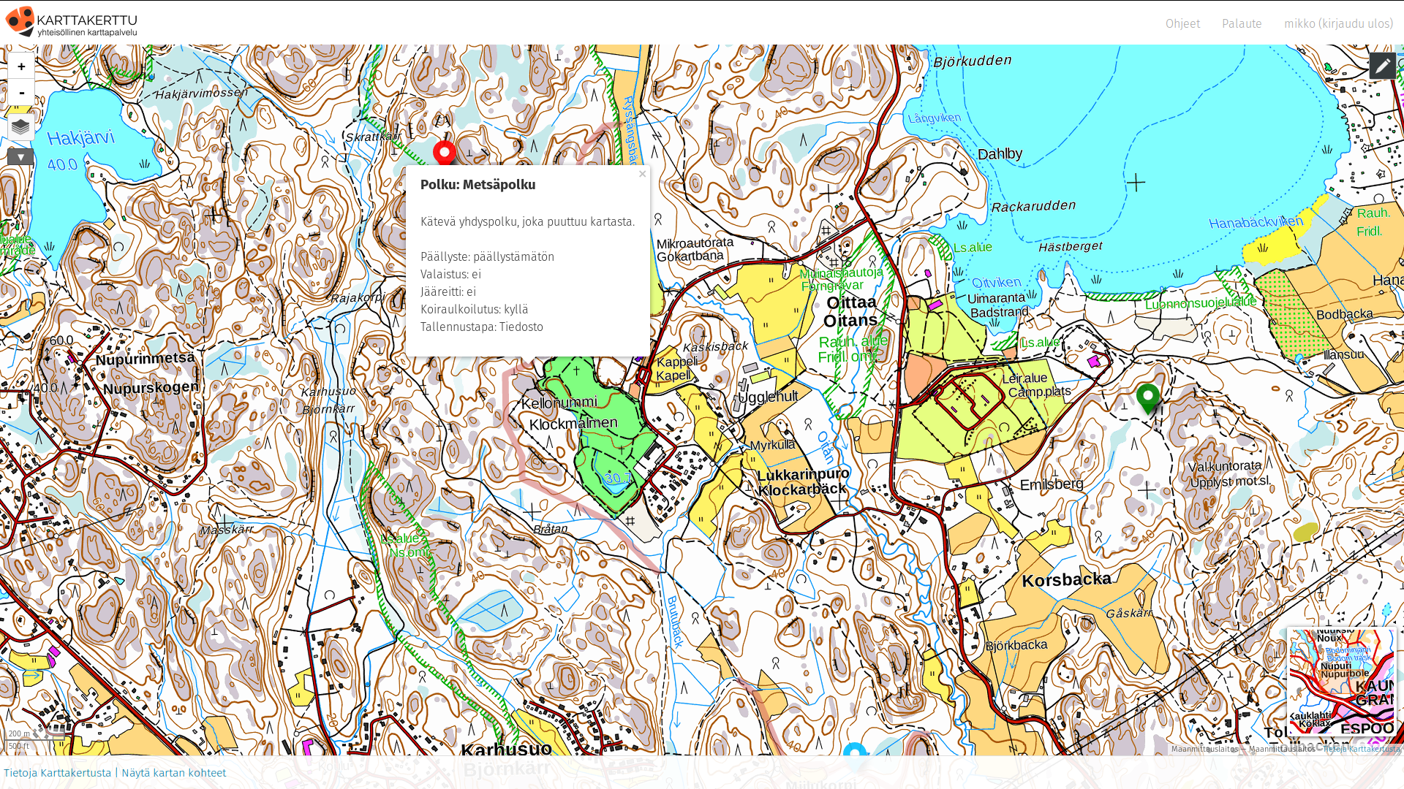

Slide 6
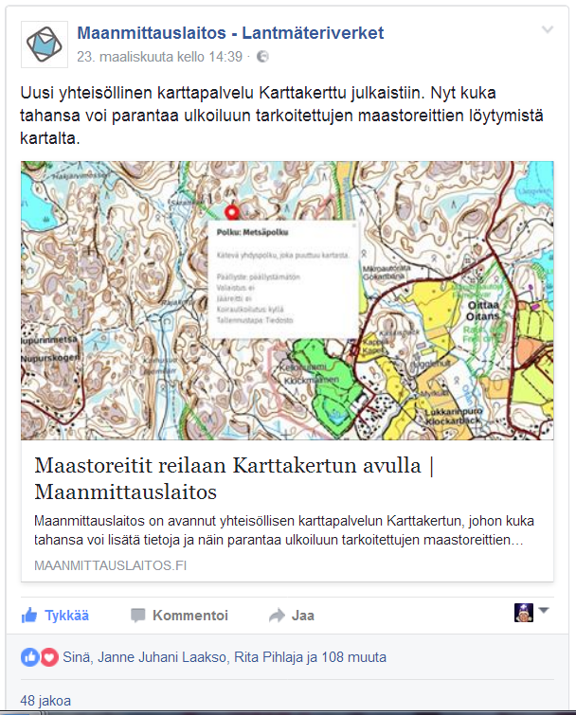
The service was published 23.3.2017
  130 registered users in one week.
  340 data features created.
Positive feedback.

Slide 7
More information
Karttakerttu.fi
www.nls.fi

