Slide 1

Linking VGI
for
Place-Based Map Generalization
Link-VGI Workshop
19th AGILE International Conference on Geographic Information Science
Helsinki, Finland
June 2016
Azam Raha Bahrehdar
Ross S. Purves

Slide 2
51°30′31″N 0°09′49″W

Slide 3
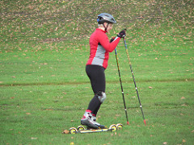
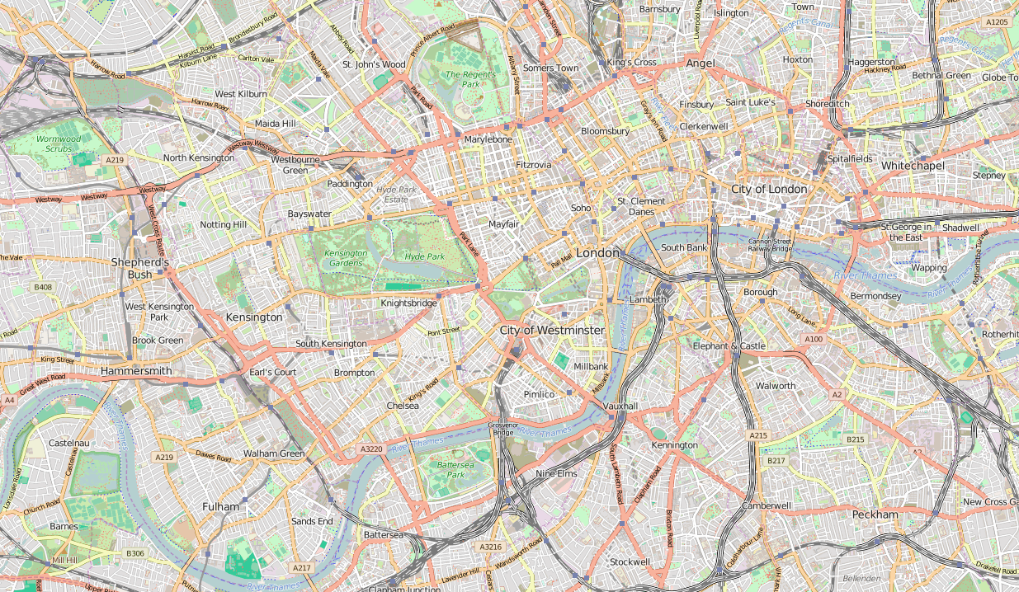
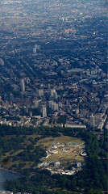
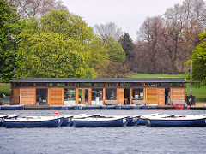
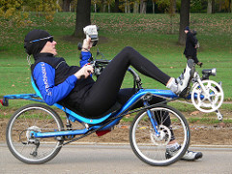
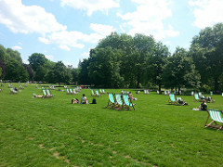
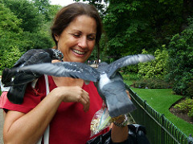
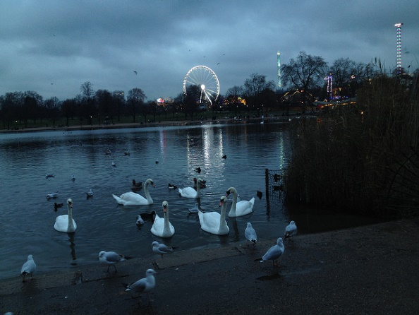
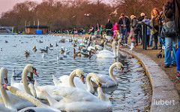
Hyde Park
Sense of Place
51°30′31″N 0°09′49″W
Locale
51°30′31″N 0°09′49″W
https://openstreetmap.org
2
(Relph, 1976; Agnew,1987; Cresswell, 2004)

Slide 4
What can we extract from VGI data sources?

Slide 5
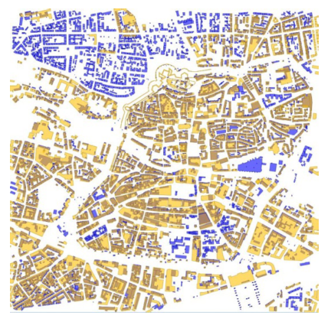
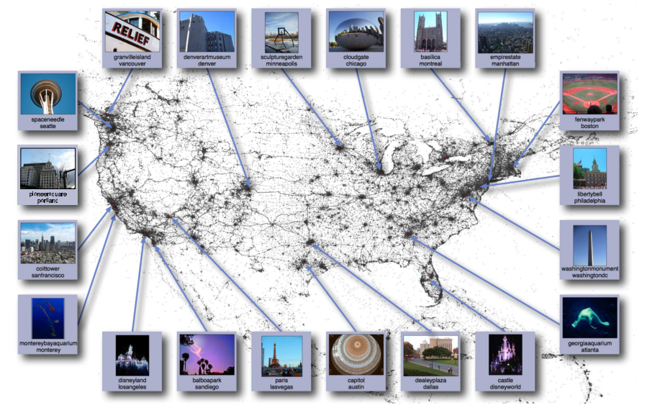
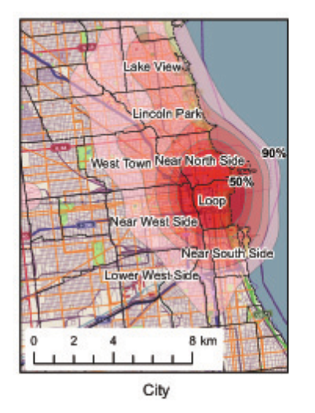

Richness of VGI data sources
Introduction | State of the art | Research Questions | Methods | Result | Conclusion & Future Work
Where are the top photographed landmarks?(Crandall & Backstorm, 2009)
Where is the city center? (Hollenstein & Purves, 2010)
“Nice places” will be covered by VGI (Haklay, 2009)
Generating landmarks for navigation (Nuhn &Reindhrdt, 2012)
Biases & distribution of data (Hollenstein & Purves, 2010; Purves & Edwardes, 2011)
3
University of
Zurich
|Link-VGI Workshop, Helsinki, 2016

Slide 6
How can we visualize this detailed information?

Slide 7
Generalising operations adapted to semantic and geometry
Introduction | State of the art | Research Questions | Methods | Result | Conclusion & Future Work
What is being displayed? (semantic)
(McMaster & Shea, 1992; Weibel & Dutton, 1999)
What level of geometric abstraction is appropriate? (geometric)
4
University of
Zurich
|Link-VGI Workshop, Helsinki, 2016
Notes:
In map generalization several very useful taxonomies of operators and conceptual models of the process have been developed which emphasise the importance of map purpose [12], [13]. Map purpose in turn implies that map semantics (i.e. what is being displayed) are central to the generalization process –
however, much research has focused on geometric transformations for specific feature classes (i.e. the simplification of mountain roads while retaining essential features).

Slide 8
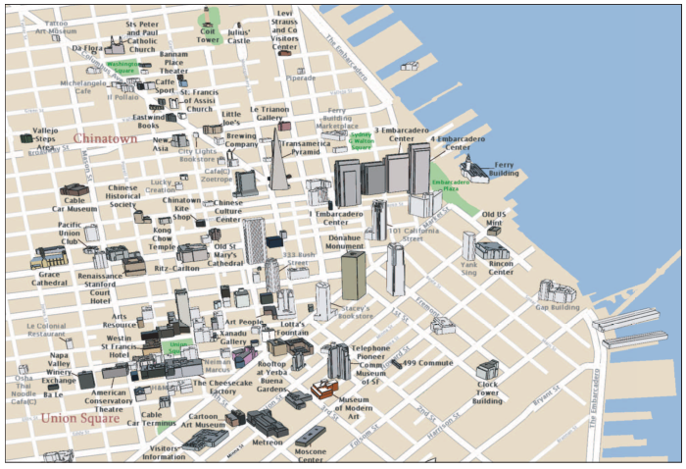
Little research
Introduction | State of the art | Research Questions | Methods | Result | Conclusion & Future Work
  computer graphics on the automatic generation of tourist maps
  (Grabler et al., 2008)
4
5
University of
Zurich
|Link-VGI Workshop, Helsinki, 2016
Notes:
In addition we use cartographic generalization techniques to reduce the complexity of the map. This digital map does not modify the building footprints

Slide 9
What is missing?
Introduction | State of the art | Research Questions | Methods | Result | Conclusion & Future Work
automatic production of place-based map
by using platial information in VGI
4
4
University of
Zurich
|Link-VGI Workshop, Helsinki, 2016
Notes:
In addition we use cartographic generalization techniques to reduce the complexity of the map. This digital map does not modify the building footprints

Slide 10
Introduction | State of the art | Research Questions | Methods | Result | Conclusion & Future Work
Research Questions
RQ1. What forms of information can be extracted from VGI which can be exploited in the generalization process?
RQ2. How can information extracted from VGI in one form be linked to VGI in a second form?
RQ3. How can the information which has been extracted and linked be used explicitly in the generalization process?
6
University of
Zurich
|Link-VGI Workshop, Helsinki, 2016
Notes:
Reform the second RQ

Slide 11
Introduction | State of the art | Research Questions | Methods | Result | Conclusion & Future Work
RQ1. What forms of information can be extracted from VGI which can be exploited in the generalization process?
Agnew Model
Location
Locale
Sense of Place
semantic
(Agnew, 1987)
Element
Qualities
Activities
  (Tversky et al., 1983; Purves et al., 2011)
Extraction framework
7
University of
Zurich
|Link-VGI Workshop, Helsinki, 2016
9
University of
Zurich
|Link-VGI Workshop, Helsinki, 2016

Slide 12
Introduction | State of the art | Research Questions | Methods | Result | Conclusion & Future Work
RQ2. How can information extracted from VGI in one form be linked to VGI in a second form?
Link
Remove Biases
Viewshed analysis
(Senarante et al., 2013; Fisher, 1996)
Levenshtein distance
(Levenshtein , 1966)
Regular expression
Tag profile
(Hollenstein & Purves, 2010)
8
University of
Zurich
|Link-VGI Workshop, Helsinki, 2016
9
University of
Zurich
|Link-VGI Workshop, Helsinki, 2016
Notes:
our focus is on the development of approaches for the generalization of OSM based on platial information, that is to say, methods “characterized by place names and descriptions as well as semantic relationships between places” [10]. To our knowledge, little or no research has been carried out on the automatic production of place-based maps, perhaps with the exception of ideas developed in computer graphics on the automatic generation of tourist maps [11].
We believe that VGI offers a potentially very rich source of semantic information which, by linking descriptions to existing geometries, can provide us with a novel way of steering the map generalization process holistically which go beyond the semantics captured in top-down, administratively generated, topographic data. However, in this paper we focus our attention on a preliminary study of the use of VGI in individual generalization operators

Slide 13
Introduction | State of the art | Research Questions | Methods | Result | Conclusion & Future Work
Taxonomy of generalisation
(Weibel & Dutton, 1999)
RQ3. How can the information which
has been extracted and linked be used
explicitly in the generalization process?
Traditional operators | Digital operators
Classification | thematic selection
 | thematic aggregation
Simplification | weeding (line)
 | unrestricted simplification
Collapse | collapse
Enhancement | enlargement
Select/ Elimination | select/ elimination
Aggregation | fusion
 | combine
9
University of
Zurich
|Link-VGI Workshop, Helsinki, 2016
9
University of
Zurich
|Link-VGI Workshop, Helsinki, 2016
Notes:
our focus is on the development of approaches for the generalization of OSM based on platial information, that is to say, methods “characterized by place names and descriptions as well as semantic relationships between places” [10]. To our knowledge, little or no research has been carried out on the automatic production of place-based maps, perhaps with the exception of ideas developed in computer graphics on the automatic generation of tourist maps [11].
We believe that VGI offers a potentially very rich source of semantic information which, by linking descriptions to existing geometries, can provide us with a novel way of steering the map generalization process holistically which go beyond the semantics captured in top-down, administratively generated, topographic data. However, in this paper we focus our attention on a preliminary study of the use of VGI in individual generalization operators

Slide 14
How do the methods work?

Slide 15
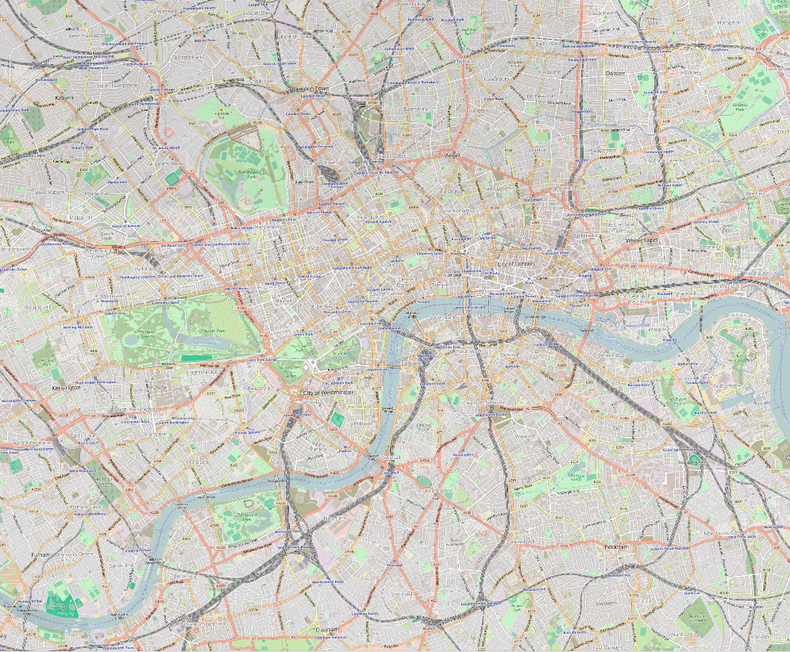
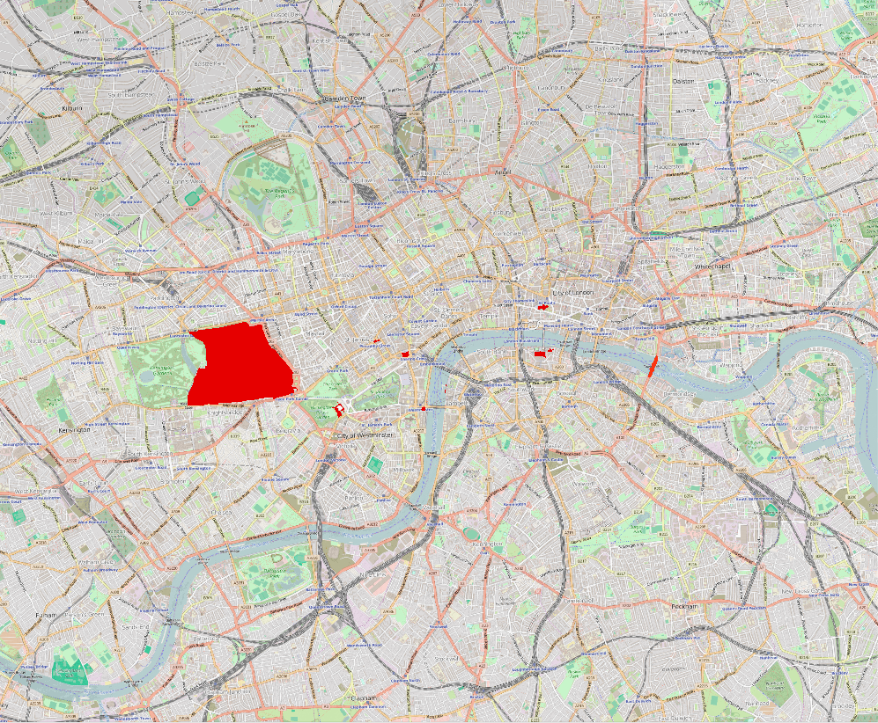
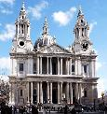
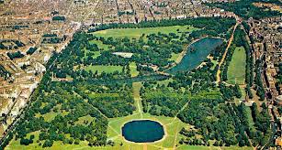
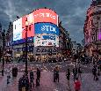
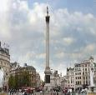
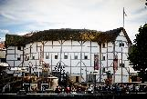


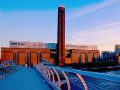
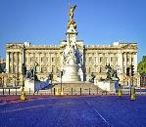
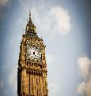
Introduction | State of the art | Research Questions | Methods | Result | Conclusion & Future Work
Ten popular places in London
Greater London
s=51.4629 w=-0.1988 n=51.5534 e= -0.0227
top photographed landmarks on Earth (Crandall et al., 2009)
Trafalgar Square, Tate Modern,
Big Ben, and London Eye
top photographed landmarks in London
(Crandall et al., 2009)
Piccadilly Circus, Buckingham Palace,
and Tower Bridge
dominant tourist attractions in London
(Crandall et al., 2009)
St. Paul’s Cathedral, Shakespeare Globe,
and Hyde Park
10
University of
Zurich
|Link-VGI Workshop, Helsinki, 2016

Slide 16
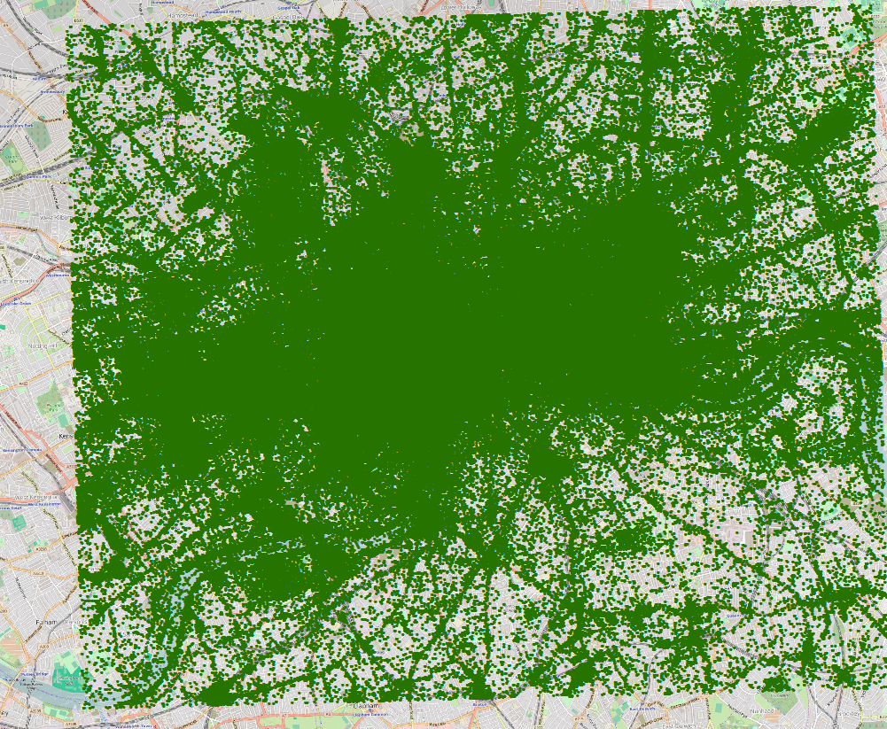
Introduction | State of the art | Research Questions | Methods | Result | Conclusion & Future Work
Greater London
s=51.4629 w=-0.1988 n=51.5534 e= -0.0227
geometry of 10 places
Open Street Map
2D geometric footprints
place names
images within the study area
Flickr
~ three million images by 49,000 users
id, owner, tags, descriptions, position, accuracy, taken, and posted time
11
University of
Zurich
|Link-VGI Workshop, Helsinki, 2016

Slide 17
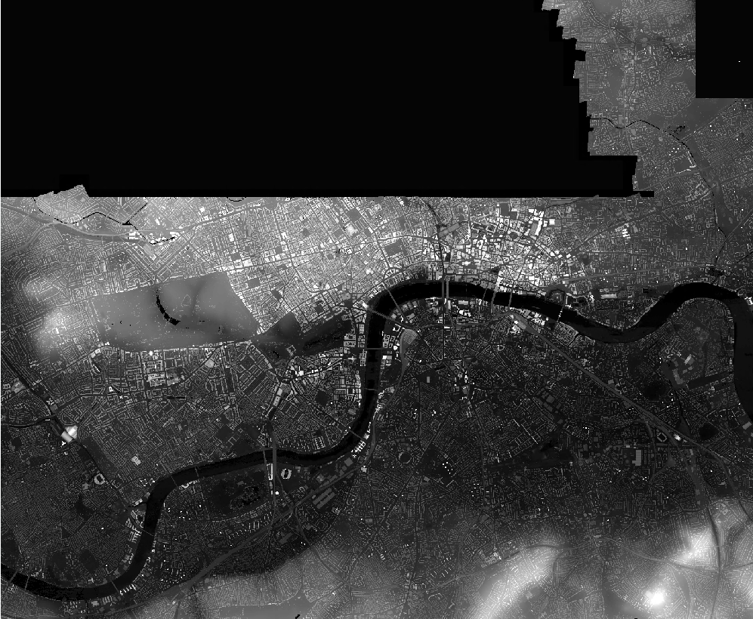
Introduction | State of the art | Research Questions | Methods | Result | Conclusion & Future Work
Link geometry to images
Open Street Map
2D geometric footprints
place names
Digital Surface Model
1 meter resolution
Flickr
~ three million images by 49,000 users
id, owner, tags, descriptions, position, accuracy, taken, and posted time
12
University of
Zurich
|Link-VGI Workshop, Helsinki, 2016

Slide 18
From where can people take photos of a place?

Slide 19
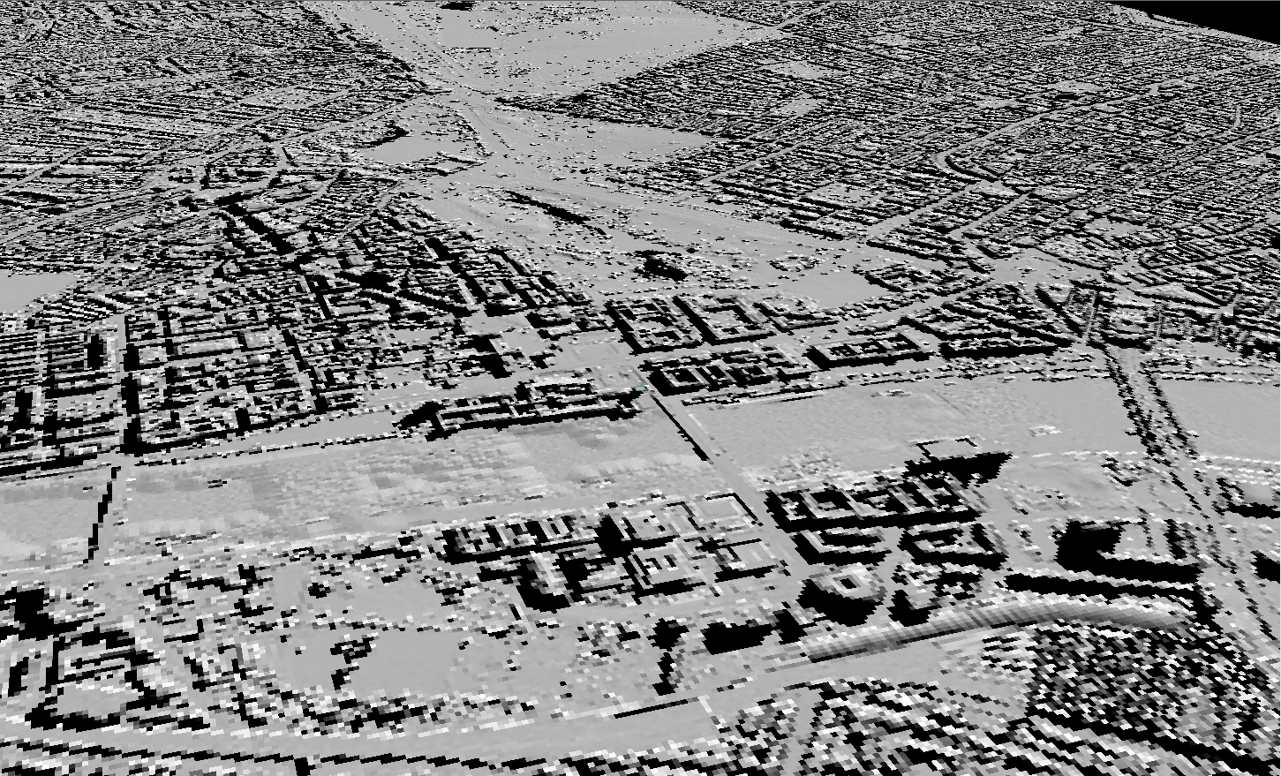
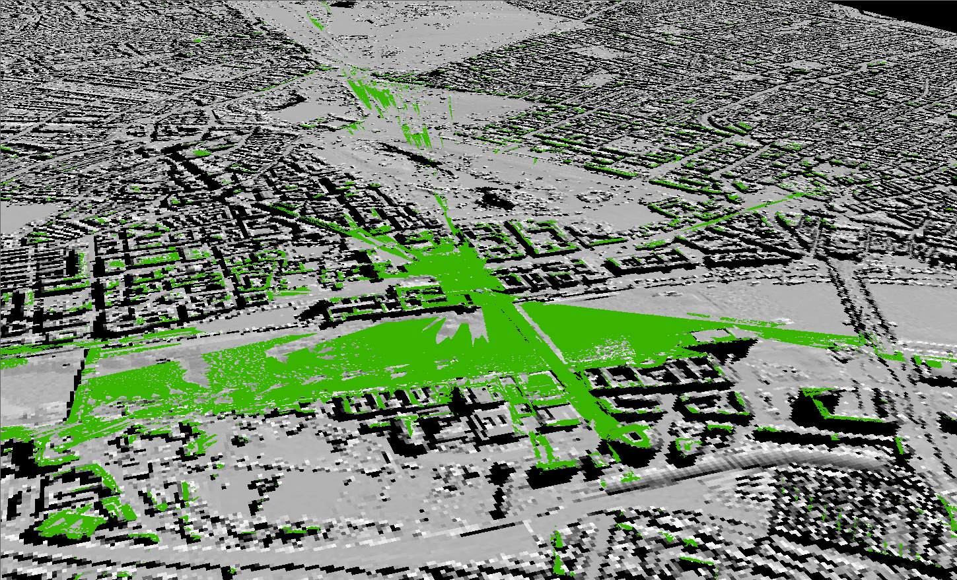
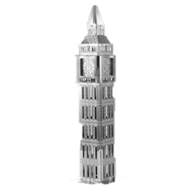
Introduction | State of the art | Research Questions | Methods | Result | Conclusion & Future Work
Viewshed analysis
DSM (Digital Surface Model)
elevation of the surface
OpenStreetMap
2D geometry of the place
Visible area:
an area that can be seen from the place or
either place can be seen from that area
University of
Zurich
|Link-VGI Workshop, Helsinki, 2016
13

Slide 20
How to find relevant images to the geometry?

Slide 21
Introduction | State of the art | Research Questions | Methods | Result | Conclusion & Future Work
Cleaning Flickr data
id | owner | acc | title | tags | description
5124 | 35468139970@N01 | 16 | img 1003 | NoValue | oh dear...
5126 | 35468139970@N01 | 16 | img 1004 | NoValue | oh dear
79259 | 35468140399@N01 | 15 | British Museum | architecture;curved;britishmuseum;courtyard;london | The new courtyard in the British Museum, London. This photo was #1 on Flickr Interesting Daily Moments for <link>
79260 | 35468140399@N01 | 15 | British Museum | architecture;curved;britishmuseum;restaurant;london | The restaurant in the British Museum, London
80392 | 44124473688@N01 | 12 | eddie | eddie izzard;december;live;london;video screen;www.exquisitefunction.com | eddie!
6235 | 12037949715@N01 | 16 | Around the BBC on the day of Greg Dyke's departure | bbc;broadcasting house;scum;media;greg dyke | This was taken by a friend of mine from the window in our office down to where the press went nuts over Greg Dyke's departure.
6252 | 12037949715@N01 | 16 | Stairs at Broadcasting House | bbc;broadcasting;house;stairs;bannisters;vertiginous;vertigo;spiral;broadcasting house | From the very very heart of London's media metropolis comes this very old cool looking set of stairs.
Filtering images out based on:
accuracy level
bulk uploads
current status of user profile
testers and lurkers
University of
Zurich
|Link-VGI Workshop, Helsinki, 2016

Slide 22
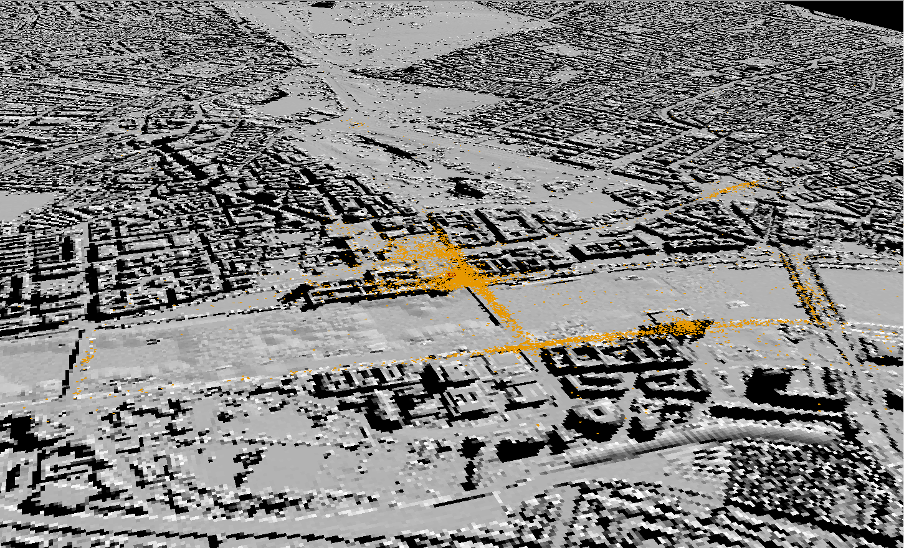
Introduction | State of the art | Research Questions | Methods | Result | Conclusion & Future Work
Relevant images to place name of the geometry
Search for place name
Textual information of images
Levenshtein Distance
a string metric for measuring distance between two sequences
15
University of
Zurich
|Link-VGI Workshop, Helsinki, 2016

Slide 23
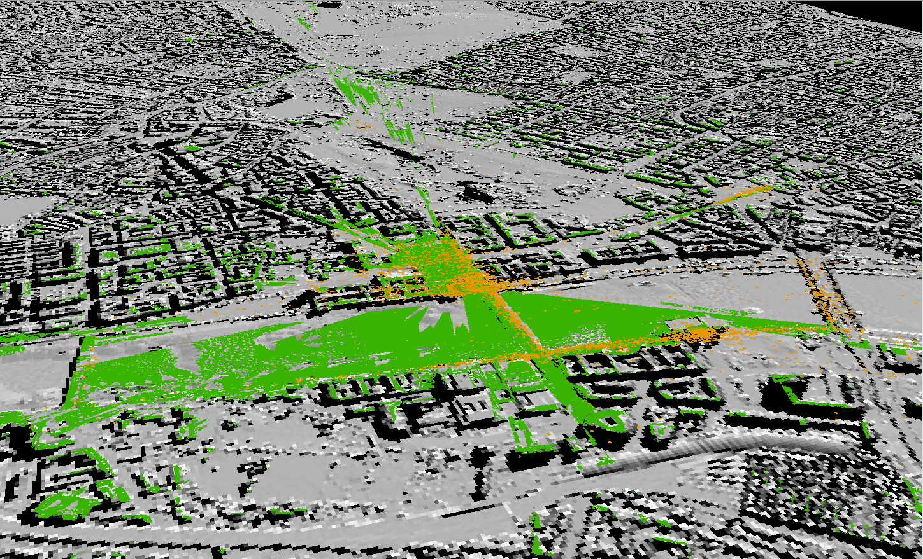
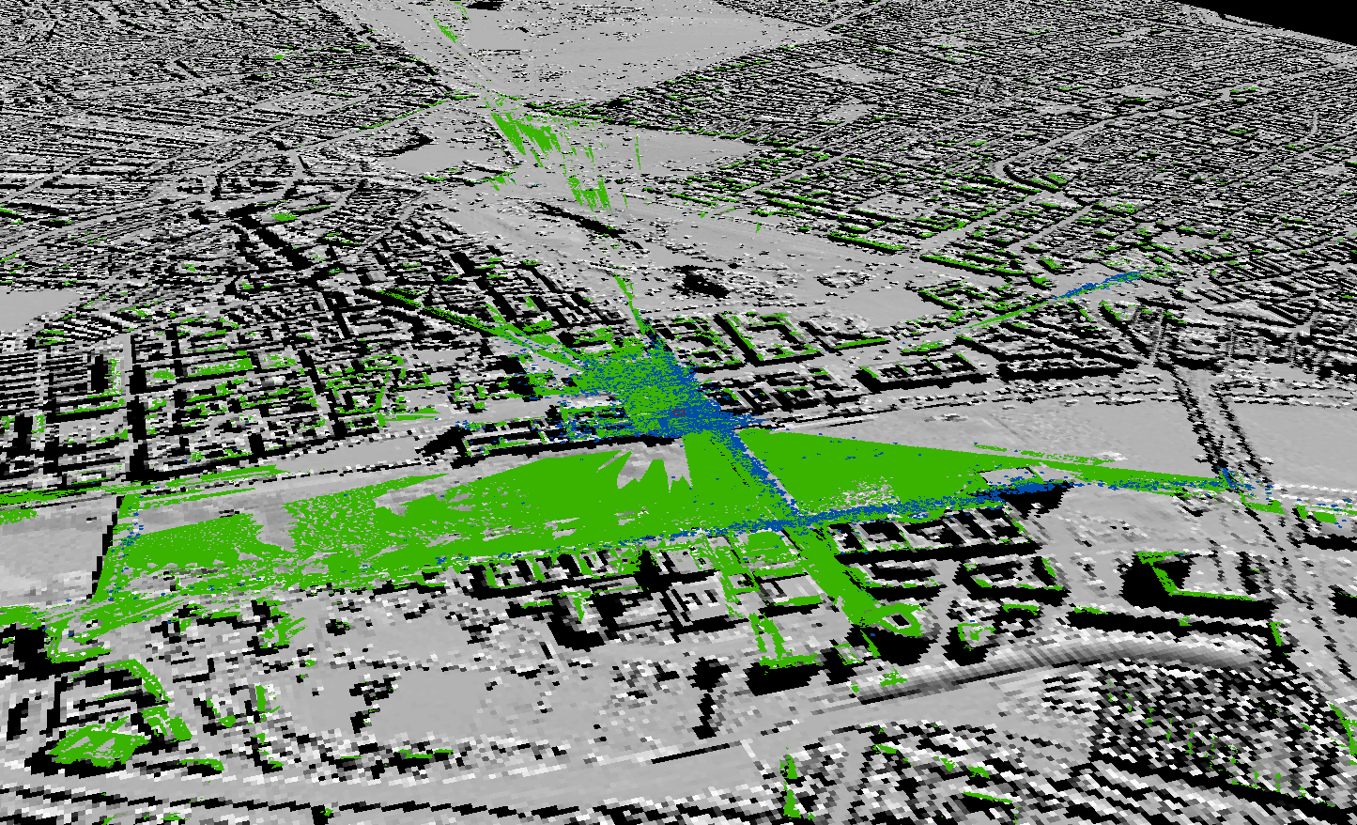
Introduction | State of the art | Research Questions | Methods | Result | Conclusion & Future Work
Tagged images within the visible area
People can take photos of the place from the visible area
16
University of
Zurich
|Link-VGI Workshop, Helsinki, 2016

Slide 24
How do people describe the images i.e. the places?

Slide 25
Extracting place description
Introduction | State of the art | Research Questions | Methods | Result | Conclusion & Future Work
Taxonomy of place descriptions (Purves et al., 2011)
elements (314) | qualities (162) | activities (108)
building | art | club
tree | safe | work
city | blue | cycling
sky | light | trip
water | red | sport
river | sunset | show
building | urban | walking
visible elements on images
qualities identifiable in images
activities depicted
17
University of
Zurich
|Link-VGI Workshop, Helsinki, 2016

Slide 26
How do we find most representative tags for each place?

Slide 27
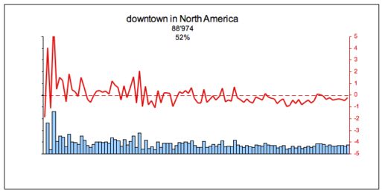
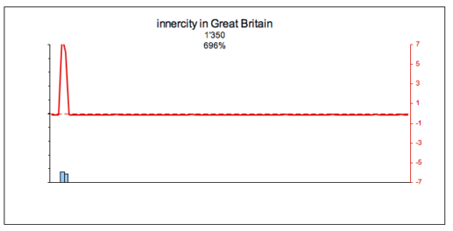
Tag Profile
Introduction | State of the art | Research Questions | Methods | Result | Conclusion & Future Work
binning images according to
prolificness of users
University of
Zurich
(Hollenstein, 2008)
18
|Link-VGI Workshop, Helsinki, 2016
Notes:
To construct the tag profiles, the instances within a data set are sorted according to their owners’ rate of contribution, with the most prolific posters on the left and the less active contributors on the right side of the x-axis. Hence, several bins on the very left might be contributed by the same user, while the rightmost column is made up of items owned by many different users. Subsequently, the occurrence of the tag in question is counted for every bin and represented by the size of the blue bar.
n order to compare the different patterns of contribution, standard or z-score values are computed to normalise the counts of the tag in a bin according to z = x−µ
σ , where x is
the raw count of the respective tag in the bin, µ is the mean of the tag per bin, and σ is the standard deviation of the entire population with respect to the given tag. The z-score is represented by the red line with peaks corresponding to bins that contain a higher- than-average proportion of instances with the given tag, and with lows corresponding to a representation of the tag below the average.

Slide 28
Introduction | State of the art | Research Questions | Methods | Result | Conclusion & Future Work
Related to contribution bias
Tags with less COV is more representative
18
University of
Zurich
|Link-VGI Workshop, Helsinki, 2016
Notes:
The overall bias in the employment of tags by different user groups is expressed by the coefficient of variation, defined as the ratio of the standard deviation σ to the mean µ of the population. The coefficient of variation serves as a measure of whether tags are employed with equal frequency among users of varying prolificness. It rises with decreasing ubiquity, meaning that tags, whether frequent or not, only used by a small group of people will show high coefficients of variation. In

Slide 29
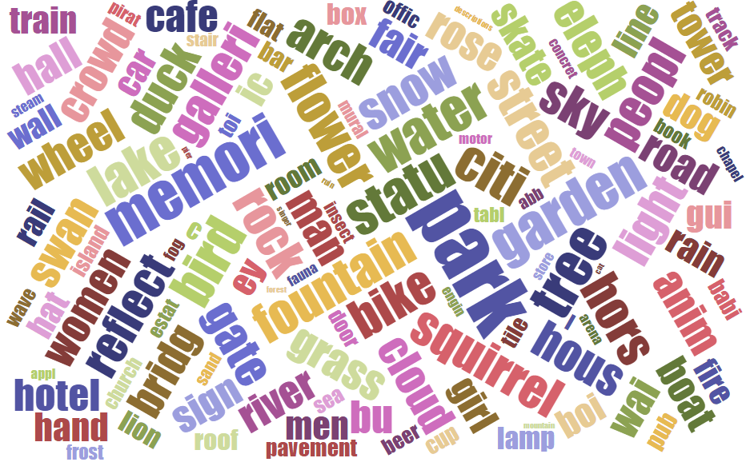
Most representative tags
Introduction | State of the art | Research Questions | Methods | Result | Conclusion & Future Work
Word cloud
Visible elements in Hyde Park
19
University of
Zurich
|Link-VGI Workshop, Helsinki, 2016

Slide 30
What have we found?

Slide 31
Introduction | State of the art | Research Questions | Methods | Result | Conclusion & Future Work
Richness of data to describe our ten popular places
location | #images | #users | #elements, #qualities, #activities
Trafalgar Square | 12,801 | 3,586 | 232,142,85
Tate Modern | 7,249 | 2,490 | 227,135,74
Big Ben | 8,257 | 4,335 | 229,134,72
London Eye | 12,645 | 4,817 | 233,132,80
Piccadilly Circus | 1,102 | 691 | 124,88,49
Buckingham Palace | 5,733 | 2,209 | 204,131,59
Tower Bridge | 7,738 | 3,621 | 227,136,70
St. Paul’s Cathedral | 5,430 | 2,179 | 221,133,69
Globe Theatre | 592 | 415 | 141,80,42
Hyde Park | 6,901 | 1,761 | 229,133,76
Popularity of place
Platial information
(water, rose and tourist)
20
University of
Zurich
|Link-VGI Workshop, Helsinki, 2016
Notes:
statistics illustrating the richness of the data describing our ten London landmarks. All locations except for the Globe Theatre are characterized by more than 1000 images, and with the exception of Piccadilly Circus, more than 1000 users contributed to these descriptions. After removing tags with high coefficients of variation, a rich set of tags capturing information about elements, qualities and activities remains.

Slide 32
How can we use the platial information for individual generalization operators?

Slide 33
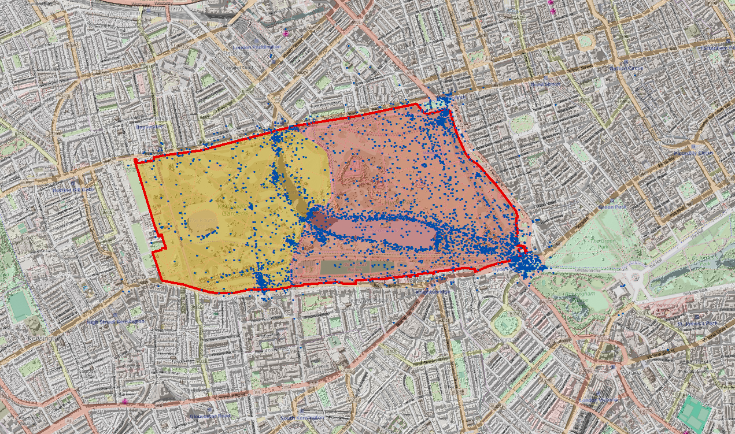
Introduction | State of the art | Research Questions | Methods | Result | Conclusion & Future Work
Potential of platial information in the generalisation process
Generalisation operators
aggregation
Perceived Hyde Park
geometries with shared semantics are merged
Hyde Park
Kensington
Garden
University of
Zurich
|Link-VGI Workshop, Helsinki, 2016
21

Slide 34
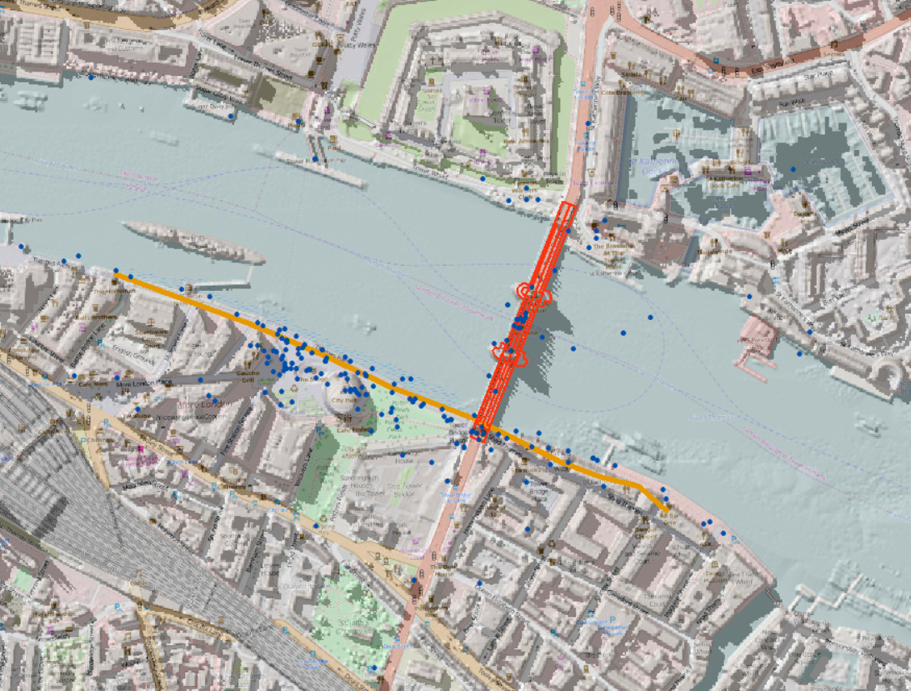
Introduction | State of the art | Research Questions | Methods | Result | Conclusion & Future Work
Potential of Platial Information In the Generalisation Process
Generalisation operators
exaggeration
particular feature is made more visually prominent
River Bank
Tower Bridge
University of
Zurich
|Link-VGI Workshop, Helsinki, 2016
22
Notes:
A second generalization operation is exaggeration, where a particular feature is made more visually prominent. Figure 3 demonstrates the potential of using clustered tags (in this case associated with river bank) with respect to Tower Bridge. Here, the south bank of the Thames appears to be clearly preferred as a view point, and a generalization operator focusing on a map of Tower Bridge might choose to widen the line representing the river bank in this region.

Slide 35
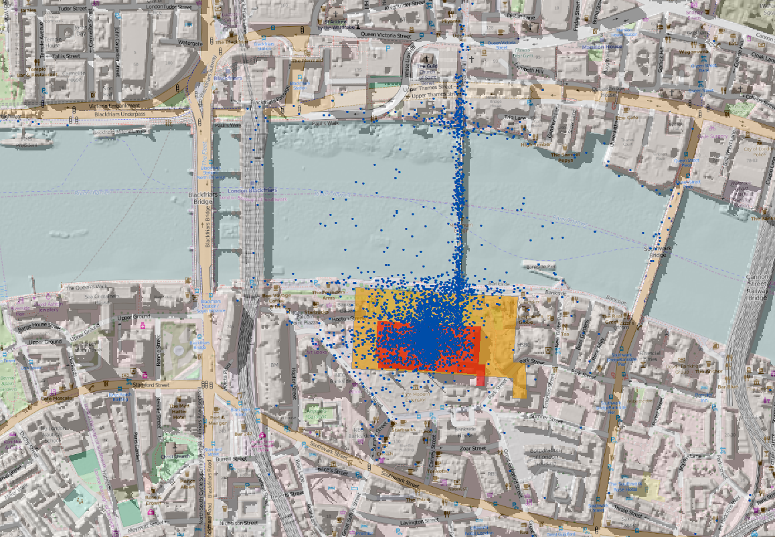
Introduction | State of the art | Research Questions | Methods | Result | Conclusion & Future Work
Potential of platial information in the generalisation process
Generalisation operators
enlargement
scaling the particular geometry
enlarged
Tate Modern
Tate Modern
University of
Zurich
|Link-VGI Workshop, Helsinki, 2016
23
Notes:
Here, an existing geometry is scaled (rather than caricatured as for an exaggeration operator). In this case, the polygon representing the Tate Modern is enlarged (Figure 4) to capture its importance as captured both by the number of images and users associated with it

Slide 36
Introduction | State of the art | Research Questions | Methods | Result | Conclusion & Future Work
Challenge:
Integrating generalization operators in a holistic generalization process to have a true place-based map
24
University of
Zurich
|Link-VGI Workshop, Helsinki, 2016

Slide 37
Introduction | State of the art | Research Questions | Methods | Result | Conclusion & Future Work
Potential of Linking VGI data in driving generalisation operators to focus on both geometric and semantic information
popularity of places
popular place descriptions using representative tags
bias free descriptive tags
25
University of
Zurich
|Link-VGI Workshop, Helsinki, 2016
Notes:
many photographs contributed by a large users group

Slide 38
Introduction | State of the art | Research Questions | Methods | Result | Conclusion & Future Work
Future work
identifying different aspects of place
structuring platial information to inform map generalisation operators
26
University of
Zurich
|Link-VGI Workshop, Helsinki, 2016
Notes:
many photographs contributed by a large users group

Slide 39
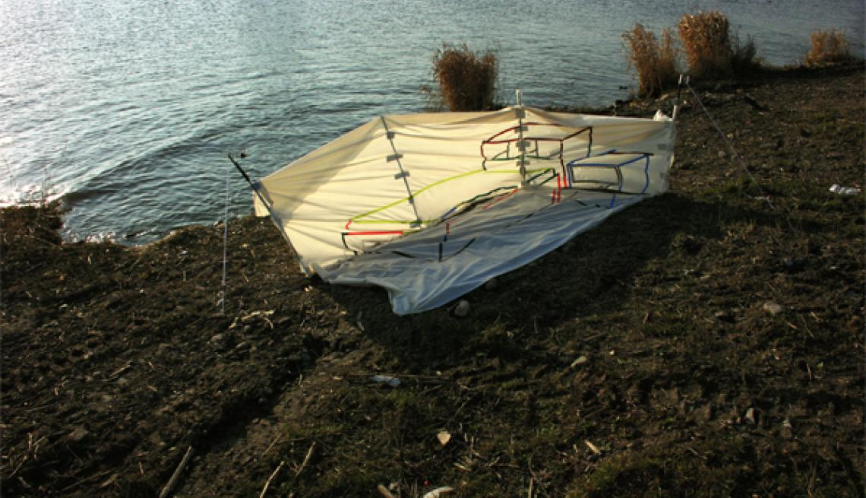
Thank you for your attention

