Slide 1
The Internet, Policy and Politics Conference, Oxford Internet Institute University of Oxford , September 25-26, 2014
The Programmable City Project
Crowdsourcing: A Geographic Approach to Identifying Policy Opportunities and Challenges Toward Deeper Levels of Public Engagement
Tracey P. Lauriault, Programmable City Project
Peter Mooney, Environmental Protection Agency Ireland and Department of Computer Science
National University of Ireland at Maynooth (NUIM)

Slide 2
1. Definitions

Slide 3
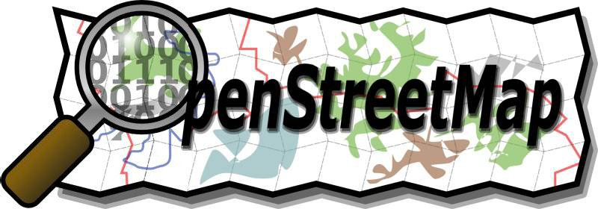
Volunteered Geographic Information (VGI)
the public creates & contributes facts to websites where the facts are synthesized into geo-databases
facts include both a geographic location and a description of one or more properties present at that location.
Goodchild, Michael F., and Linna Li. (2012).
Notes:
Volunteered geographic information (VGI) is a phenomenon of recent years, offering an alternative mechanism for the acquisition and compilation of geographic information. As such it offers substantial advantages, but suffers from a general lack of quality assurance.
A version of crowd-sourcing in which members of the general public create and contribute georeferenced facts about the Earth’s surface and near-surface to websites where the facts are synthesized into databases. This phenomenon is part of a broader trend, but has special characteristics that are attributable to the geographic nature of the information, in other words to the requirement that every contributed fact specifies both a geographic location and a description of one or more properties present at that location.
Goodchild, Michael F., and Linna Li. 2012. “Assuring the Quality of Volunteered Geographic Information.” Spatial Statistics 1 (May): 110–20. doi:10.1016/j.spasta.2012.03.002.
M.F. Goodchild, Citizens as sensors: the world of volunteered geography, GeoJournal, 69 (4) (2007), pp. 211–221

Slide 4
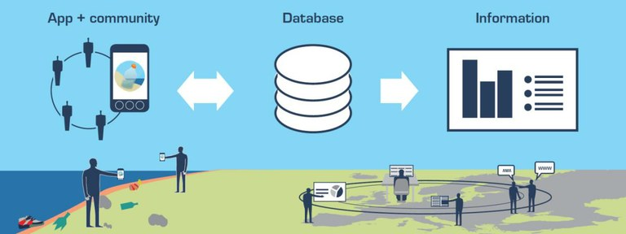
Citizen Science (CS)
process whereby citizens are involved in science as researchers:
concerned citizens
government agencies
industry
academia
community groups, and
local institutions
collaborate to monitor, track and respond to issues of common community concern.
not “scientists using citizens as data collectors,” but rather, “citizens as scientists”
Marine LitterWatch
Conrad, Cathy C., and Krista G. Hilchey (2011)
Notes:
Citizen science is the process whereby citizens are involved in science as researchers: a process where concerned citizens, government agencies, industry, academia,
community groups, and local institutions collaborate to monitor, track and respond to issues of common community [environmental] concern. The focus of recent citizen science is not the traditional “scientists using citizens as data collectors,” but rather, “citizens as scientists”
Conrad, Cathy C., and Krista G. Hilchey. 2011. “A Review of Citizen Science and Community-Based Environmental Monitoring: Issues and Opportunities.” Environmental Monitoring and Assessment 176 (1-4): 273–91. doi:10.1007/s10661-010-1582-5.
A research technique which enlists the public in gathering scientific data and information. Large-scale citizen science projects can engage participants in continental or even global data-gathering networks
Bonney, Rick, Caren B. Cooper, Janis Dickinson, Steve Kelling, Tina Phillips, Kenneth V. Rosenberg, and Jennifer Shirk. 2009. “Citizen Science: A Developing Tool for Expanding Science Knowledge and Scientific Literacy.” BioScience 59 (11): 977–84. doi:10.1525/bio.2009.59.11.9.
Muki Hacklay 2011 classification of citizen science activities http://povesham.wordpress.com/2011/07/20/classification-of-citizen-science-activities/
Marine Litter Watch collect data on marine litter on beaches relevant for the MSFD to support official monitoring http://www.eea.europa.eu/themes/coast_sea/marine-litterwatch
Safecast mapping radiation levels and building a sensor network, enabling people to contribute and freely use the data collected http://blog.safecast.org/
Project Noah is a tool to explore and document wildlife and a platform to harness the power of citizen scientists everywhere http://www.projectnoah.org/
Galaxy Zoo a project to classify galaxies http://www.galaxyzoo.org/

Slide 5
Participatory Mapping (PM)
Approaches & techniques that combines cartography w/participatory methods to represent the spatial knowledge of local communities.
inhabitants possess expert knowledge which can be expressed in a geographical framework
Often socially or culturally distinct understanding w/information that is not in official maps.
customary land boundaries
traditional natural resource management practices
sacred areas
Traditional Place names
Brown and Kytta 2014
Ogiek Peoples visualizing their traditional lands Nessuit, Kenya
Good practices in participatory Mapping (2009)
International Fund for Agricultural Development (IFAD) http://www.ifad.org/pub/map/pm_web.pdf
Notes:
Def: Participatory Mapping
Participatory mapping – “also called community-based mapping - is a general term used to define a set of approaches and techniques that combines the tools of modern cartography with participatory methods to represent the spatial knowledge of local communities. It is based on the premise that local inhabitants possess expert knowledge of their local environments which can be expressed in a geographical framework which is easily understandable and universally recognised. Participatory maps often represent a socially or culturally distinct understanding of landscape and include information that is excluded from mainstream or official maps. Maps created by local communities represent the place in which they live, showing those elements that communities themselves perceive as important such as customary land boundaries, traditional natural resource management practices, sacred areas, and so on”.
“Participatory mapping relies on the ability of individuals to recall their transactional experiences in a place or landscape i.e., the actualized affordances, or in the absence of previous experience, the ability to locate the potential affordances of places on a map”. (Brown and Kytta, 2014)
Greg Browna and Marketta Kyttäb, 2014, Key issues and research priorities for public participation GIS (PPGIS): A synthesis based on empirical research, Applied Geography
Volume 46, January 2014, Pages 122–136 http://www.sciencedirect.com/science/article/pii/S0143622813002531
Community Mapping -
Counter Mapping - kalimantan

Slide 6
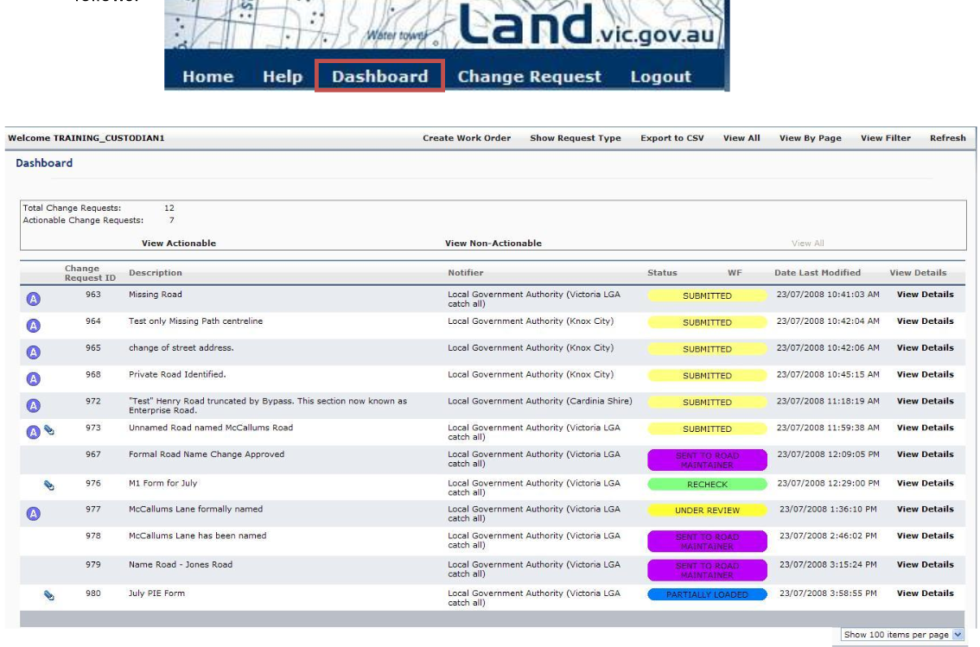
Crowdsourcing
Involves people not normally in your workspace to help collect information
An organization has a task it needs performed
An online community voluntarily performs the task
The result is mutual benefit for the organization and the online community.
Daren C. Brabham IBM Center for The Business of Government, 2013, Using Crowdsourcing In Government
Notes:
Daren C. Brabham IBM Center for The Business of Government, 2013, Using Crowdsourcing In Government,, http://www.businessofgovernment.org/report/using-crowdsourcing-government
Definition: “Crowdsourcing is a type of participative online activity in which an individual, an institution, a non-profit organization, or company proposes to a group of individuals of varying knowledge, heterogeneity, and number, via a flexible open call, the voluntary undertaking of a task. The undertaking of the task, of variable complexity and modularity, and in which the crowd should participate bringing their work, money, knowledge and/or experience, always entails mutual benefit. The user will receive the satisfaction of a given type of need, be it economic, social recognition, self-esteem, or the development of individual skills, while the crowdsourcer will obtain and utilize to their advantage what the user has brought to the venture, whose form will depend on the type of activity undertaken”.(Estellés-Arolas and González-Ladrón-de-Guevara, 2012, p.197)
Involves people not normally in your workspace to help collect information
An organization has a task it needs performed
An online community voluntarily performs the task
The result is mutual benefit for the organization and the online community.
Google Flu Trends - http://www.google.org/flutrends/about/how.html
Mechanical Turk - https://www.mturk.com/mturk/welcome
Notification Edit Service Manual - http://nes.land.vic.gov.au/WebSite/help/NES_User_Manual_V1.8.pdf, site - http://nes.land.vic.gov.au/WebSite/Login.aspx?ReturnUrl=%2fWebSite%2fDefault.aspx

Slide 7
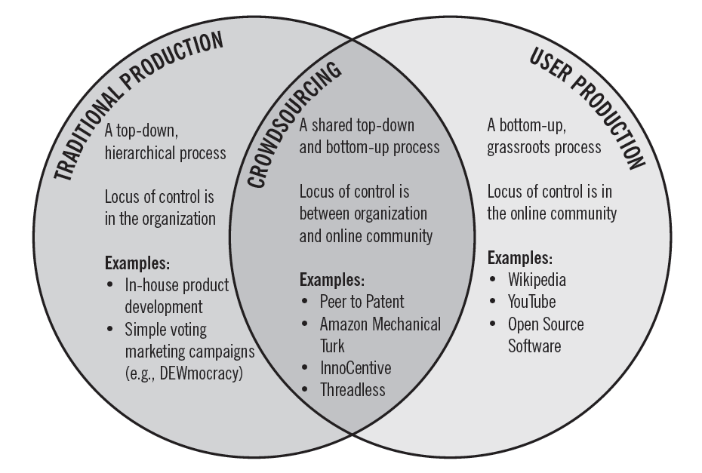
Crowdsourcing
Daren C. Brabham & IBM Center for The Business of Government,(2013) Using Crowdsourcing In Government
Notes:
Daren C. Brabham IBM Center for The Business of Government, 2013, Using Crowdsourcing In Government,, http://www.businessofgovernment.org/report/using-crowdsourcing-government
4 types of approaches—
the Knowledge Discovery and Management approach,
the Distributed Human Intelligence Tasking approach,
the Broadcast Search approach, and
the Peer-Vetted Creative Production approach
No science
Human sensor to see patterns
Treadless
Top down

Slide 8
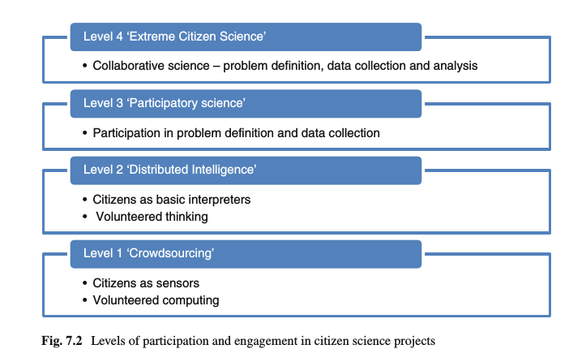
Typology of Participation
Muki Haklay, Citizen Science and Volunteered Geographic Information:
Overview and Typology of Participation. (2013)
Notes:
Haklay, Muki. 2013. “Citizen Science and Volunteered Geographic Information: Overview and Typology of Participation.” In Crowdsourcing Geographic Knowledge, edited by Daniel Sui, Sarah Elwood, and Michael Goodchild, 105–22. Springer Netherlands. http://link.springer.com/chapter/10.1007/978-94-007-4587-2_7.
“This typology exposes how citizen science integrates and challenges the way in which science discovers and produces knowledge. Questions about the way in which knowledge is produced and truths are discovered are part of the epistemology of science. As noted above, throughout the 20th century, as science became more specialised, it also became professionalised”.
Crowdsourcing: “At the most basic level, participation is limited to the provision of resources, and the cognitive engagement is minimal. Volunteered computing relies on many participants that are engaged at this level and, following Howe (2006), this can be termed ‘crowdsourcing’. In participatory sensing, the implementation of a similar level of engagement will have participants asked to carry sensors around and bring them back to the experiment organiser. The advantage of this approach, from the perspective of scientific framing, is that, as long as the characteristics of the instrumentation are known (e.g. the accuracy of a GPS receiver), the experiment is controlled to some extent, and some assumptions about the quality of the information can be used. At the same time, running projects at the crowdsourcing level means that, despite the willingness of the participants to engage with a scientific project, their most valuable input – their cognitive ability – is wasted”. Climateprediction.net
Distributed intelligence: “in which the cognitive ability of the participants is the resource that is being used. Galaxy Zoo and many of the ‘classic’ citizen science projects are working at this level. The participants are asked to take some basic training, and then collect data or carry out a simple interpretation activity. Usually, the training activity includes a test that provides the scientists with an indication of the quality of the work that the participant can carry out. With this type of engagement, there is a need to be aware of questions that volunteers will raise while working on the project and how to support their learning beyond the initial training”.
Community science “is a level of participation in which the problem definition is set by the participants, and in consultation with scientists and experts, a data collection method is devised. The participants are then engaged in data collection, but require the assistance of the experts in analysing and interpreting the results. This method is common in environmental justice cases, and goes towards Irwin’s (1995) call to have science that matches the needs of citizens. However, participatory science can occur in other types of projects and activities – especially when considering the volunteers who become experts in the data collection and analysis through their engagement. In such cases, the participants can suggest new research questions that can be explored with the data they have collected. The participants are not involved in detailed analysis of the results of their effort – perhaps because of the level of knowledge that is required to infer scientific conclusions from the data.”
extreme citizen science: “Finally, collaborative science is a completely integrated activity, as it is in parts of astronomy where professional and non-professional scientists are involved in deciding on which scientific problems to work and the nature of the data collection so it is valid and answers the needs of scientific protocols while matching the motivations and interests of the participants. The participants can choose their level of engagement and can be potentially involved in the analysis and publication or utilisation of results. This form of citizen science can be termed ‘extreme citizen science’ and requires the scientists to act as facilitators, in addition to their role as experts. This mode of science also opens the possibility of citizen science without professional scientists, in which the whole process is carried out by the participants to achieve a specific goal”

Slide 9
Spectrum of VGI Contributors
Expert Amateur
Degree of
VGI Contribution
Expert Professional
Interested Amateur
Expert Authority
Neophyte
Knowledge of Geographic Information
GeoConnections Volunteered Geographic Information (VGI) Primer (2012)
Notes:
Neophyte: “someone with no formal background in a subject, but possessing the interest, time, and willingness to offer an opinion on a subject”;
Interested Amateur: “someone who has "discovered" their interest in a subject, begun reading the background literature, consulted with other colleagues and experts about specific issues, is experimenting with its application, and is gaining experience in appreciating the subject”;
Expert Amateur: “someone who may know a great deal about a subject, practices it passionately on occasion, but still does not rely on it for a living”;
Expert Professional: “someone who has studied & practices a subject, relies on that knowledge for a living, and may be sued if their products, opinions and/or recommendations are proven inadequate, incorrect or libelous”
Expert Authority: “someone who has widely studied and long practiced a subject to the point where he or she is recognized to possess an established record of providing high-quality products and services and/or well-informed opinions -- and stands to lose that reputation and perhaps their livelihood if that credibility is lost even temporarily”.
Diagram: In Hickling Arthurs Low (HAL), 2012, Volunteered Geographic Information (VGI) Primer, CANADIAN GEOSPATIAL DATA INFRASTRUCTURE INFORMATION PRODUCT 21e, Science & Technology Policy Research and Analysis Resource team, GeoConnections. Ottawa: Natural Resources Canada. http://ftp2.cits.rncan.gc.ca/pub/geott/ess_pubs/291/291948/cgdi_ip_21e.pdf
Typology Coleman, D., Georgiadou, Y., & Labonte, J. (2009). Volunteered Geographic Information: the nature and motivation of produsers. International Journal of Spatial Data Infrastructures Research, Vol 4

Slide 10
2. Assemblage Approach
& Data Collection

Slide 11
Kitchin’s Data Assemblage
Attributes | Elements
Systems of thought | Modes of thinking, philosophies, theories, models, ideologies, rationalities, etc.
Forms of knowledge | Research texts, manuals, magazines, websites, experience, word of mouth, chat forums, etc.
Finance | Business models, investment, venture capital, grants, philanthropy, profit, etc.
Political economy | Policy, tax regimes, public and political opinion, ethical considerations, etc.
Govern-mentalities / Legalities | Data standards, file formats, system requirements, protocols, regulations, laws, licensing, intellectual property regimes, etc.
Materialities & infrastructures | Paper/pens, computers, digital devices, sensors, scanners, databases, networks, servers, etc.
Practices | Techniques, ways of doing, learned behaviours, scientific conventions, etc.
Organisations & institutions | Archives, corporations, consultants, manufacturers, retailers, government agencies, universities, conferences, clubs and societies, committees and boards, communities of practice, etc.
Subjectivities & communities | Of data producers, curators, managers, analysts, scientists, politicians, users, citizens, etc.
Places | Labs, offices, field sites, data centres, server farms, business parks, etc, and their agglomerations
Marketplace | For data, its derivatives (e.g., text, tables, graphs, maps), analysts, analytic software, interpretations, etc.
Governmentalities-legalities
Systems of thought
Forms of knowledge
Political economy
Practices
Places
Finance
The marketplace
Subjectivities-communities
Organisations-institutions
Materialities-infrastructures
Notes:
A data assemblage is conceived as a complex socio-technical system consisting of a number of inter-related elements — systems of thought; forms of knowledge; finance; political economy; governmentalities; materialities and infrastructures; practices; organisations and institutions; subjectivities and communities; places; and marketplaces — that work together to frame how data are produced, managed, analyzed, shared and used.
This framework we think has utility in understanding and contextualizing the wider changing data landscape.

Slide 12
Method
Interaction type
Trigger event
Domain
Organization
Actors
Data sets
Process
Feedback
Goal
Side effects
Contact point
Policy
Legal
Standards
Data quality
Technology
Sustainability
Credibility of the source
Preservation
Security
http://discovery.ucl.ac.uk/1433169/

Slide 13
3. Examples

Slide 14
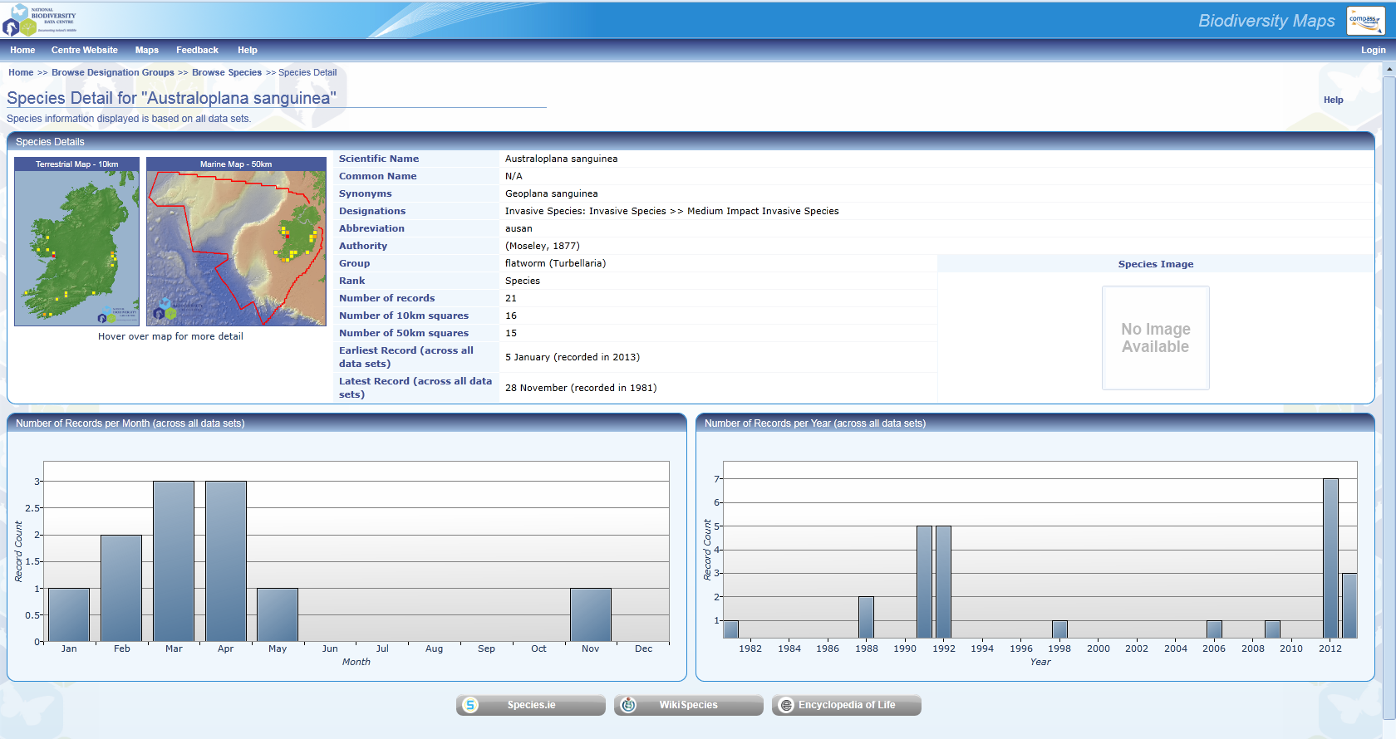
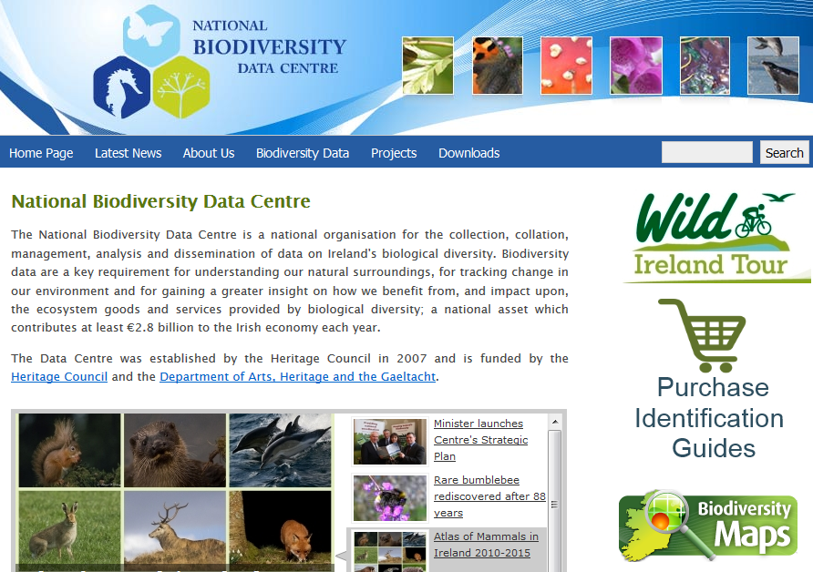
National Biodiversity Data Centre
http://www.biodiversityireland.ie/
Notes:
Bioblitz
http://discovery.ucl.ac.uk/1433169/
http://maps.biodiversityireland.ie/#/Home
http://www.biodiversityireland.ie/

Slide 15
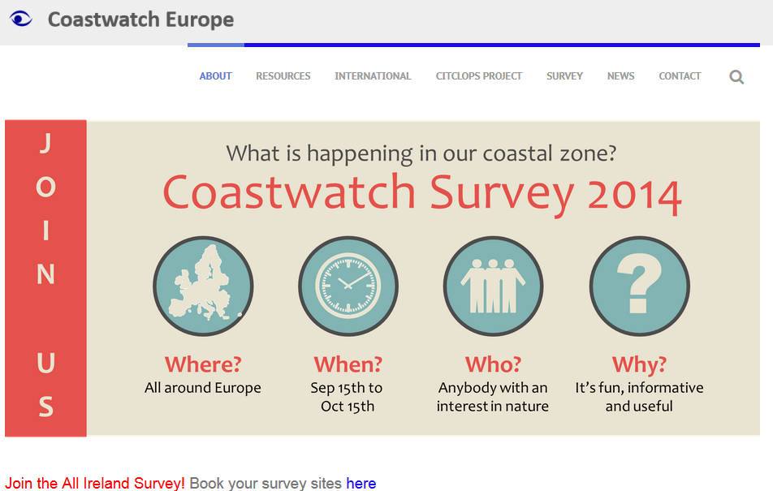
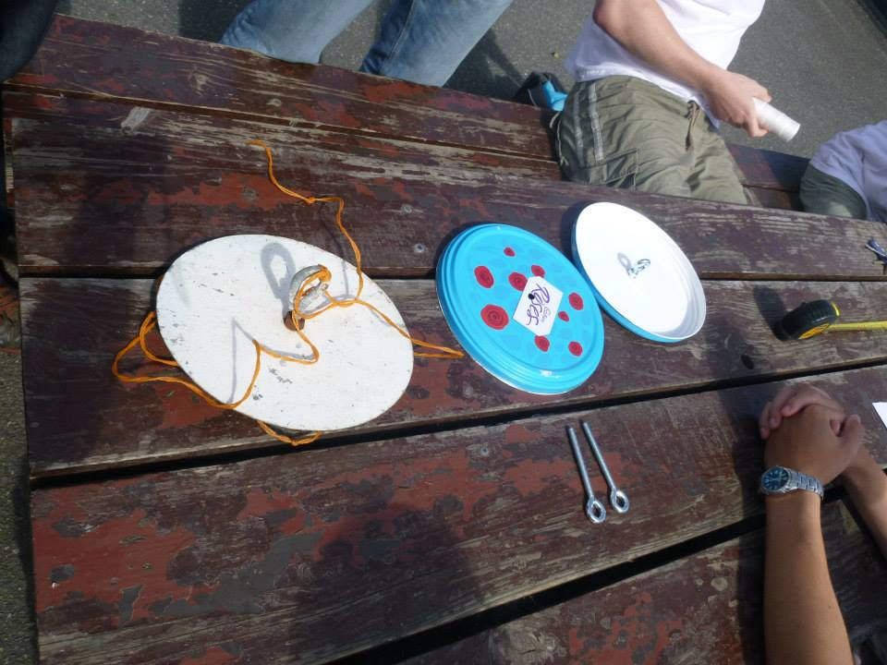
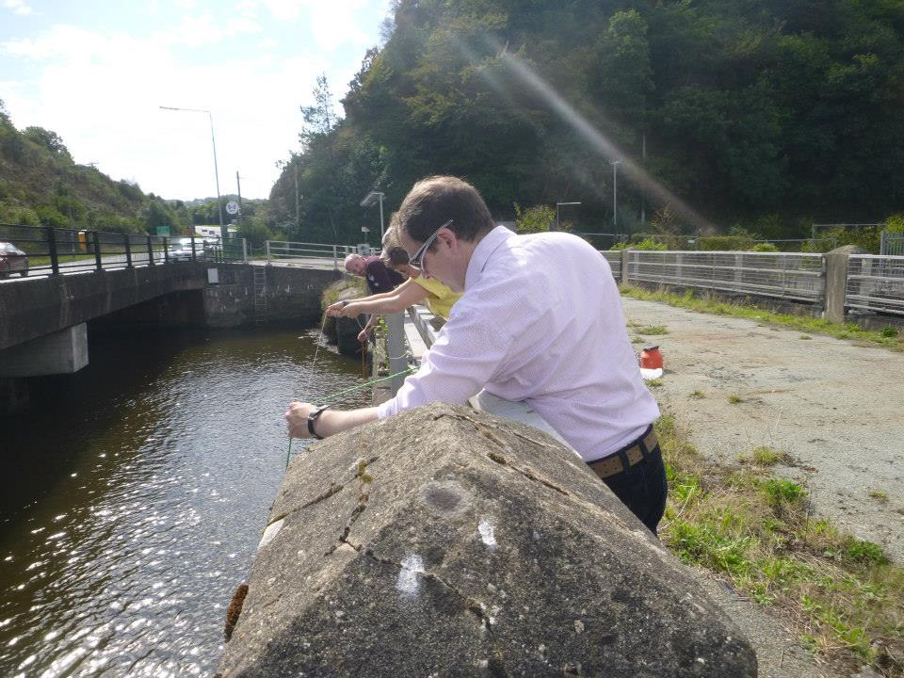
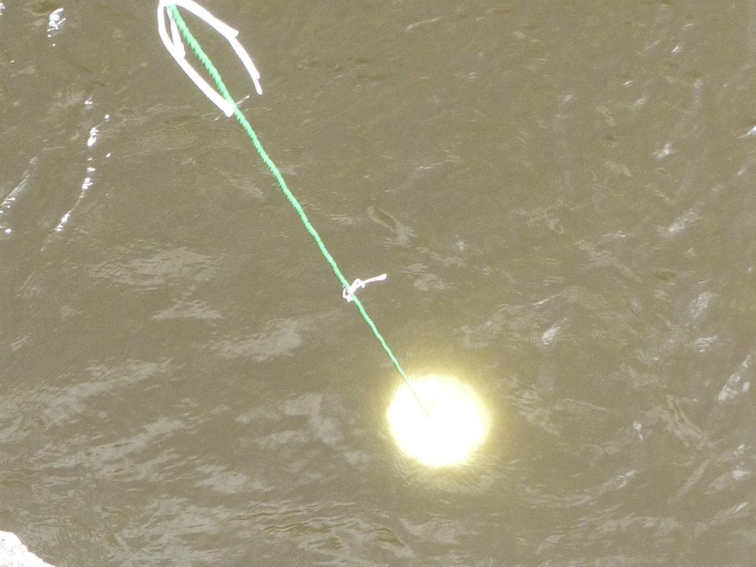
Coastwatch
http://worldmap.harvard.edu/maps/cwsurveyunits &
Notes:
FB page
https://www.facebook.com/media/set/?set=a.10151913629137154.1073741826.8955392153&type=1

Slide 16
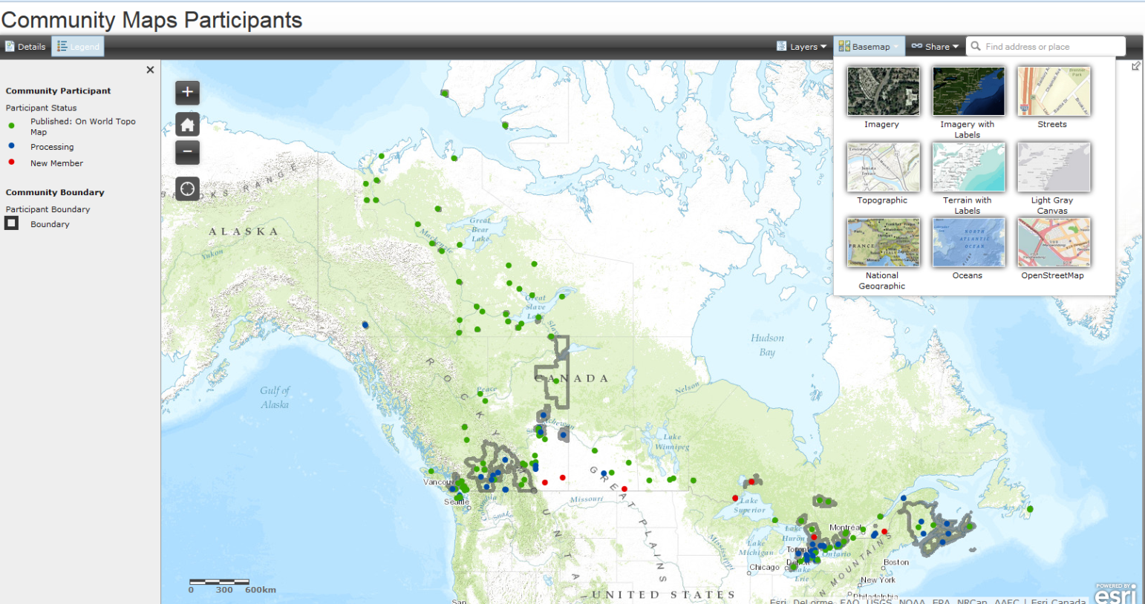
ESRI Community Map Program
http://maps.esri.ca/gallery/
Notes:
http://exchange.maps.arcgis.com/apps/OnePane/basicviewer/index.html?appid=c457169604a545e4b641463246628416
http://maps.esri.ca/gallery/

Slide 17
Cybercartography
Gwich’in Social and Cultural Institute
Ingrid Kritsch used for 3 weeks
Collected over 800 spoken place names, photos and videos w/elders on an iPad
Data replicated back in Ottawa in a matter of hours
https://gcrc.carleton.ca/confluence/display/GCRCWEB/Overview

Slide 18
Nunaliit Cybercartographic Atlas Framework
https://github.com/GCRC/nunaliit/wiki
http://nunaliit.org/

Slide 19
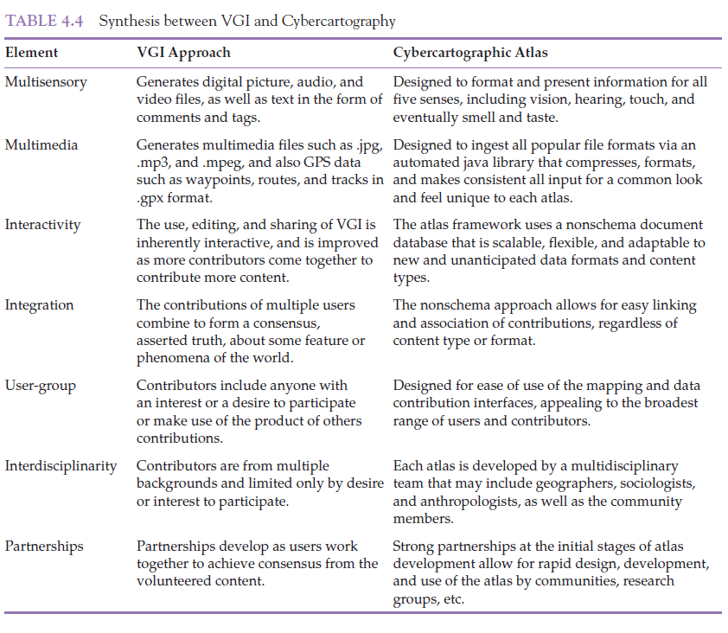
Cybercartographic Framework
Nate Engler, Teresa Scassa, and D. R. Fraser Taylor, (2014), Cybercartography and Volunteered Geographic Information
Notes:
Nate Engler,Teresa Scassa, D. R. Fraser Taylor, (2014), Cybercartography and Volunteered Geographic Information, Chapter 4 in D.R. Fraser Taylor and Tracey P. Lauriault, Developments in the Theory and Practice of Cybercartography, 2nd Edition, Elsevier.

Slide 20
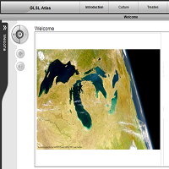
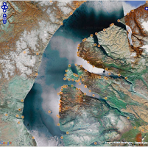
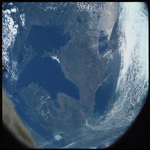
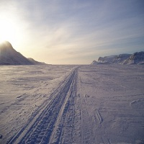
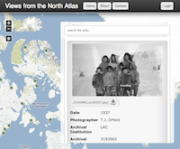
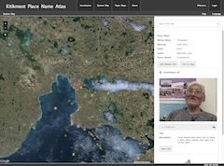
Cybercartographic Atlases
Atlas of Indigenous Perspectives & Knowledge
Atlas of Arctic Bay
Lake Huron Treaty Atlas
Inuit (Siku)Sea Ice Use & Occupancy Project
Views from the North
Kitikmeot Place Name Atlas
https://gcrc.carleton.ca/confluence/display/GCRCWEB/Atlases

Slide 21
Government of Canada
http://www.nrcan.gc.ca/earth-sciences/geomatics/canadas-spatial-data-infrastructure/8904
http://spatialinformation.files.wordpress.com/2013/04/white-paper-final-version.pdf
Notes:
In Hickling Arthurs Low (HAL), 2012, Volunteered Geographic Information (VGI) Primer, CANADIAN GEOSPATIAL DATA INFRASTRUCTURE
INFORMATION PRODUCT 21e, Science & Technology Policy Research and Analysis Resource team, GeoConnections. Ottawa: Natural Resources Canada. http://ftp2.cits.rncan.gc.ca/pub/geott/ess_pubs/291/291948/cgdi_ip_21e.pdf
Canadian Geomatics Community Strategy "White Paper" and Scenarios (January 2013) was prepared for Natural Resources Canada by Hickling Arthurs Low Corporation (HAL).

Slide 22
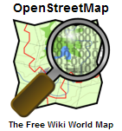
VGI Quality Control & System Openness
Professionals
Quality Control Formality
The Crowd
Restricted
VGI System Openness
Open
GeoConnections Volunteered Geographic Information (VGI) Primer (2012)
Notes:
“The range of contribution models for VGI input to Web - based geospatial databases is also broad. Figure 2 illustrates this spectrum, from systems that are restricted to authorized contributors who are typically in the expert professional or authority categories, to open systems that will accept content from anyone, with variations of these models in between. It also shows that the formality of quality control methods covers a spectrum, from iterative refinements made by individual citizen contributors (the “crowd”) to quality assessment by trained geographic professionals”.
Hickling Arthurs Low (HAL), 2012, Volunteered Geographic Information (VGI) Primer, CANADIAN GEOSPATIAL DATA INFRASTRUCTURE
INFORMATION PRODUCT 21e, Science & Technology Policy Research and Analysis Resource team, GeoConnections. Ottawa: Natural Resources Canada. http://ftp2.cits.rncan.gc.ca/pub/geott/ess_pubs/291/291948/cgdi_ip_21e.pdf

Slide 23
5. Recommendations

Slide 24
Using Crowdsourcing In Government
Clearly define the problem and solution parameters
Determine the level of commitment to the outcomes.
Know the online community and their motivations.
Invest in usable, stimulating, well-designed tools.
Craft policies that consider the legal needs of the organization and the online community.
Launch a promotional plan and a plan to grow and sustain the community.
Be honest, transparent, and responsive.
Be involved, but share control.
Acknowledge users and follow through on obligations.
Assess the project from many angles
Daren C. Brabham IBM Center for The Business of Government, 2013, Using Crowdsourcing In Government http://www.businessofgovernment.org/report/using-crowdsourcing-government

Slide 25
6. Final Remarks

Slide 26
CS as a Springboard to engagement
VGI, Citizen Science, Participatory Mapping & Crowdsourcing
Co-governance
Deliberative Democracy
Evidence informed decision making
Policy development

Slide 27
Q & A
Thank You!
Tracey.Lauriault@NUIM.ie
@TraceyLauriault
http://www.nuim.ie/progcity/
Peter.Mooney@nuim.ie
@________________
URL_______________

Slide 28
References
Bonney et al 2009
Budhathoki et al 2008
Bryan 2014, Brown and Kytta 2012
Goodchild 2007
Johnson and Siber 2013
de leeuw et al 2011
Kitchin & Dodge 2013
Ritzer 2008
Stafford et al 2010
Scassa 2014
Taylor and Lauriault 2014

Slide 29
Literature Rev
http://discovery.ucl.ac.uk/1433169/
Bonney et al 2009 - cs
Budhathoki et al 2008 - vgi
Bryan 2014, Brown and Kytta 2012 – pm
public as sensors Goodchild 2007 Johnson and Siber 2013
Analysis w/gov de leeuw et al 2011
TK Stafford et al 2010, Taylor and Lauriault 2014

Slide 30
Abstract
Title: Crowdsourcing: A Geographic Approach to Identifying Policy Opportunities and Challenges Toward Deeper Levels of Public Engagement
Crowdsourcing in geography comes in a number of models, here we examine three: Volunteered Geographic Information (VGI), Citizen Science (CS) and participatory mapping (PM). These are long standing knowledge generation models to study the human and physical world (Goodchild 2007, Audubon Society 1900, Peluso 1995). The field notes of new world explorers, for example, show that amateur scientists and officials extracted knowledge from those they colonized and used those data to inform colonial policies. Fortunately, a more critical form of geography combined with internet technologies such as Google Maps, APIs, and webmapping among other things such as interoperability standards and geotagging, have democratized crowdsourcing and made it a little easier, transforming members of the public, albeit often a highly qualified public with specialized, scientific and technological skills; from passive consumers of authoritative data into data producers (Dodge and Kitchin 2013) or prosumers (Ritzer 2008).
Successful VGI and CS examples such as OpenStreetMap, FixMyStreet, Zooniverse and Project Noah, are grassroots initiatives. PM, which here implies community mapping, counter mapping, and participatory GIS; includes stakeholders collaborating with cartographers and geomaticians in action oriented research settings to produce maps (e.g. All Island Research Observatory, cybercartographic atlases). These three established crowdsourcing models, provide a deep level of public engagement and reliable data, yet continue to inform public policy from the outside. To date there are very few CS, VGI or PM endeavours driven or adopted by government. Open511.ca, GeoConnections and the Canadian Geomatics Community Round Table, Bird Atlas of Britain and Ireland, and the Notification and Editing Service (NES) are examples where the potential of crowdsourcing as discussed here are being examined. Researchers and policy-makers have however just begun to examine the opportunities and challenges presented by these data driven models of public engagement at all scales. This paper therefore aims to describe and critically examine these models by applying a data assemblage framework (Kitchin 2012) to identify actors, forms of knowledge, technologies, data quality, practices and norms within a select number of case studies from Ireland, Canada and internationally toward the early development of a typology of practical policies to help government adopt crowdsourcing as a public engagement strategy.
A number of affordances for government to use data collected through CS (Bonney et al 2009), VGI in a national spatial data infrastructure context (Budhathoki et al 2008) and PM (Bryan 2014, Brown and Kyttä 2014) have been identified. This includes the potential for the public to act as “sensors of their environment” (Goodchild 2007, Johnson and Siber 2013), to analyze those data with government (de Leeuw et al 2011) and in the case of local and traditional knowledge, it is an opportunity for other worldviews to be represented such as indigenous toponyms, land use and occupancy, or biodiversity (Stafford et. al 2010, Taylor and Lauriault 2014). As governments in many jurisdictions must act with reduced budgets and limited human resources CS, VGI and PM offer an opportunity to include the public in data collection and analysis toward a more grounded approach to evidence informed decision-making. We suggest that governments can build public engagement opportunities by capitalizing on these three established geographic crowdsourcing models, furthermore, these models may also inform crowdsourcing processes more broadly.

Slide 31
Abstract (Cntd)
Governments to date, even with the adoption of open government principles and the launching of open data portals, have been reluctant to embrace crowdsourcing. Performance and accountability measures are of primary concern and focus of public managers and administrators. Governments cannot simply just begin to use crowdsourced data without understanding policy implications. The adoption of crowdsourced data introduces many challenges including the sustainability of VGI, CS and PM; authorship; public officials as public mediators; data and software ownership; and the reliability of data sources, to name a few. The widely held perception that VGI and CS data and to a lesser extent those of PM contain many data quality problems compared to authoritative sources is a major constraint. There are also legal implications for governments if the data they use are inaccurate, biased, or somehow flawed (Scassa 2014). Scientists and data analysts inside government departments cannot be expected to simply begin using crowdsourced data without first developing suitable structures, technologies, policies to do so. Formalized processes for the collection of VGI, CS and PM data (incorporating data quality controls and verification) coupled with the development of government structures to use these are therefore required.
Concurrently, governments are: signing onto the Open Government Partnership; adopting open government practices and launching open data projects which include increased public engagement. Governments have also recently begun to understand how to leverage myriad internet technologies (e.g. Web 2.0, APIs, GeoWeb) and are participating in new forms of public engagement activities such as hackathons, data dives, app contests and un-conferences (e.g. GovCamps) where officials and the public collaborate to derive meaning from authoritative datasets or mash these up with CS/VGI data into new apps. Interestingly, the data assemblage of open data and open government often differs from CS, VGI and PM. It is suggested here, that there is a need to study the lessons learned arising from successful efforts and demonstrate ways for governments to engage with VGI, CS and PM communities and that the spirit of the open data movement in government provides an opportunity for this form of experimentation.
This paper will identify some of the common barriers making officials reluctant to adopt crowdsourcing. We will compare these barriers with the best practices identified in three geography based crowdsourcing models and some open data examples, with the objective of developing public policy recommendations to assuage government to include crowdsourcing into their public engagement practices. A recent report by the European Commission (Science for Environmental Policy 2013) remarked that in Europe many initiatives to incorporate CS in environmental policymaking as part of a broader development of participatory forms of democracy are in their early stages. This paper will contribute in a small way to the advancement of knowledge in this area.
Finally, we argue that governmental reform, increased demand for transparency and accountability combined with open government practices are changing the relationship between the public and government and can serve as springboards for developing the concept of data informed co-governance and open opportunities for the incorporation of VGI, CS and PM into government decision-making, policy development, and meeting regulatory reporting obligations.

