Slide 2
VGI and crowd sourced data
Some use cases swisstopo
  Customer feedback and revision service
  Harvesting hints in the update process
  Crowdsourcing as a public relation instruments
Is this all for swisstopo?
  A⁴C⁴ quality requirements and consequences to VGI acquisition

Slide 3
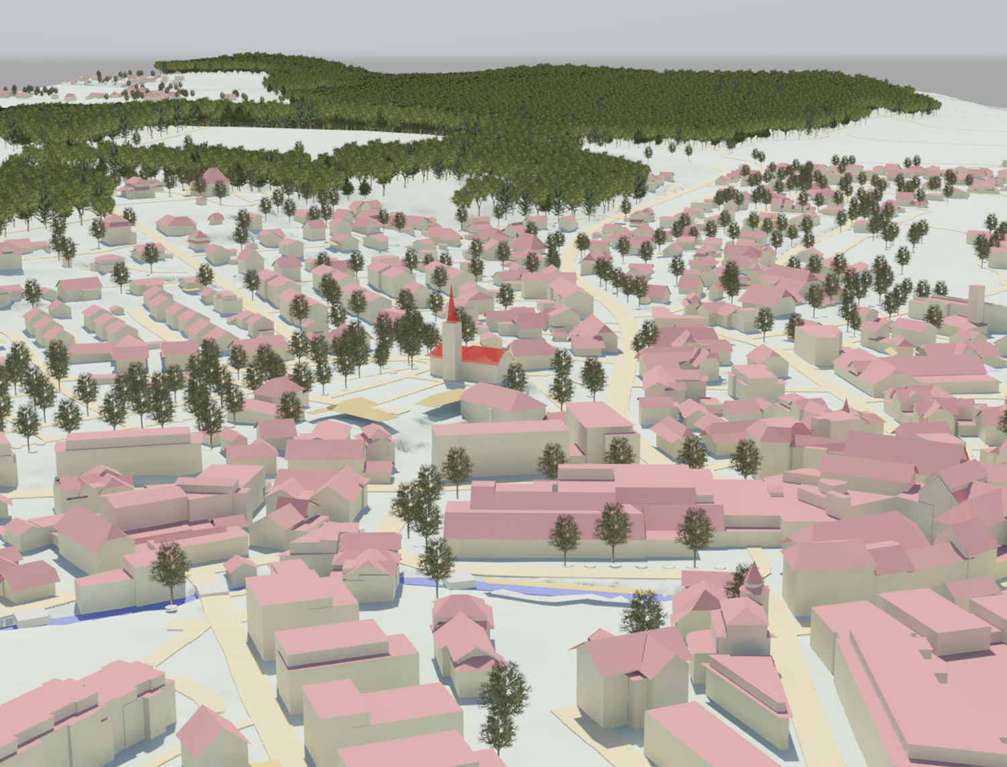
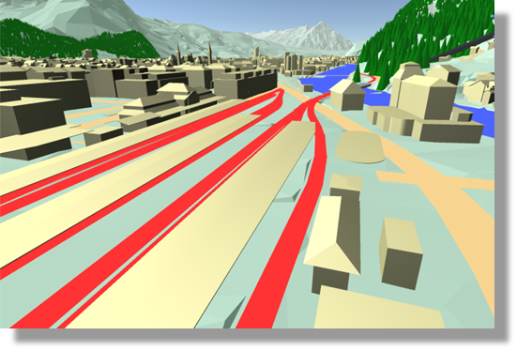
swissTLM^{3D}
The 3D topographic landscape model of Switzerland

Slide 4
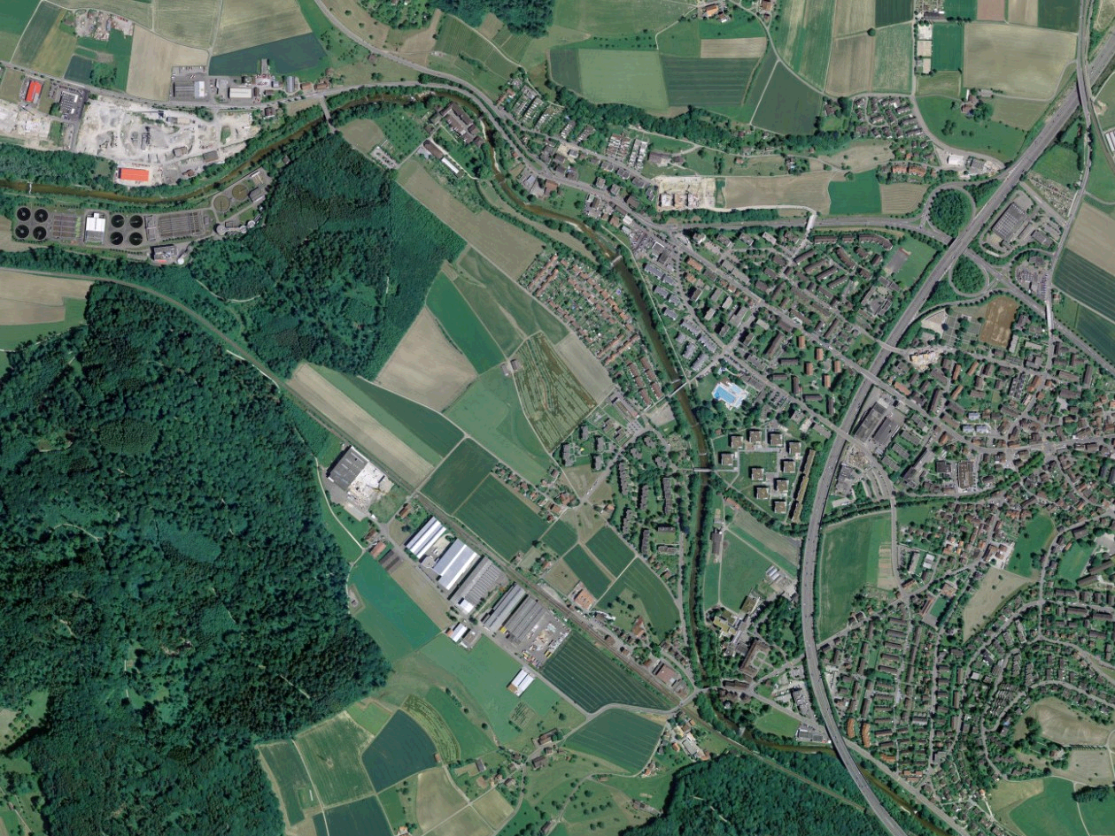
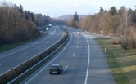
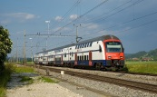

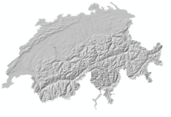
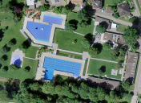
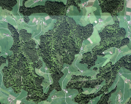
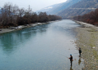
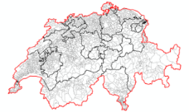

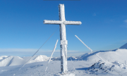
swissTLM^{3D}
roads and paths
public transportation
buildings
DEM
✓
✓
→ 2017
✓
areals
land cover
waters
→ 2019
→ 2019
→ 2019
administrative boundaries
names
single objects
✓
✓
✓

Slide 5
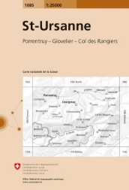
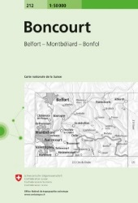
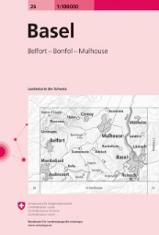


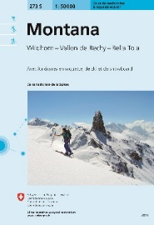
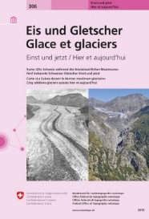




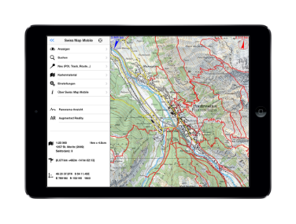
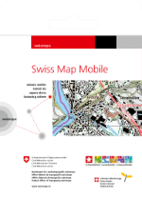

Maps of Switzerland
printed
Topographic Maps
digital Version
Swiss Raster Map
Swiss Vector Map
Thematic Maps
Swiss Map Mobile
(iPhone/Android)
Notes:
Bezeichnung des Anlasses mit Datum bzw Geschäft / Vorhaben
Stand TT.MM.JJ
Bereich
5

Slide 6
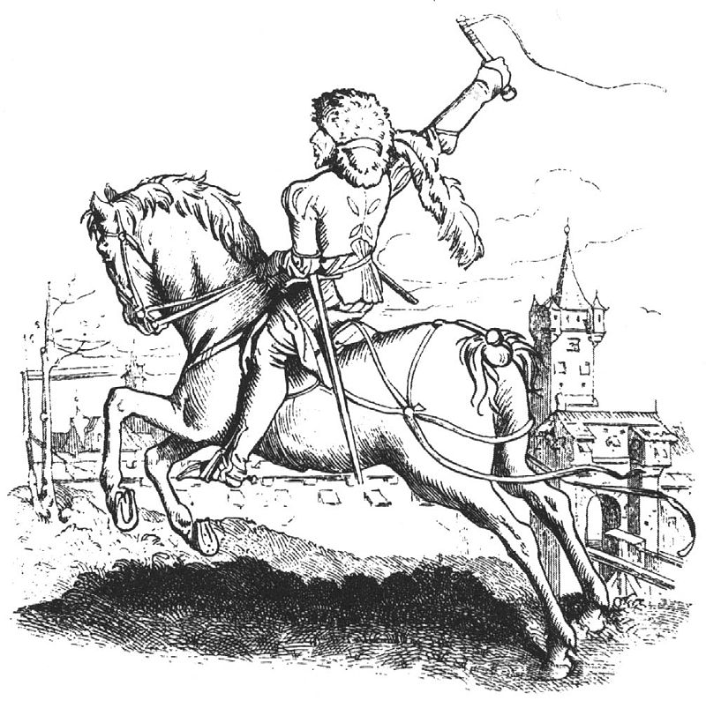
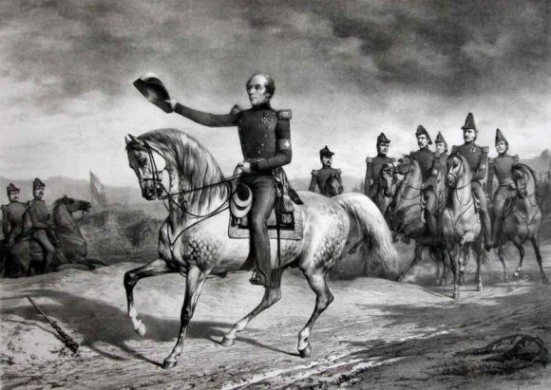
Customer feedback
Oldest crowdsourcing action of swisstopo
Lasting more than 175 years
A.Dürer-berittener Bote
Jules Hébert, Le Général Dufour avec son bâton à cheval

Slide 7
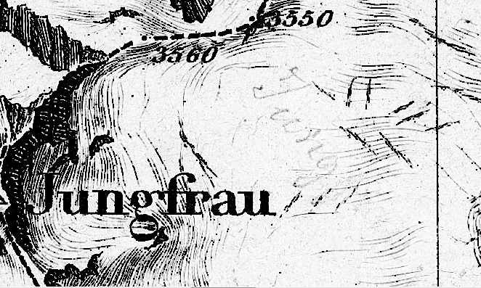

Dufour map 1854 new names and position added by customer

Slide 8
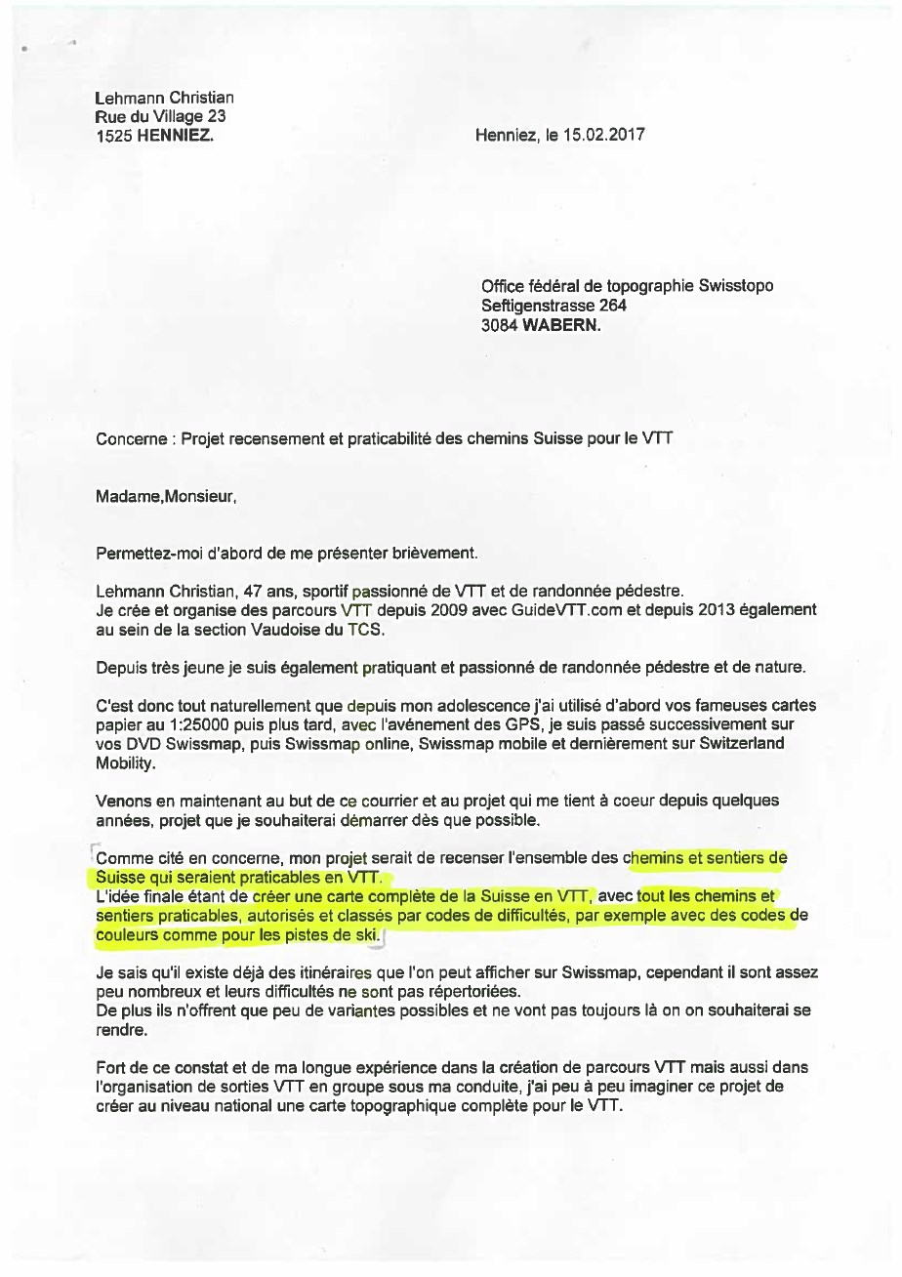
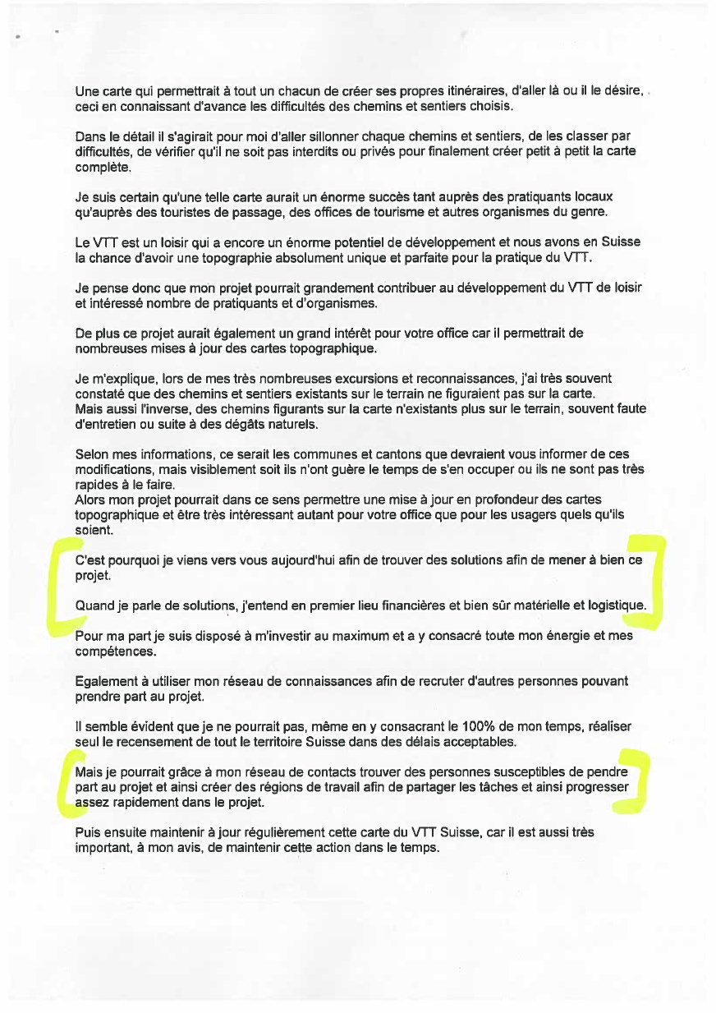

Incoming surface mail

Slide 9
Incoming online messages (email)
Gesendet: Dienstag, 3. Januar 2017 18:32
An: _swisstopo-webgis <webgis@swisstopo.ch>
Betreff: Namen auf der Karte
Habe eben festgestellt, dass in der Gemeinde Fischenthal plötzlich zwei Gehöfte mit dem Namen Waldsberg in der neuen Karte sind.
Waldsberg ist aber nur bei Koordinate 2’713’448 / 1’245’874
Euer zweites Waldsberg mit den Koordinaten 2’715’355 / 1’245’499 hiess und heisst bei uns immer noch Waldberg
Wieso werden plötzlich so viele Namen einfach geändert oder weggelassen?
Mit freundlichen Grüssen von einer Verehrerin Ihrer sonst vorzüglichen Kartenwerke
-----------------------------------------------------------------------------------------------------------------------
Gesendet: Sonntag, 15. Januar 2017 17:21
An: NNNNNNNNNNNNNNNNNN swisstopo <NNNN.NNN@swisstopo.ch>
Betreff: cartes nationales
Bonjour et bonne année
Je vous remercie pour les adresses que vous m'avez communiquées fin octobre. j'ai maintenant toute la Suisse à 400 pixels par kilomètre et je maitrise bien les agrandissements sur votre site pour des recherches de toponymes. Cependant les hydronymes me posent des problèmes car des mots comme tobel ne figurent pas dans mon petit dictionnaire allemand-français.
Existerait-il un glossaire chez SwissTopo, le dictionnaire historique de la Suisse est surtout historique
Grand merci pour votre réponse.
Cordialement
---------------------------------------------------------------------------------------------------------------------------------
Gesendet: Montag, 6. Februar 2017 09:24
An: _swisstopo-Revisionsdienst <Revisionsdienst@swisstopo.ch>
Betreff: WG: Fragen zur neuen Landeskarte 1:25'000
Sehr geehrte Damen und Herren,
ich habe vor etwa 3 Wochen (14.1.) folgenden Kommentar und Korrektur-
hinweis auf map.geo.admin.ch eingegeben, aber bisher keine Antwort
erhalten. Dass die Korrektur ein paar Tage dauert ist verständlich. Mich
würde aber schon noch Ihre Stellungnahme zu den anderen Fragen
interessieren.
Mit freundlichen Grüssen
--------------------------------------------------------------------------------------------------------------------------------------------
Gesendet: Donnerstag, 12. Januar 2017 09:46
An: _swisstopo-Info <Info@swisstopo.ch>
Betreff: Frage betr. Geographie und Namensgebung
Grüezi,
Beim Kartenstudium habe ich eine interessante Entdeckung gemacht. Normalerweise trägt ein Gipfel in unmittelbarer Umgebung eines Tals denselben Namen wie das Tal hat. Beim Piz Sampuoir resp. Val Sampuoir ist das nicht der Fall. Das Val Sampuoir liegt bei Samnaun, der Piz Sampuoir hingegen an der Nationalparkgrenze zwischen Ofenpass und Ardez.
Kann mir jemand erläutern woher das kommt? Mich dünkt das ziemlich interessant und spannend.
Freundliche Grüsse,
------------------------------------------------------------------------------------------------

Slide 10
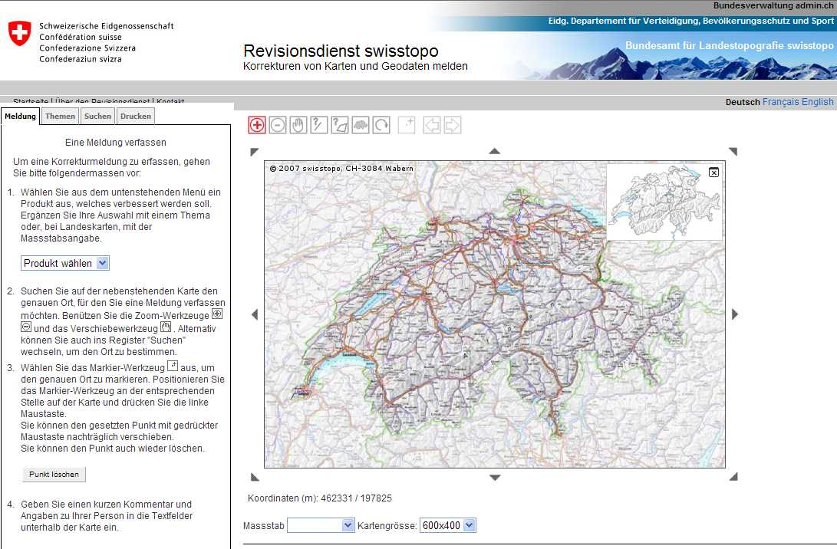
Revision service release 2009
Desktop service
swisstopo viewer

Slide 11
Revision Web Service
2009: First Release
2011: Second Release
  + Based on Federal Spatial Data Infrastructure FSDI Technology
  + Capture of lines and polygons
  + Integration of attachments
  + Separate mobile application
2015: Third Release
  + Integration into the geoportal of the Swiss Confederation
  + Higher level of dissemination
  + Highest actuality and data availability
  + One single web-application for desktop and mobile

Slide 12
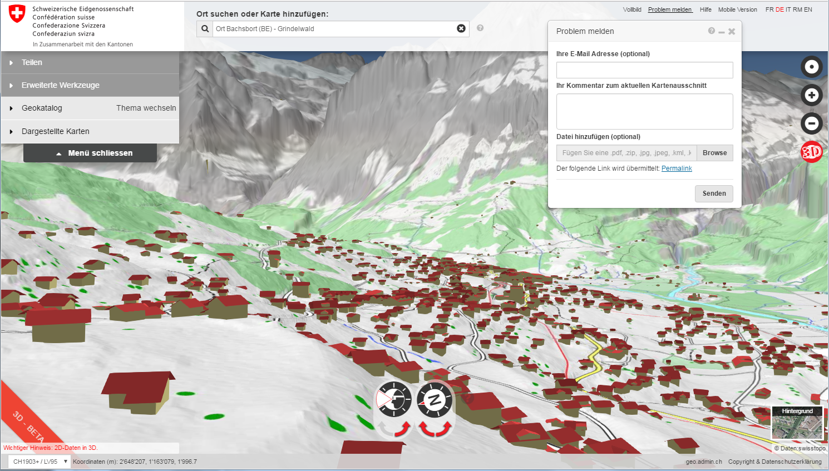
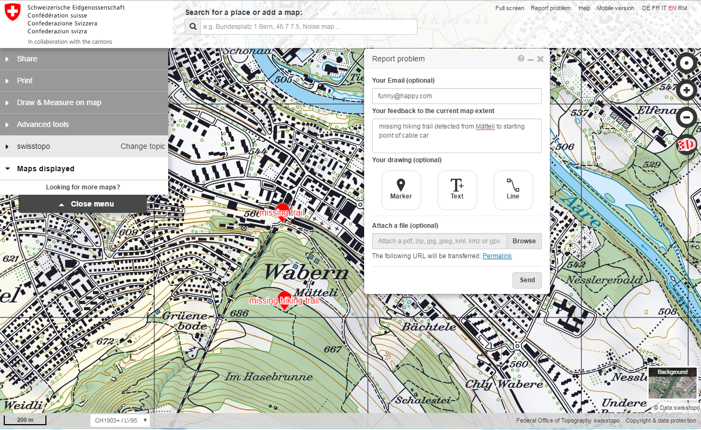
Release 2015 map.geo.admin.ch

Slide 13
Annual statistics map.revisions.admin.ch
External messages | per year
2011 | 403
2012 | 487
2013 | 750
2014 | 1136
2015 | 936
2016 | 923
2016 | messages
daily | 2.5
weekly | 18
monthly | 77

Slide 14
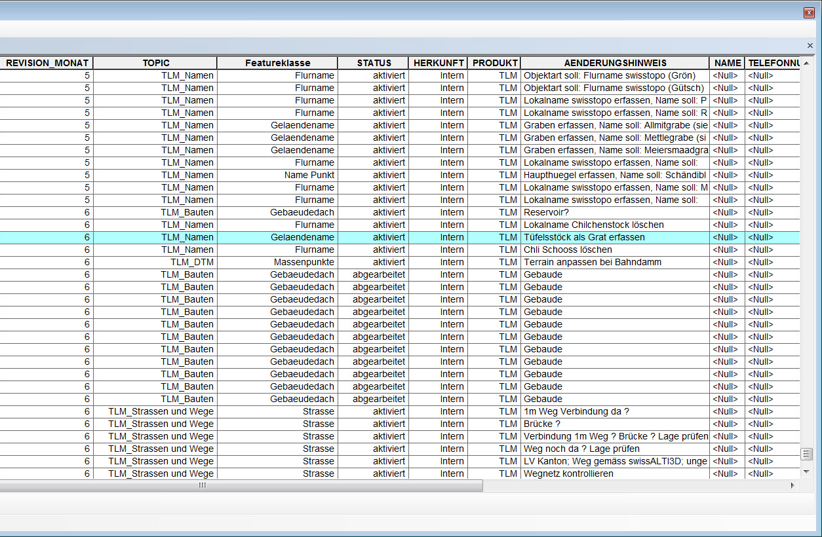
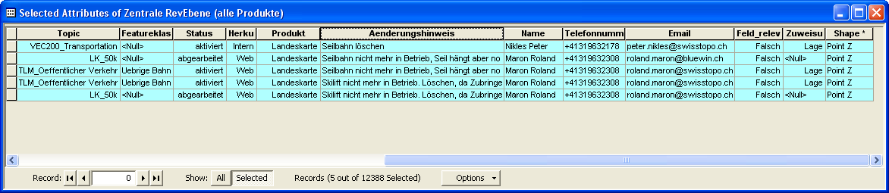
Revision Workflow – Central Revision Layer
Notes:
After synchronisation at night, my comment is copied as a point in the central revision layer with the status not assigned. The information can now be dispatched to the responsible production group. The status change in activated.

Slide 15
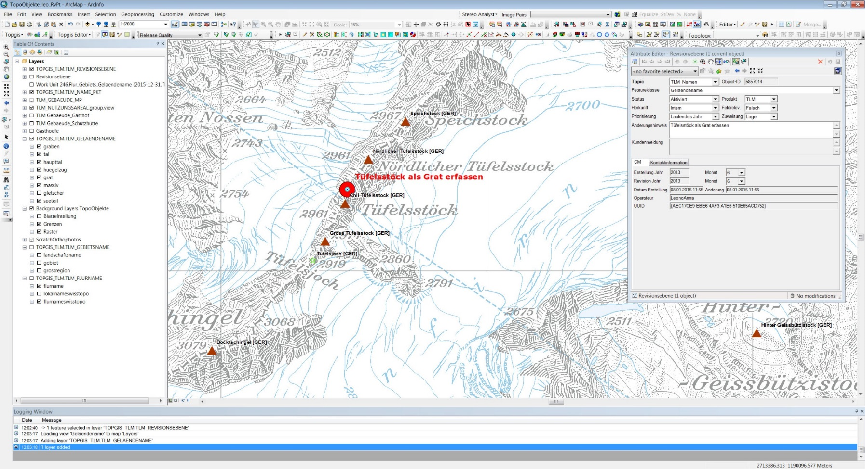
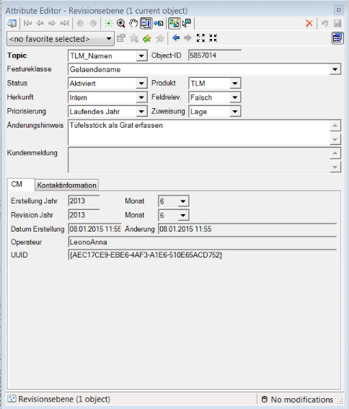
Production Tools
Notes:
The Status change from activated into completed

Slide 16
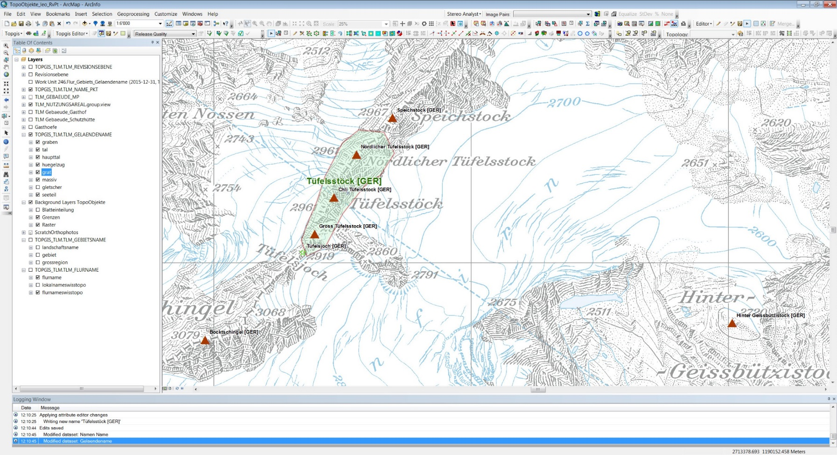
Production Tools

Slide 17
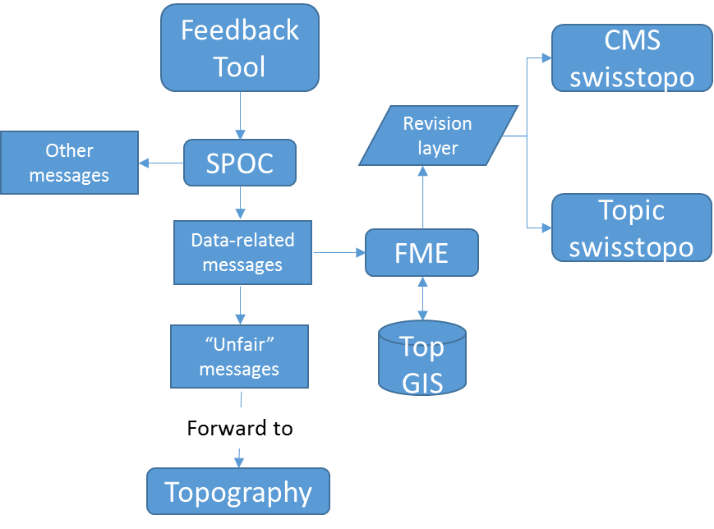
Workflow 2017
SPOC → FME → TOPGIS → cron / FME → geojson

Slide 18
Workflow and experience
Every message is checked and dispatched by a swisstopo specialist
Quality check of messages before integration in productive database
We keep every message (even unfair messages)
Volunteers need information about time and content of message implementation
Give immediate feedback to user community
Keep workflow for user message transparent

Slide 19
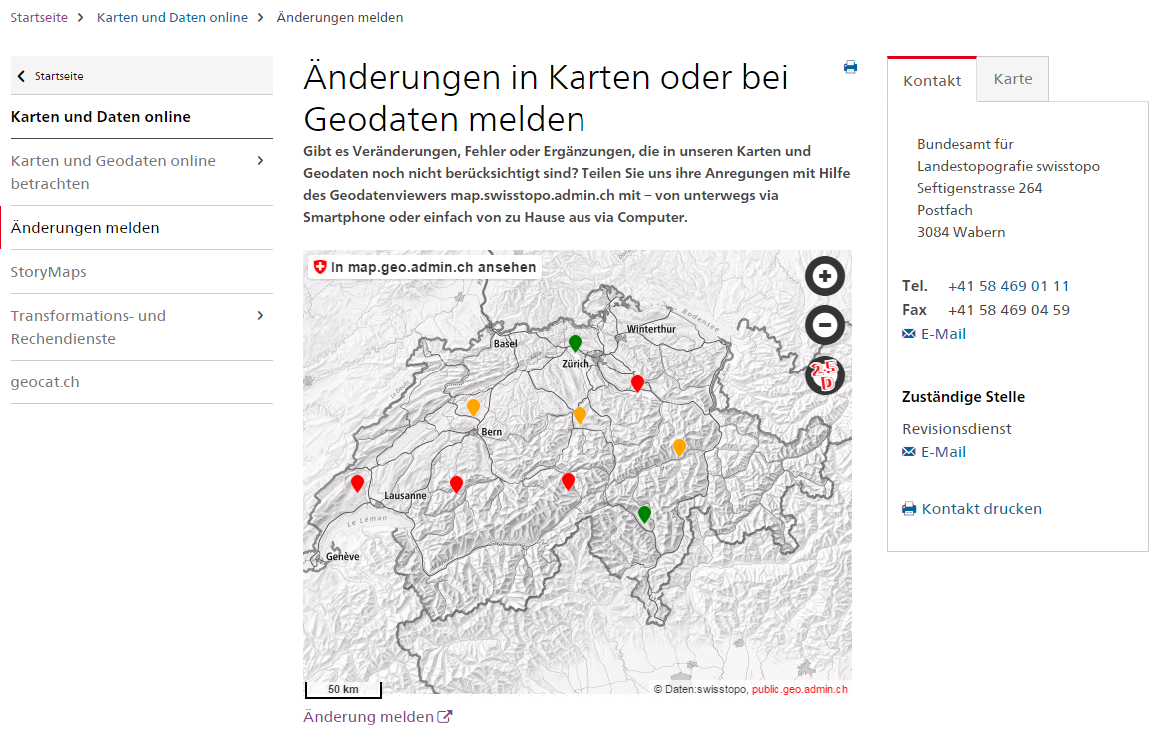
Release May 2017: map.geo.admin.ch
immediate feedback visible on swisstopo website (based on iFrame and KML-layer)

Slide 20
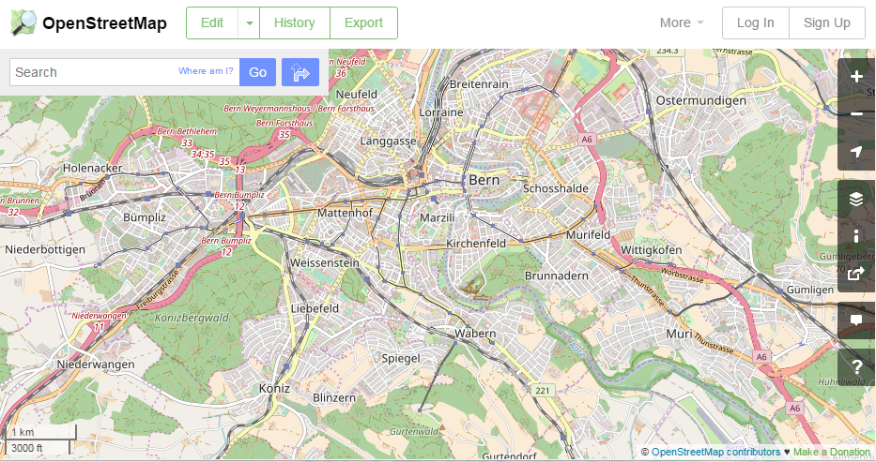
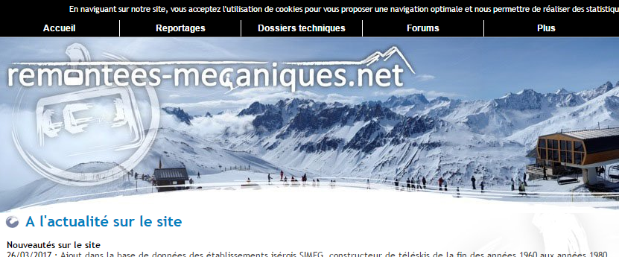
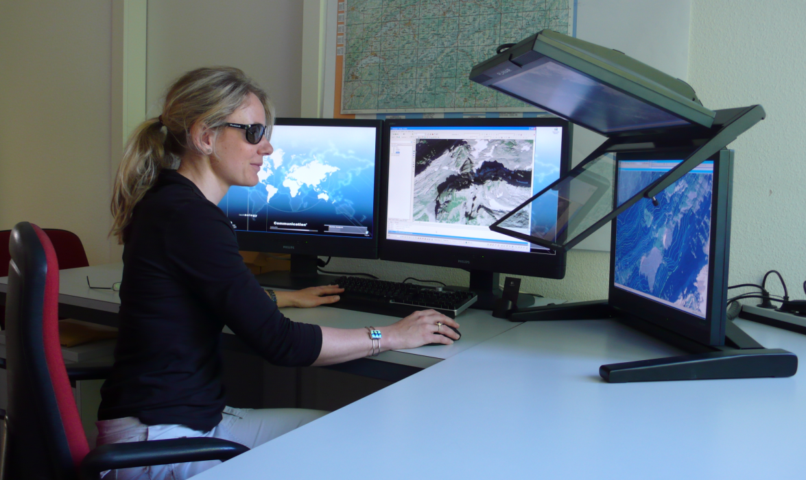
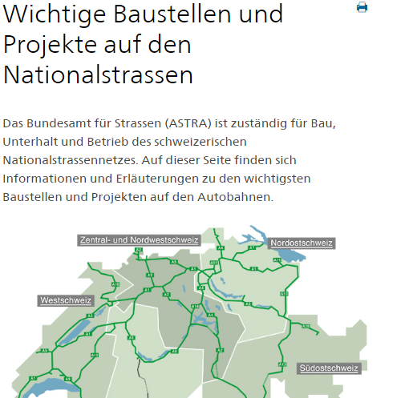

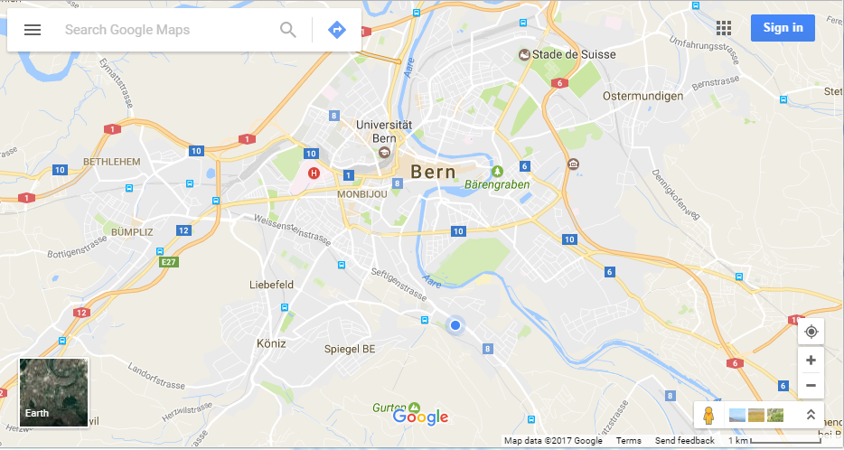
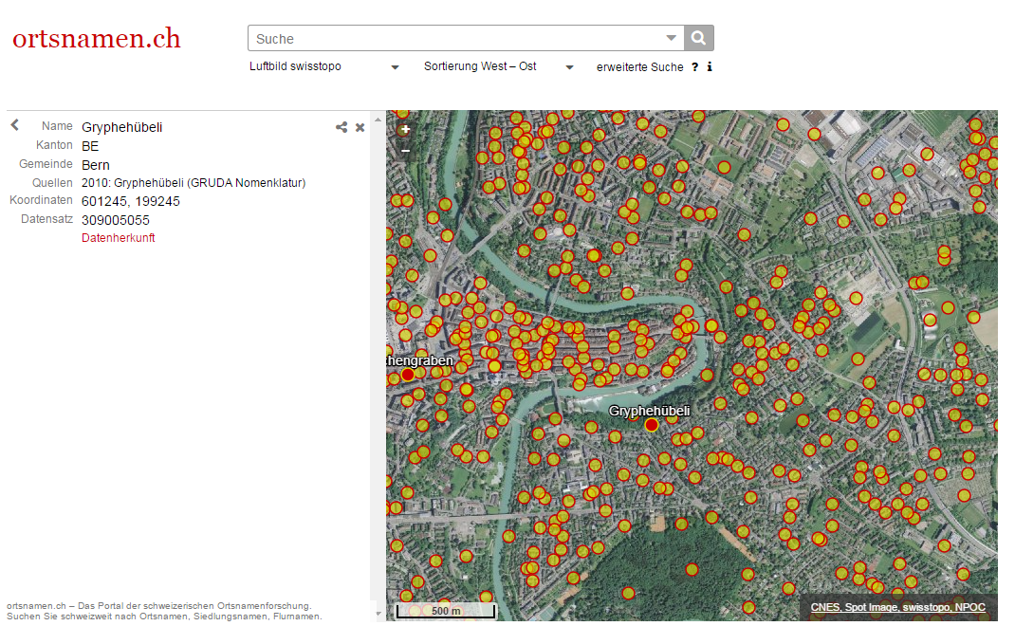
VGI as hints (harvesting data)

Slide 21

VGI as a public relation instrument
www.schatzkarte.ch
Travel through Switzerland
Tasks related to the Geodata from swisstopo to be solved
Different yearly topics
2016 treasure hunt:
Collect all animal related geographical names swissTLM^{3D}, swissNAMES^{3D}

Slide 22
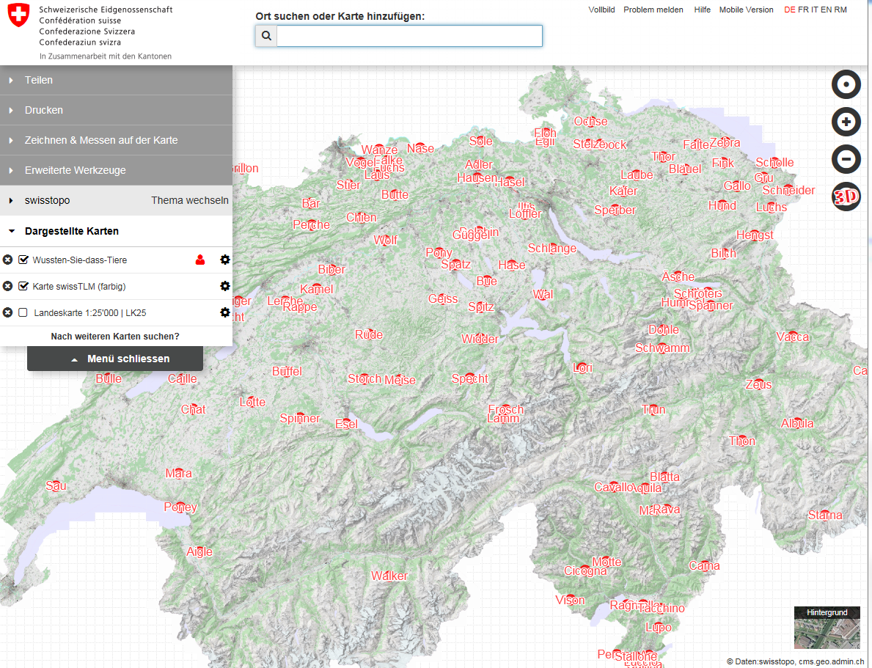

2016 Treasure hunt : animal names

Slide 23

Is this all in crowdsourcing for swisstopo?

Slide 24
The A⁴C⁴ quality requirements by swisstopo: for Geodata (swissTLM^{3D})
Authority (data source, production)
Accuracy (precision)
Availability (data access)
Actuality (date of data specific survey)
Completeness (steered by surveying rules)
Coverage (nationwide homogeneity, not hotspots)
Consistency (data contradictoriness and coherence )
Correctness (comparison model <-> landscape)

Slide 25

Consequences out of A⁴C⁴ quality requirements to VGI data acquisition
Authority
(Most) geodata of swisstopo are legally binding
Authoritative character of geodata → NMCA is in charge

Slide 26
Consequences out of A⁴C⁴ quality requirements to VGI data acquisition
Accuracy
Precision of data (geometry, attributes) given by law and/or data model → adapted acquisition quality tools needed
Quality check needed → reliability of the crowd?

Slide 27
Consequences out of A⁴C⁴ quality requirements to VGI data acquisition
Availability
Ensure public access to NMCA data → you receive better VGI information/data
Not all data needed as VGI reference is available
Data

Slide 28
Consequences out of A⁴C⁴ quality requirements to VGI data acquisition
Actuality
Volunteers are on place and can react immediately to changes → very helpful for NMCA

Slide 29
Consequences out of A⁴C⁴ quality requirements to VGI data acquisition
Completeness
Individual volunteers means individual completeness of VGI
Quality checks for VGI completeness unrealistic → expert VGI needed

Slide 30
Consequences out of A⁴C⁴ quality requirements to VGI data acquisition
Coverage
Where the crowd lives and stays → you get the coverage
NMCA needs a homogeneous coverage

Slide 31
Consequences out of A⁴C⁴ quality requirements to VGI data acquisition
Consistency
Spatial, temporal coherence of the VGI data is hard to achieve
Data contradictoriness is not solely a matter of the data model but from the data understanding too

Slide 32
Consequences out of A⁴C⁴ quality requirements to VGI data acquisition
Correctness
Does the model represent the landscape → depends on model design and on the perception of the data mapper

Slide 33

Is this all in crowdsourcing / VGI for swisstopo?
→ Yes it is! Thank you!
PR data
crowd-owned datasets
Change / Error detection for
NMCA datasets
Authority
Accuracy
Availability
Actuality
Completeness
Coverage
Consistency
Correctness
Expert crowd-sourcing for
NMCA datasets
Initial data for upcoming NMCA datasets

